Slide 1
Open Educational Resources (OER)
Nowadays, everywhere in the world, children and young people need to be trained to face
challenging social, emotional and economical problems they will confront with - as adults -
both in their personal lives and in the context of the wider world.
In order to do so, they must DEVELOP HIGHER LEVEL THINKING SKILLS which, we believe,
WILL FLOURISH IF ENCOURAGED TO BE CREATIVE, INNOVATIVE, INGENIOUS AND ADAPTABLE.
The present Open Educational Resources (OER) have been designed within the Creative School Project, whose objective
is to develop teaching/learning modules for school teachers and students, PROMOTING SELF-DIRECTED LEARNING AND CRITICAL AND VISUAL THINKING SKILLS, using CULTURAL HERITAGE CONTENTS made available by the Institutions and Organizations the Creative School Project Partners belong to.
The BENEFICIARIES of the present Open Educational Resources are:
PRIMARY AND SECONDARY SCHOOL TEACHERS who, through engaging with the Project, will become equipped with the skills necessary to facilitate pedagogical strategies for creativity and critical thinking;
CHILDREN AND YOUNG PEOPLE which will use the OER developed by the Project.
Please, note that OER TOPICS HAVE BEEN SELECTED BY AN INTERNATIONAL GROUP OF TEACHERS AND EDUCATORS from Austria, Croatia, Finland, France, Ireland, Italy and the United Kingdom, through focus groups and surveys.
We hope the present materials enrich your teaching resources and foster creative and critical thinking among students.
https://www.creative-school.eu
The Creative School project has been funded with the support of the European Union and the French National Agency for the Erasmus+ Programme (Grant Agreement 2019-1-FR01-KA201-062212). This publication reflects the views only of the author, and the European Union and the French National Agency for the Erasmus+ Programme cannot be held responsible for any use which may be made of the information contained therein.
Materials can be used according to the: Creative Commons Non Commercial Share Alike license

Slide 2
Subject:
Environment, Natural Sciences
Topic:
Biodiversity; Conservationism; Visual Arts
Age range:
11-14 years

Slide 3
Idea and graphic design project by:
Matilde Biondi and Sara Borella
~ 3 D, academic year 2020-2021 ~
~ High School for Arts F. Arcangeli ~
~ Bologna, Italy ~
With the supervision of STEPs srl - Italy

Slide 4
THE ADVENTURES OF
MAX, SAMIR AND BUZZYETTE

Slide 5
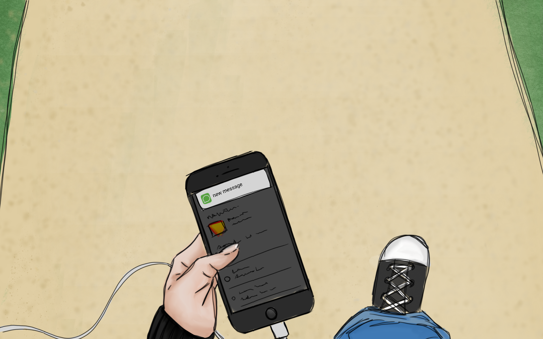
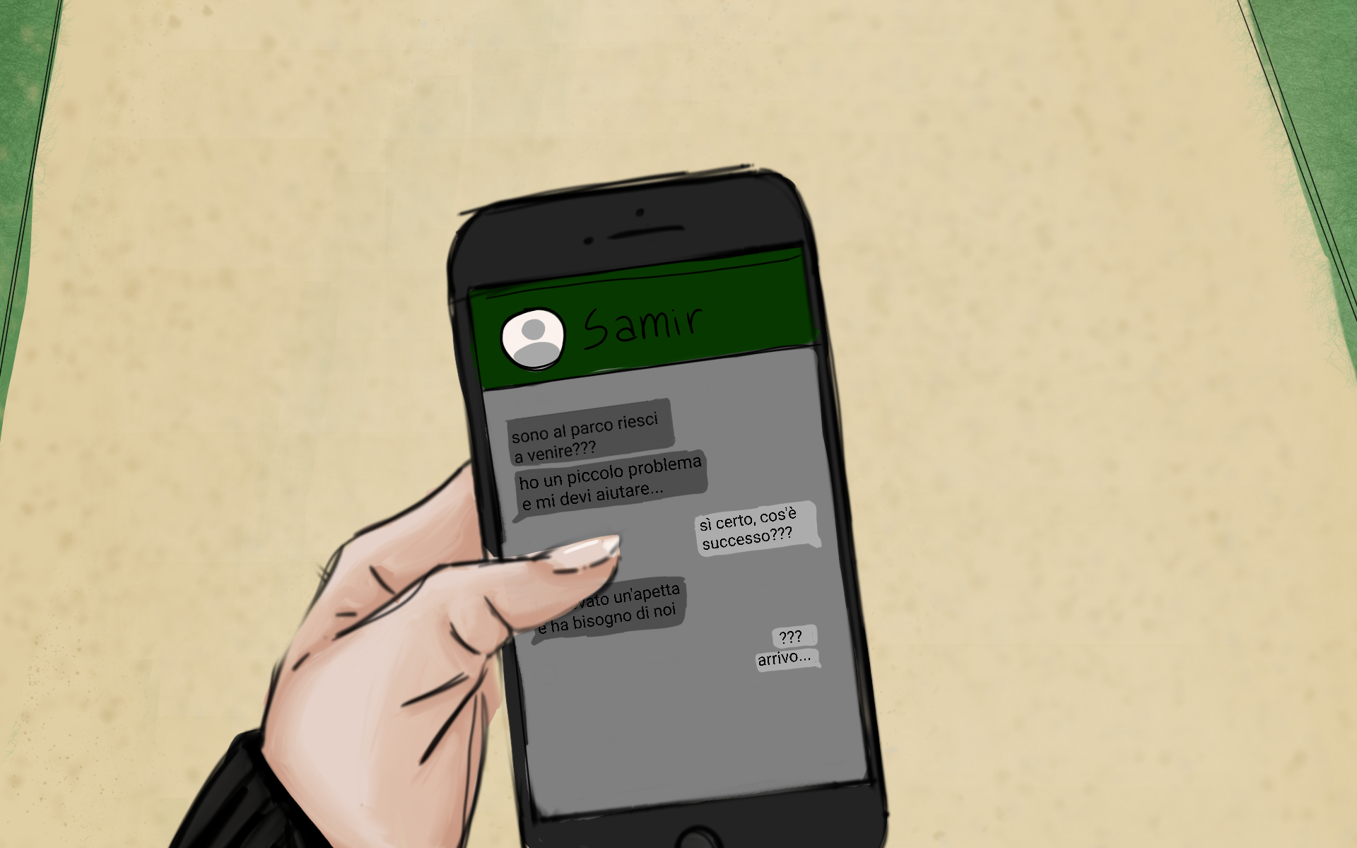
MAX IS ON HIS WAY BACK FROM SCHOOL, WHEN HE GETS A MESSAGE FROM HIS BEST FRIEND SAMIR , ASKING FOR HELP…..
“I’VE FOUND A LITTLE BEE IN DANGER! SHE NEEDS US!! COME!!”
“What??!! A bee..??”

Slide 6
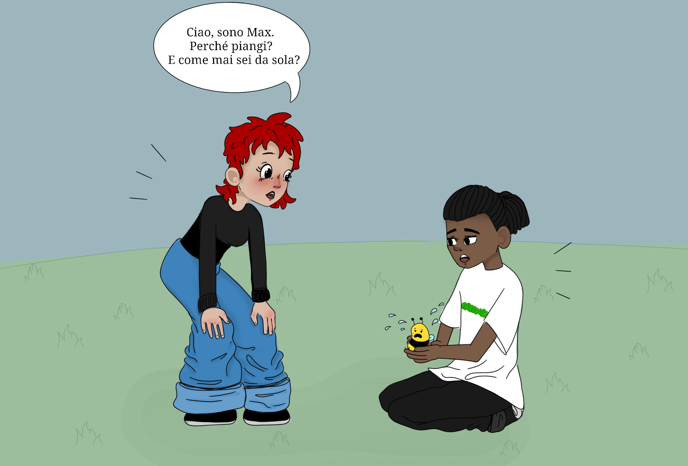
What happens? Why are you crying? Why are you alone?
Hallo little bee, I’m Max. And this is my friend Samir.
What’s your name?
Ohhh, this is a
VERY BAD PIECE OF NEWS !!
How do we do with no bees???
My name is Buzzyette.
All the bees of my hive are leaving the city BECAUSE THE AIR IS TOO POLLUTED HERE IN TOWN.
I am so sad!! I don’t want to leave, so I’m hiding from the other bees.

Slide 7
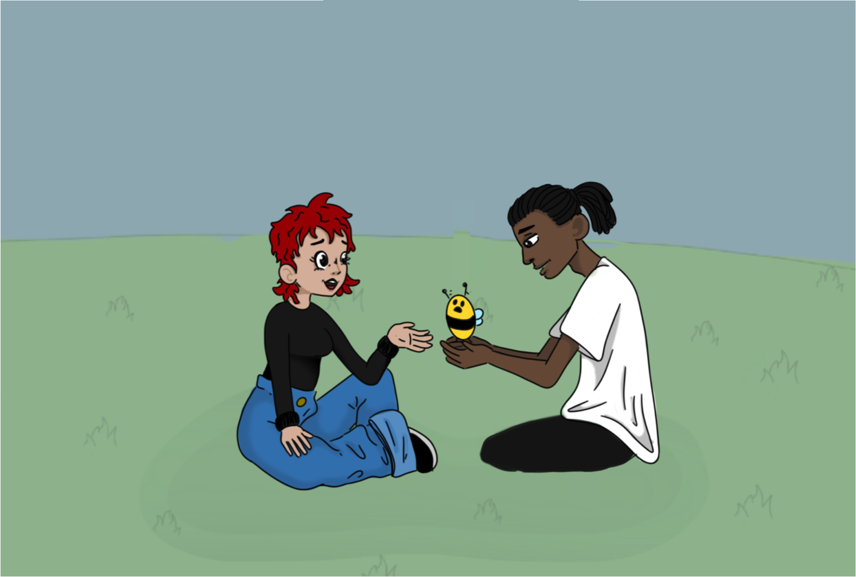
BIODIVERSITY depends on you, as the greatest part of our FOOD !
Samir is right!
HOW WILL WE SURVIVE WITH NO BEES ?

Slide 8
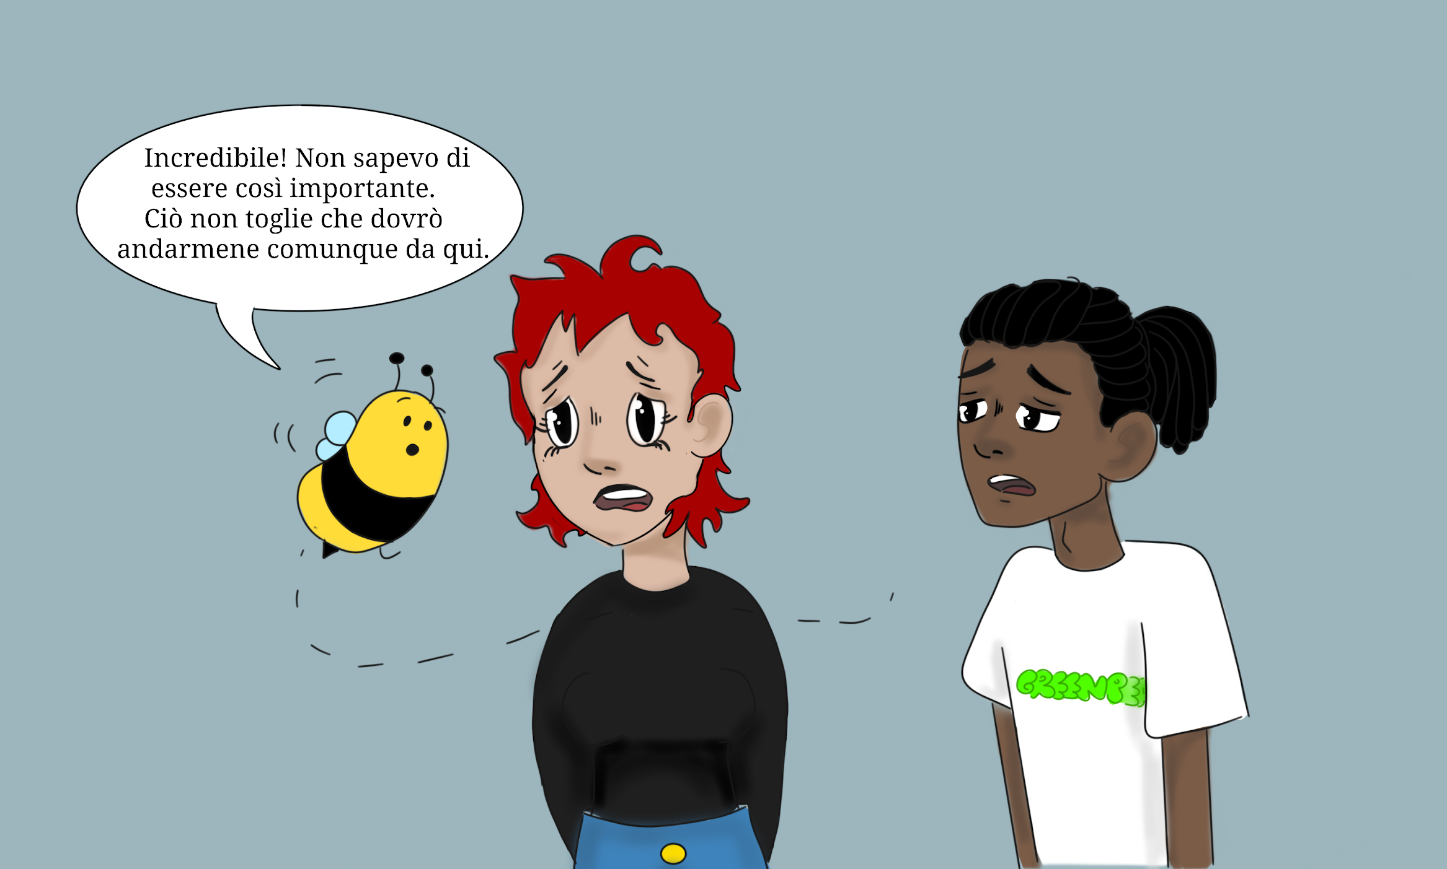
I know, I know that us BEES PLAY A VERY IMPORTANT ROLE ....
… sadly, I must leave the city, because the air is so polluted that I will die!

Slide 9
Such disappearances have occurred sporadically throughout the history of apiculture.
You’re right, Buzzyette… Since a few years, HONEY BEES HAVE BEEN DYING IN GREAT NUMBER. Scientists call this abnormal phenomenon “COLONY COLLAPSE DISORDER” (CCD).
This is a STILL UNKNOWN PHENOMENON for which colonies of bees
(Apis mellifera) abruptly perish.
The phenomenon the was named CCD in 2006 in conjunction with a drastic rise in reports of disappearances of honey bee colonies in North America.
Beekeepers in most European countries have observed a similar phenomena since 1998.
In 2007 the phenomenon became more global when it affected some Asian and African countries as well.

Slide 10
CCD CAUSES ARE STILL UNCERTAIN. Several possible causes have been proposed, such as: …..
...the stress suffered by bees due to ENVIRONMENTAL AND CLIMATE CHANGES …
… MALNUTRITION OF BEES: the decrease in the amount and quality of pollen available in nature means that bees have less protein at their disposal and consequently their immune system is weakened. …
.
… infections with various PATHOGENS, e.g. the “Israelian Acute Paralysis Virus” (IAPV) …
… PESTICIDES …
… ACARIOSIS …
… RADIATION FROM MOBILE PHONES and other man-made devices …

Slide 11
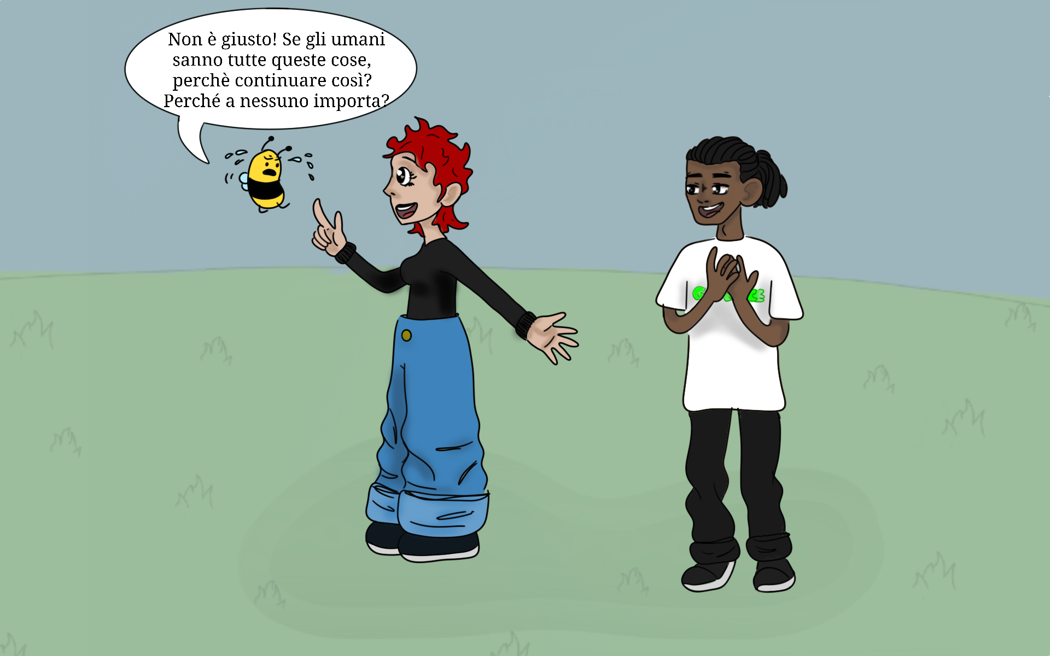
Don’t feel lonely, Buzzyette!
There are thousands of
PEOPLE FIGHTING FOR BEES,
aren’t they, Samir?
Wow, you humans are a real threat for the bees!
WHY DO YOU KEEP ON POLLUTING THE EARTH?
WHY DON’T YOU TAKE ACTION?
Sure, Max! For example, people from GREENPEACE like me, have done a lot to reduce the use of pesticides in agricolture.
WHY NOBODY CARES ABOUT BEES ?

Slide 12
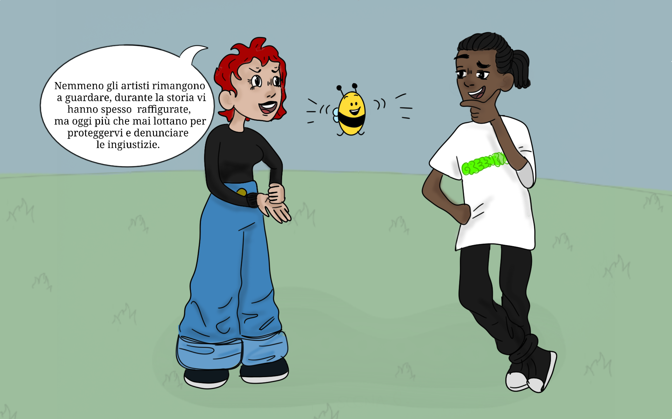
Also ARTISTS
play a great role: they FIGHT to protect bees and STAND UP against injustices with their ARTWORKS.
Let’s go together to look at some artworks, then!!
WOW!
I’m eager to see what artists do for us !

Slide 13
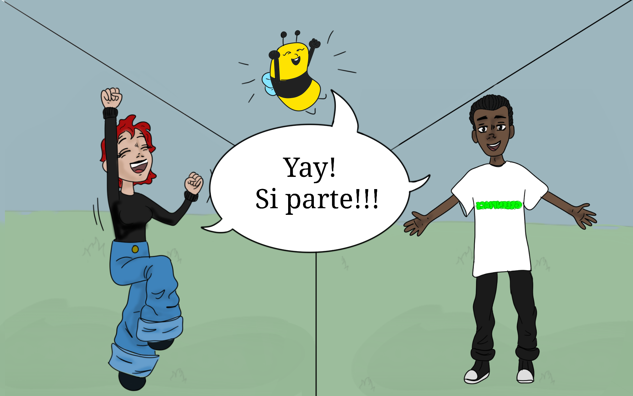
YAY!
Let’s go !!!

Slide 14
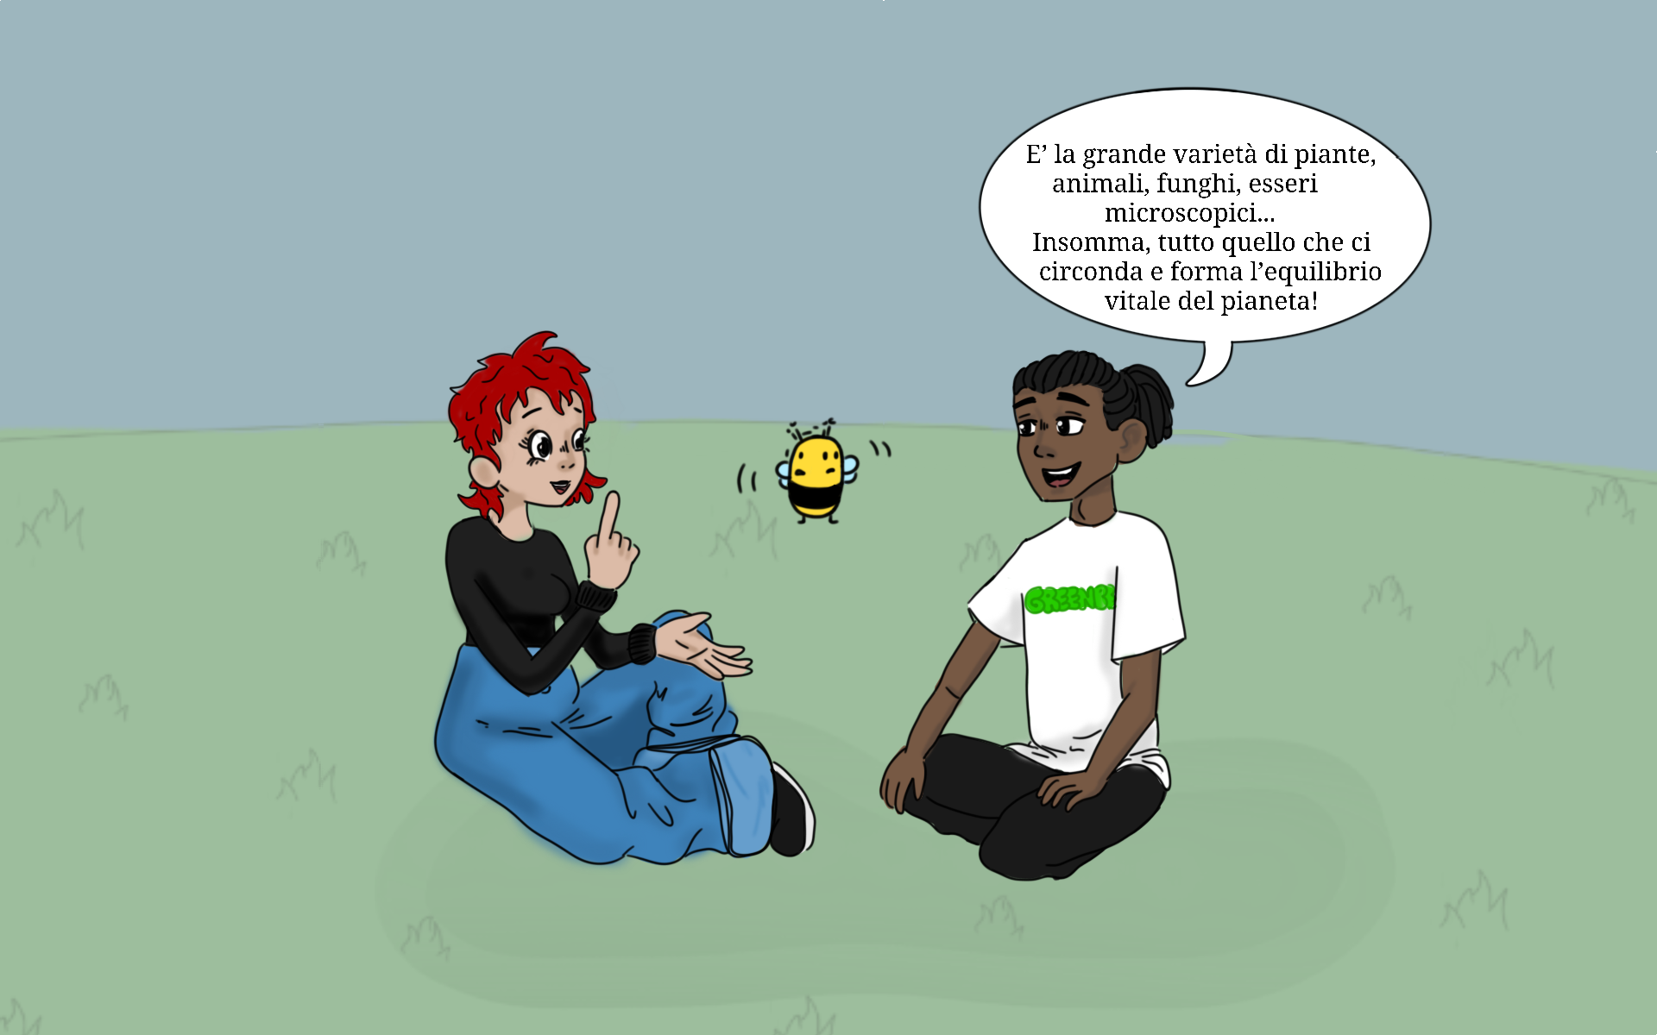
Our tour begins with an artist named ……

Slide 15
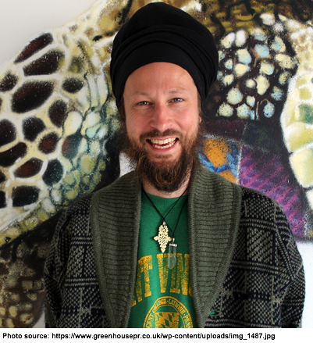
LOUIS MASAI
Louis is a British artist. His parents had a restaurant.
Besides cooking, Louis' father's other passion was painting.
In his father's spare moments, Louis would go with him to his studio to do his art homeworks.
Since childhood, Louis has always been interested in animals and nature.
After high school, Louis studied art at university.

Slide 16
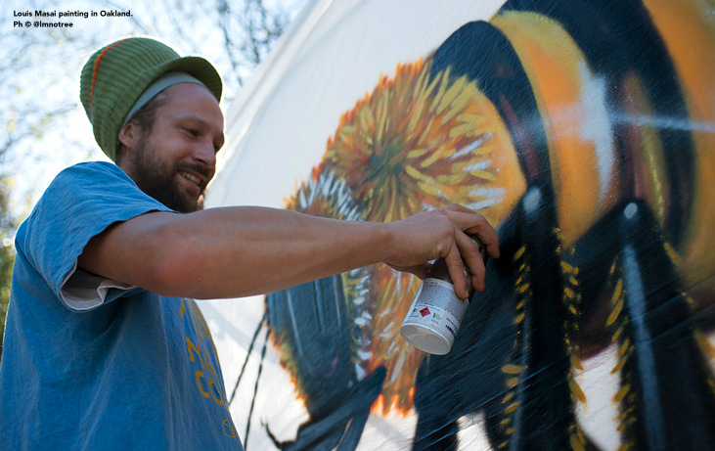
LOUIS' COMMITMENT
For many years, Louis has been committed to defending BIODIVERSITY and ENDANGERED SPECIES through his art.
Through his work, Louis denounces the SIXTH MASS EXTINCTION, talks about CLIMATE CHANGE and raises awareness about EQUAL RIGHTS BETWEEN SPECIES.
Louis is a special kind of artist: his works are almost all painted on WALLS.
Louis also makes sculptures, paintings on paper, recycled wood and other media.

Slide 17
Of course!!! Louis has created a whole project about bees, called “SAVE THE BEES”
Let's see some paintings together!
You said Louis cares a lot about us bees?

Slide 18
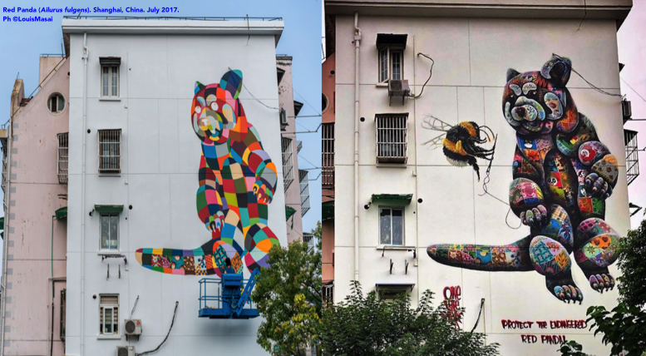
The RED PANDA is endangered and Louis painted a giant one on the wall of a building in Shanghai
Here's Louis at work!

Slide 19
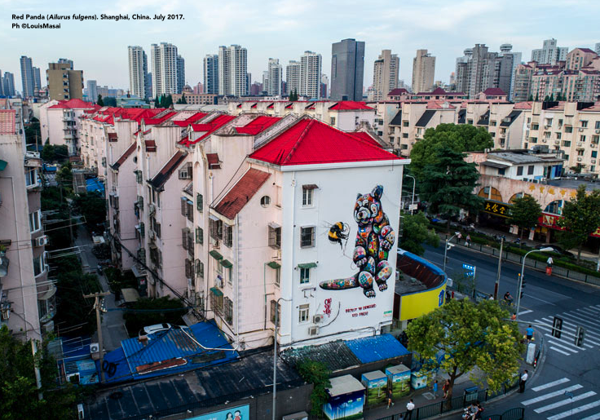
What effect does Louis whish to achieve by painting on walls?

Slide 20
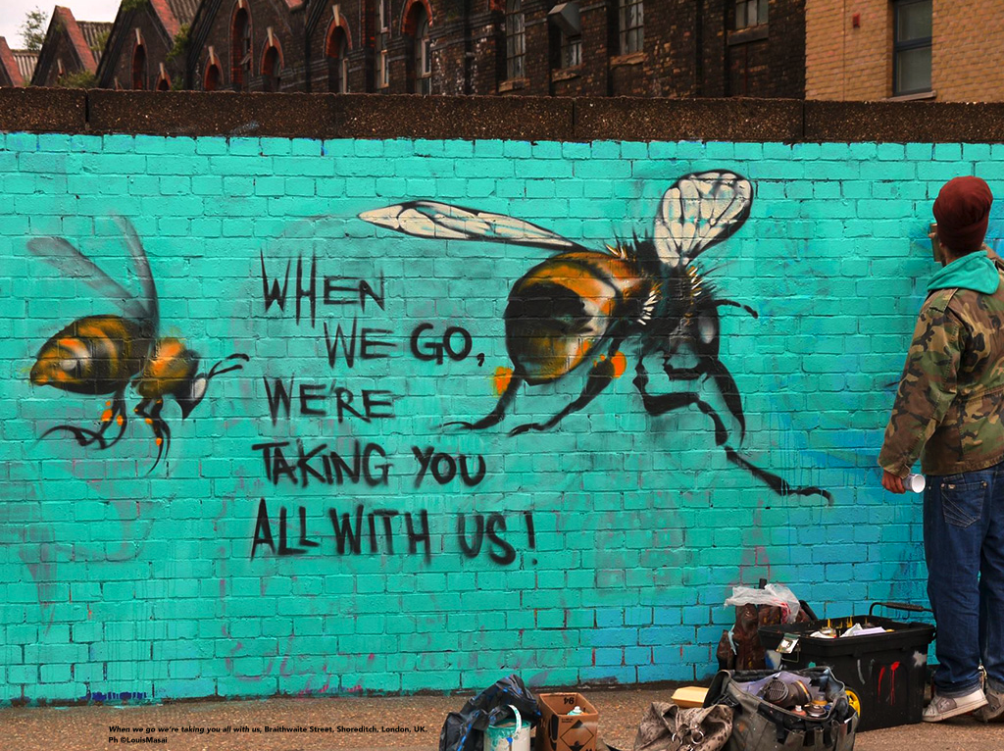
NOTE FOR TRANSLATORS: the words “WHEN WE GO, WE’RE TAKING YOU ALL WITH US” must be translated into your national language. Please delete these instructions afterwards.
Louis on this wall has written :
“WHEN WE GO,
WE’RE TAKING YOU ALL WITH US”
What does it mean, Buzzyette ?

Slide 21
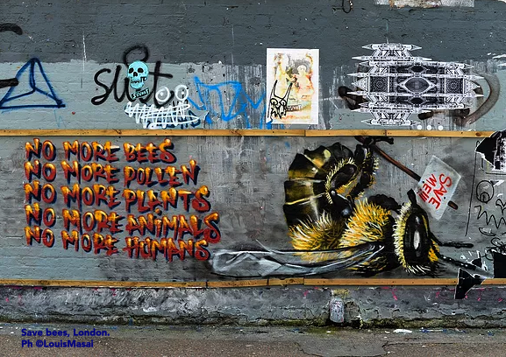
Here Louis wrote:
NO MORE BEES,
NO MORE POLLEN,
NO MORE PLANTS,
NO MORE ANIMALS,
NO MORE HUMANS.
The bee is holding a sign that says: SAVE ME.

Slide 22
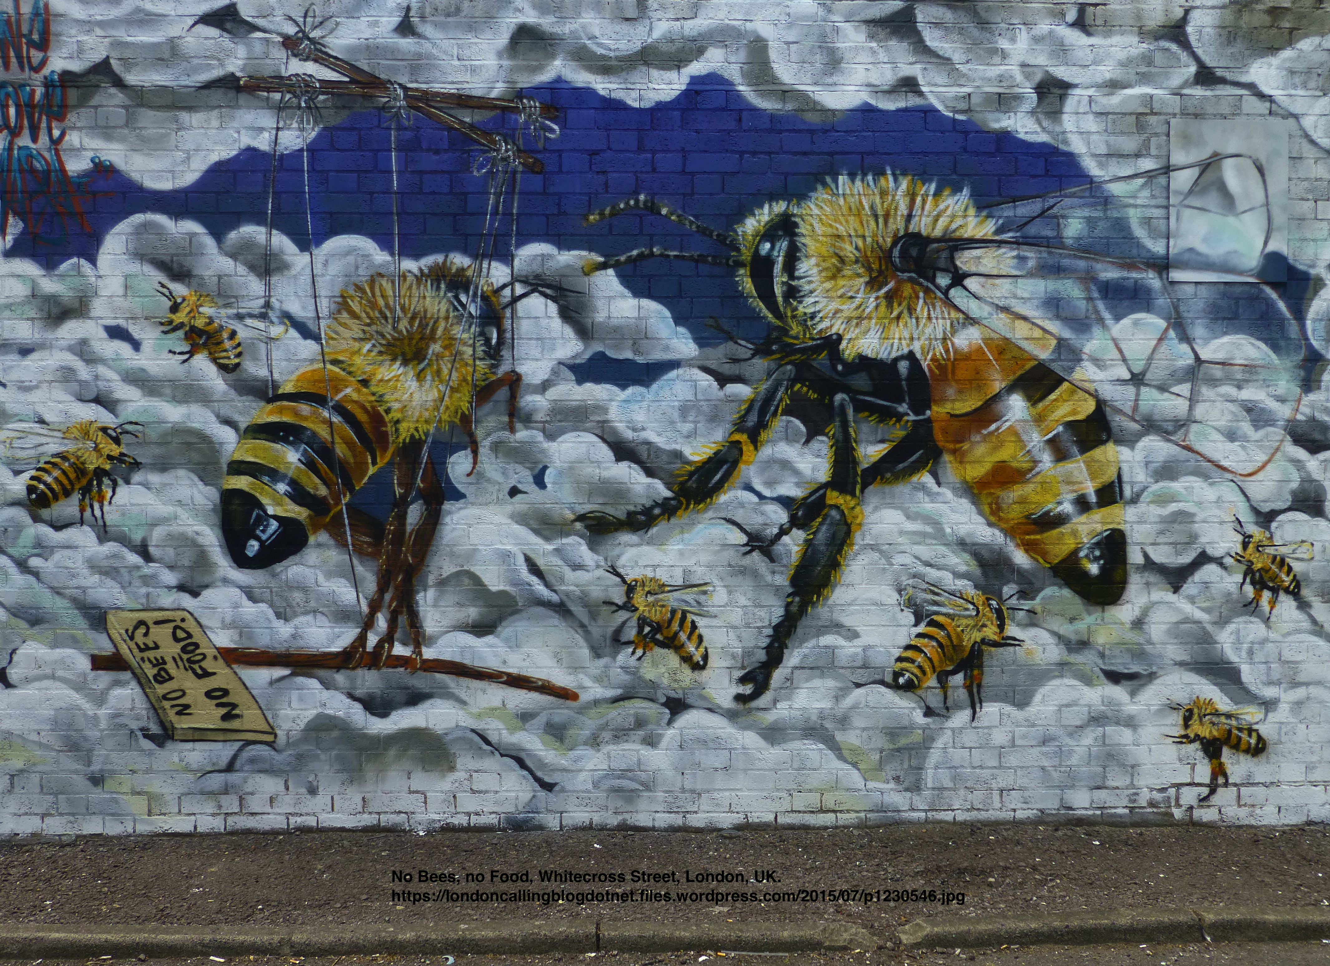
This sign says:
“ NO BEES,
NO FOOD ” !
Hey, but here Louis painted us like we were PUPPETTS. Why?

Slide 23
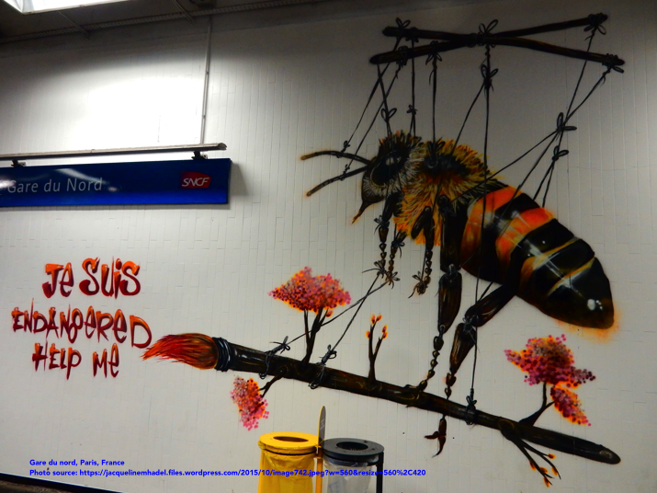
Here as well !!

Slide 24
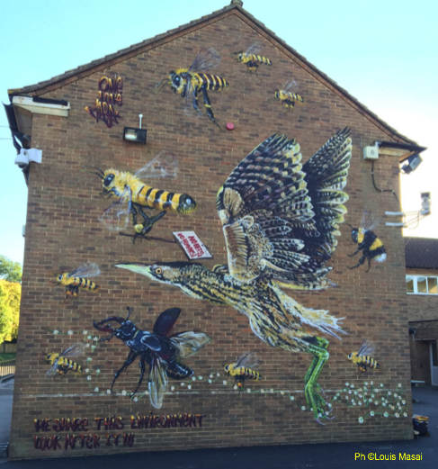
Hey, Max, this bee has a sign that says:
NO BEES,
NO HUMANS.
Here, Louis wrote:
WE SHARE THE SAME ENVIRONMENT. LOOK AFTER IT.
To whom or what is he referring ?

Slide 25
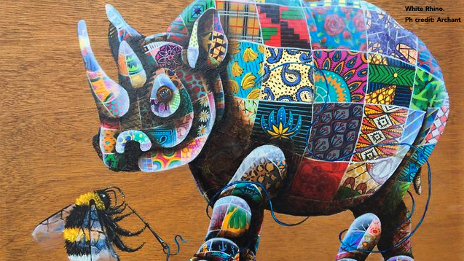
In the SAVE THE BEES project,
bees are either represented alone
or together with other animals.
Why ?

Slide 26
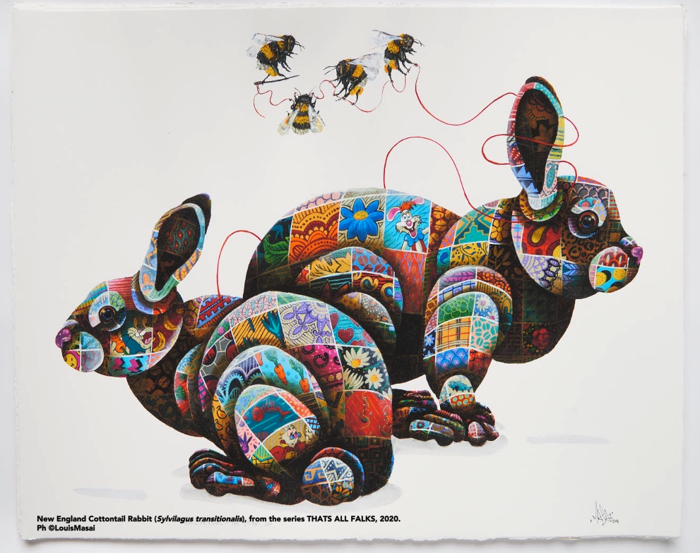
The animals are painted as if they were made OF MANY PIECES OF COLOURED FABRIC with various designs.
Try to explain why.

Slide 27
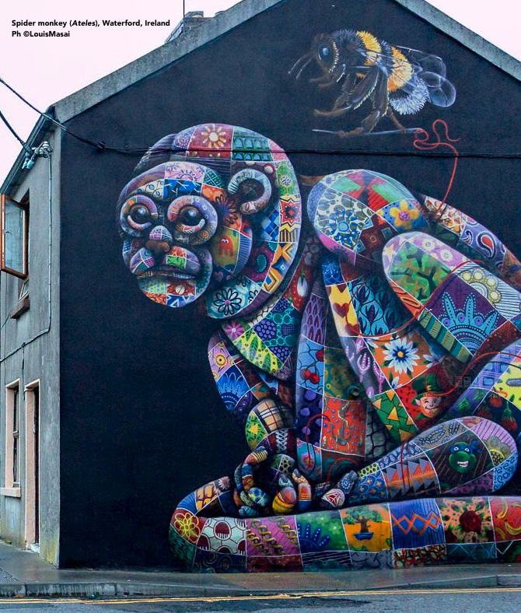
Another thing you may have noticed is that the bees are holding SEWING NEEDLES AND THREADS.
These are important elements in understanding Louis' message…

Slide 28
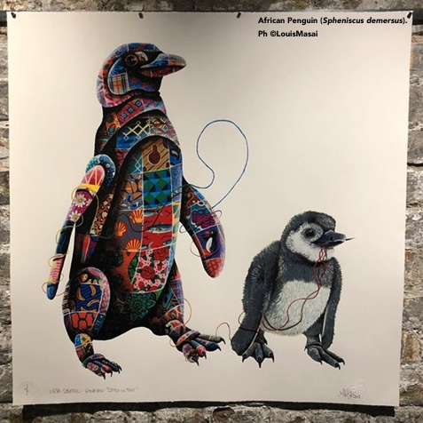
In some cases, Louis paints an animal with its REAL CHARACTERISTICS and places a companion of the same species next to it, but MADE OF CLOTH OR PLASTIC.
Here again, Louis is trying to tell us something specific ....

Slide 29
Take a good look at the murals below.
What are they about?
Yes, it's true, Louis talks to us about many topics.
THANK YOU LOUIS MASAI!!!
How nice that you remember us bees !!!!
….. ..... Did you say that this artist talks about MANY OTHER TOPICS concerning the ENVIRONMENT?
Such as?

Slide 30
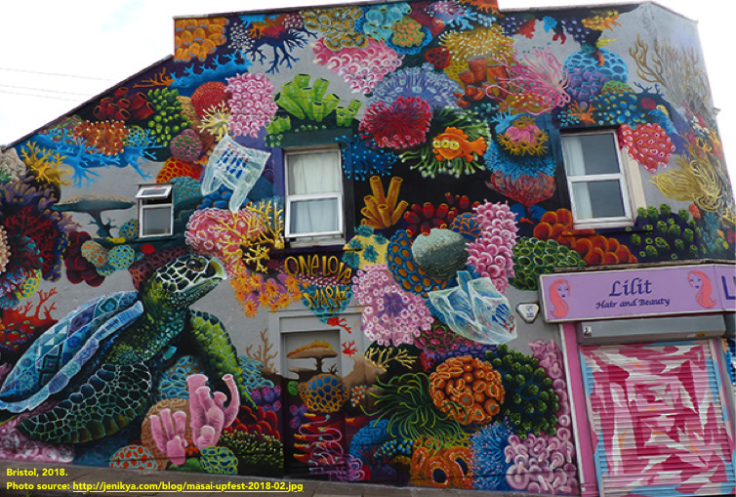
The survival of TURTLES depends on the health of the SEABED and of the other LIVING CREATURES THAT LIVE THERE.
The artist wanted to pay homage to the cartoon series THE SIMPSONS by including a fish with three eyes in the mural. Where is it?

Slide 31
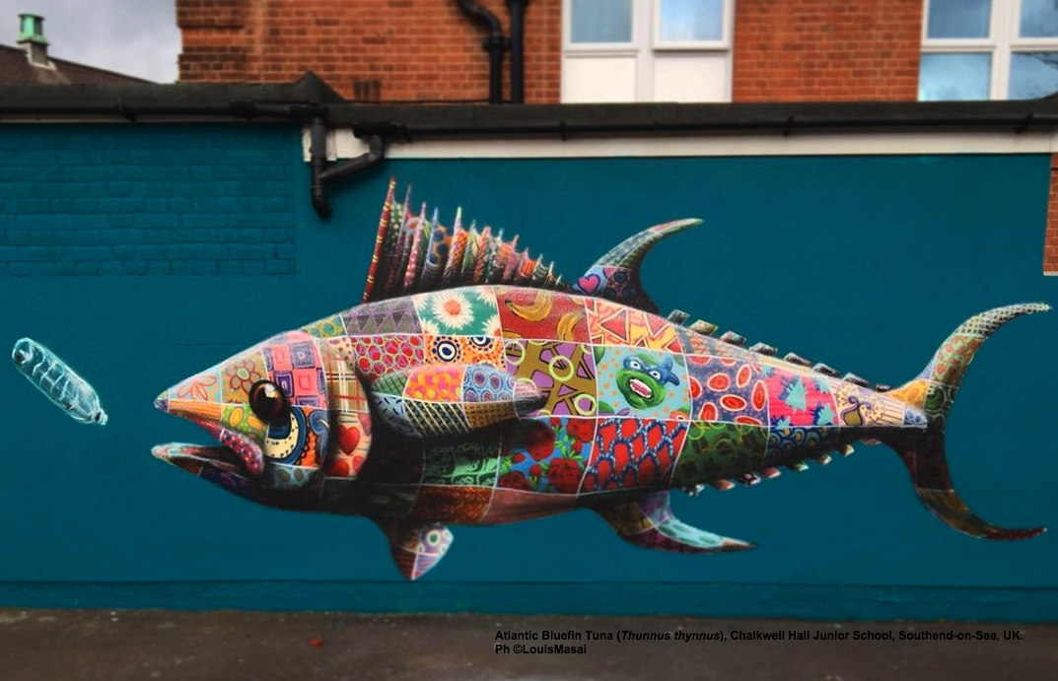

Slide 32
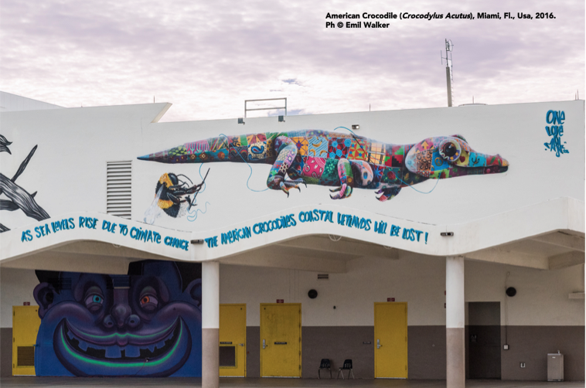
Hey, it says right here:
”As SEA LEVELS RISE due to CLIMATE CHANGE, the AMERICAN CROCODILES coastal wetlands will be lost”.

Slide 33
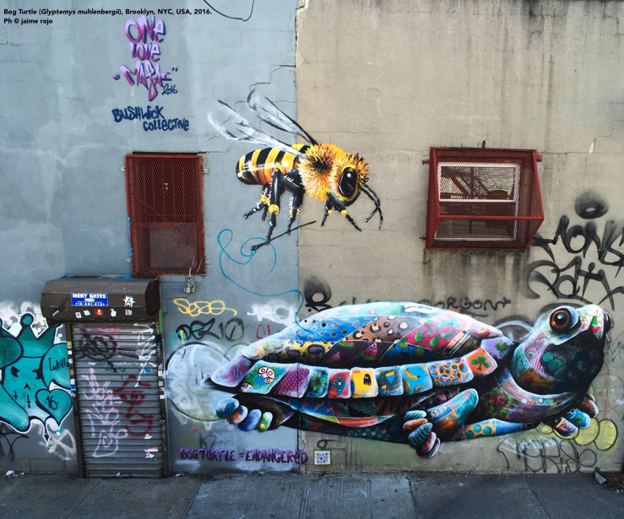

Slide 34
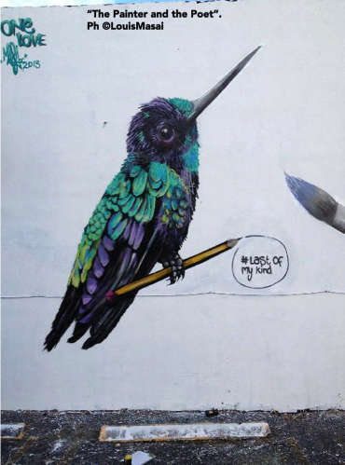
..... Hey Samir, what's the name of this little blue bird?
He is the
SANTA MARTA SABREWING
(Campylopterus phainopeplus). He is endangered: he has 20% chance of extinction within 20 years. It is estimated that there are only 1500-1700 individuals left.
Hummingbirds are VERY IMPORTANT TO THE PLANET, just like you bees!
Do you know why?
I see that between his paws, Louis has drawn a pencil. The pencil has written:
LAST OF MY KIND.
What does that mean, Max?

Slide 35
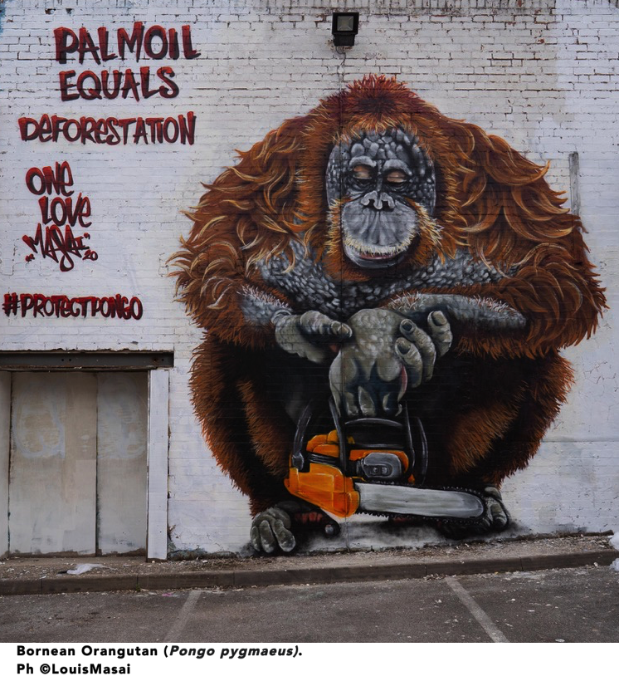
The inscription reads:
"PALM OIL EQUALS DEFORESTATION".
What does it refer to?
Why is the orangutan holding a CHAINSAW?

Slide 36
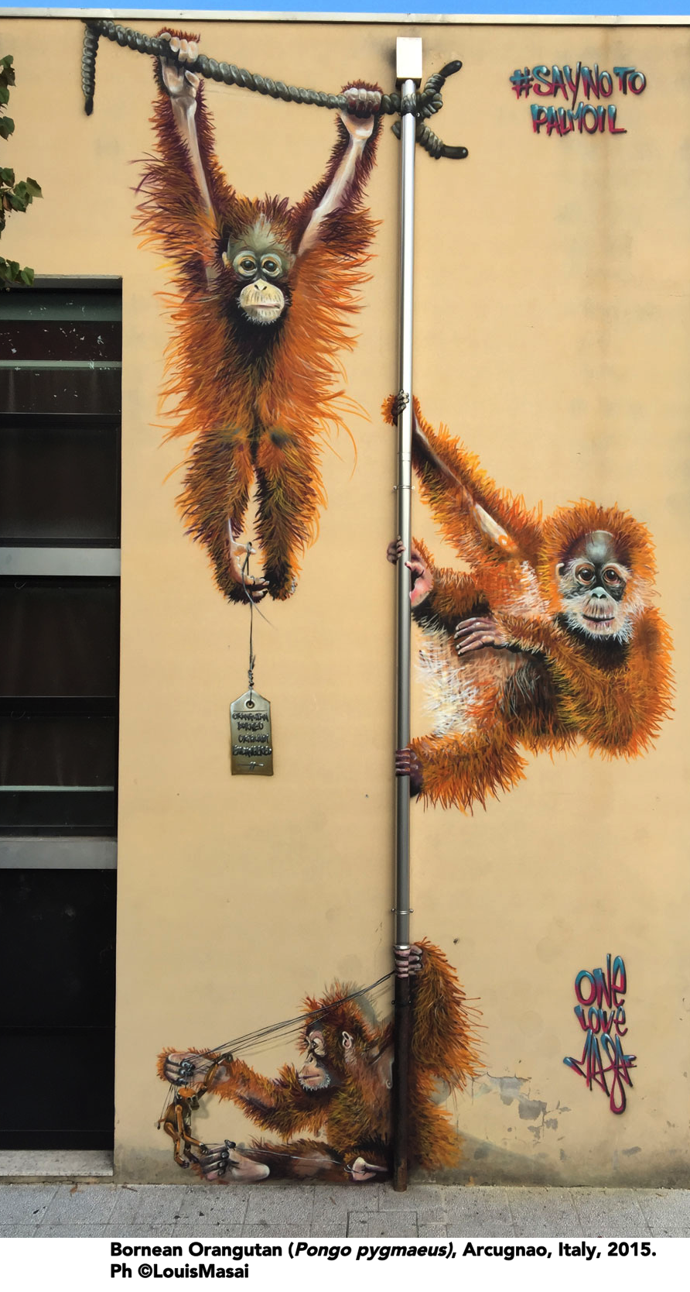
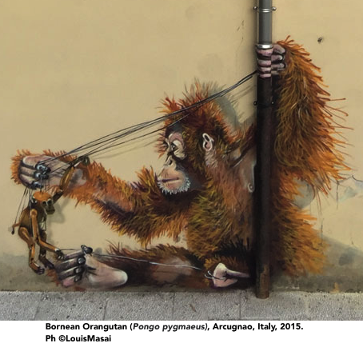
... Here it says:
"SAY NO TO PALM OIL."
... What is the baby Orangutan playing with?

Slide 37
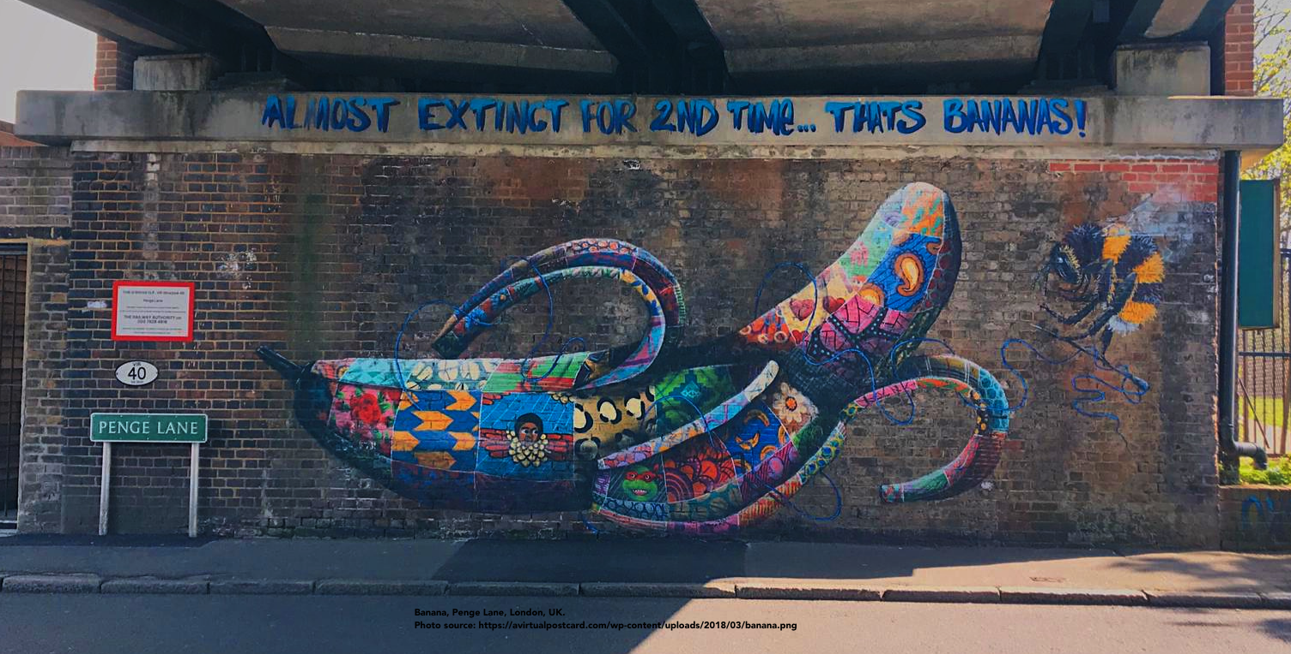
Hey, Samir, it says here:
“ALMOST EXTINCT FOR THE SECOND TIME... THAT’S BANANAS”.
What does it mean? Bananas are already extinct once?

Slide 38
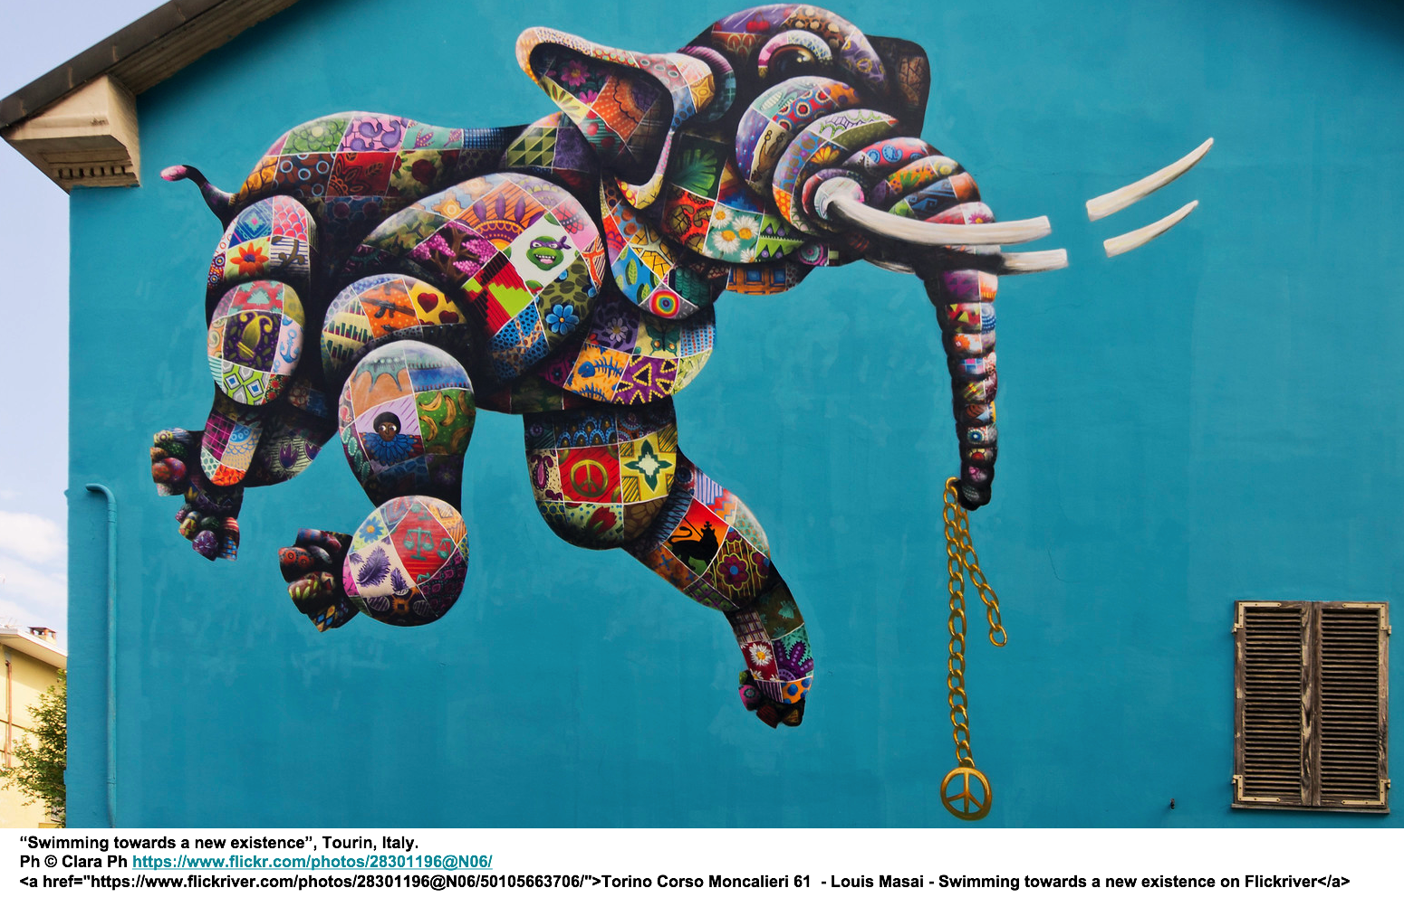
… wow, an elephant!
... Hey, Buzzyette, this mural was painted on a building in TURIN, Italy!!!
This painting’s title is:
“SWIMMING TOWARDS A NEW EXISTENCE”
What is the elephant doing?
And what does it hold in its trunk?

Slide 39
Fighting inequalities
Financing wars
Extinction of elephants
With this painting Louis speaks to us about many topics.
Here’s a list of some of them.
Arms trafficking
Ivory trafficking
Peace between peoples
Can you say how all these topics are RELATED to each other?

Slide 40
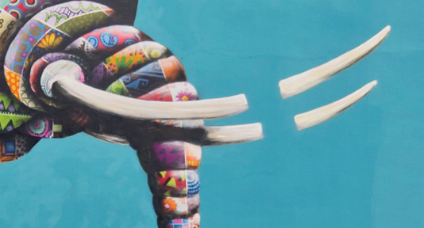
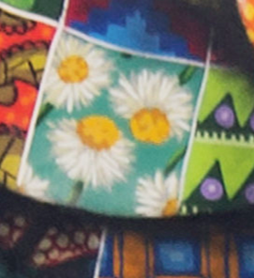
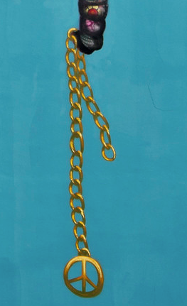
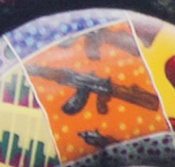
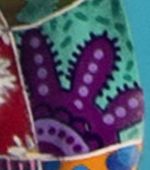
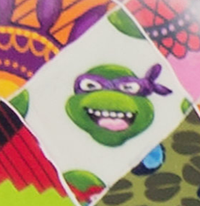
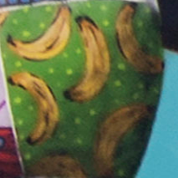
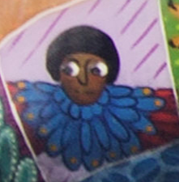
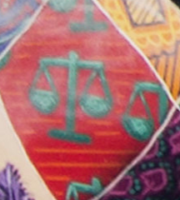
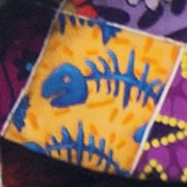
Louis in his painting gives us many clues....
...try to understand how...

Slide 41
The Turin elephant also tells us about other things….
Sea levels rise
Climate change
Justice
Migrations
Solid institutions
Look carefully at the picture of the elephant and try to say which DETAILS refer to the topics on the right side....
Integration
Sustainable development

Slide 42
If you liked the works of Louis Masai,
you can see many more by
by typing into Google:
Louis+Masai+images

Slide 43
In addition, on his website you can find many VIDEOS explaining his work, made together with scientists involved in biology and environmental protection:
https://louismasai.com

Slide 44
Very good, Buzzyette!
Our exploration into the world of art continues with another artist who I am sure you will love! She is.....

Slide 45
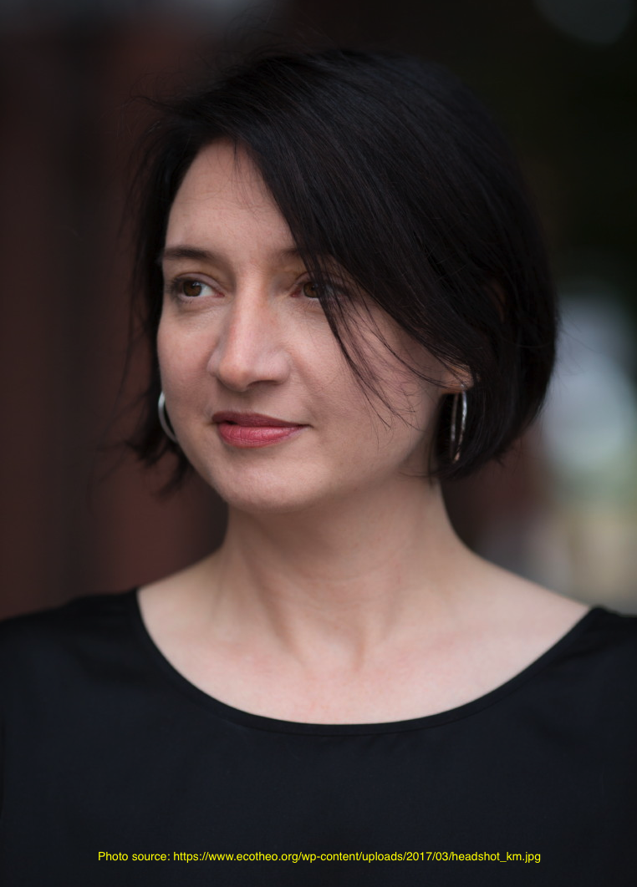
KATE MACDOWELL
Kate MacDowell is an American artist. Her preferred medium is PORCELAIN.
This artist likes porcelain for its BRIGHTNESS and FINENESS.
The fragility of porcelain reminds her of the FRAGILITY OF NATURE.
Kate often leaves her works hollow, i.e. empty on the inside, so that you can PUT A LIGHT INSIDE and illuminate them from within.
The effect is of GREAT VISUAL IMPACT.

Slide 46
WHAT DOES KATE TELL US?
Kate MacDowell's works aim to represent the close link between man and the natural world.
This relationship is often very difficult. Man and nature are often
IN CONFLICT.
With her work Kate talks to us about topics such as CLIMATE CHANGE,
POLLUTION and GENETICALLY MODIFIED CROPS.

Slide 47
Kate MacDowell also investigates
the fundamental role of BEES
in ensuring the maintenance of BIODIVERSITY
and HUMAN BEINGS’ SURVIVAL....
Let's discover some of her sculptures ...

Slide 48
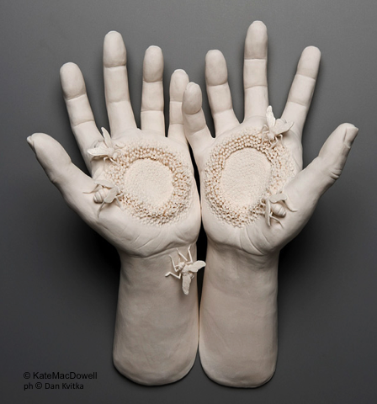
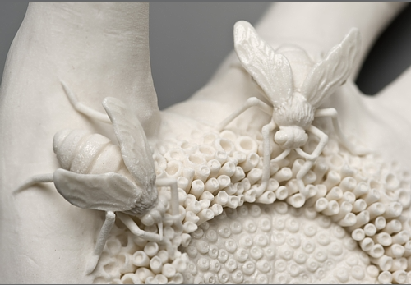
Cross-Pollination, 2009
Samir, why does the artist represent
HUMAN HANDS, BEES and POLLEN?

Slide 49
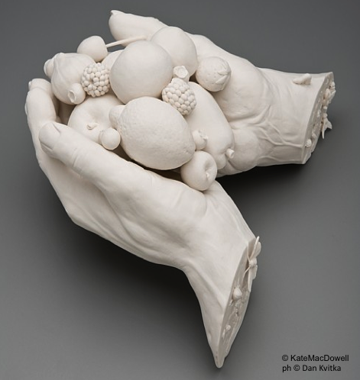
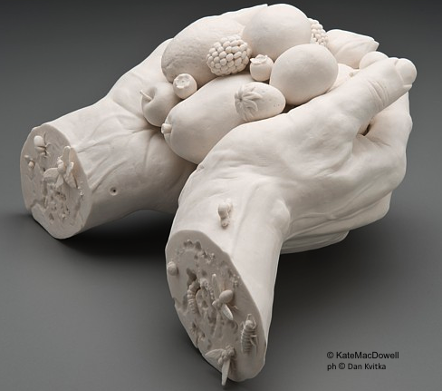
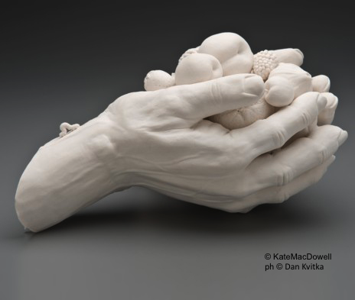
Goblin Market, 2008
worm
insects
Buzzyette, what does this work represent?
Take a good look ...

Slide 50
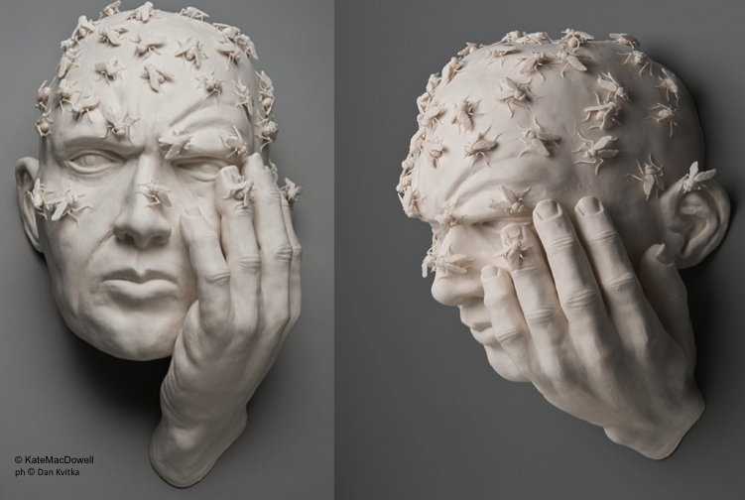
Buzz, 2008
There you are again, my friend Buzzyette !!!!!

Slide 51
Kate MacDowell often creates sculptures that represent only a part of the human body and not the whole body.
For example, only the face, the heart, the hands, the feet, with tragic or humorous effect.
Her work reveals an intimate familiarity with anatomy. But she has not received formal medical or biological training. She has taken a class in figure sculpting that focused on human anatomy, and she has studied scientific drawings, especially of skeletal systems. Sometimes she watches online youtube videos of animals to see how they move and get a sense of their posture at rest.
Look at the pictures and
then try to explain why!

Slide 52
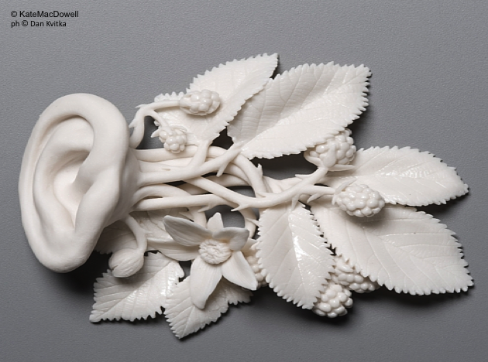
Taking root, 2009

Slide 53
formica
ant
Migrant, 2009

Slide 54
Venus, 2006
The work is entitled 'Venus'.
What does it represent?
What does this have to do with biodiversity?
What do these shapes look like to you?

Slide 55
Canary, 2008
What part of the body does this look like to you?
Do you see something in it?
What?

Slide 56
Kate sometimes represents animals with human qualities: for example, her animals wear safety equipment.
Why?

Slide 57
First and last breath, 2010
What animals did Kate represent in this sculpture?
Buzzyette, why do you think the artist called this work "FIRST AND LAST BREATH"?

Slide 58
Canary 2, 2008
What is this canary doing?

Slide 59
Safety, 2008

Slide 60
Kate MacDowell's works communicate a sense of friction and discomfort between man and the natural environment,
with the disturbing implication that we too are vulnerable to being victimized by our destructive practices.
What do you think of the following images?
What do you see?
Are there CONTRASTS?
What do they have to do with BIODIVERSITY?

Slide 61
Assisted living, 2012

Slide 62
Nursemaid 1, 2 e 3, 2015

Slide 63
Feral, 2019
Do you notice anything STRANGE?
What animals do you see?
What is happening?

Slide 64
So, Buzzyette...
What do you think of Kate MacDowell's work?
.... Aw!!!....
They are really POWERFUL !!!!
How did you feel?

Slide 65
beautiful
delicate
paradox
I suggest some FEELINGS, ACTIONS and IDEAS that her work arouse in me ...
disgust
impermanence
pale
grotesque
bleeding
disturbing
terrible
heartbreaking
shock
ethereal
vulnerable
intricate
realism
Fragile
fractured
inexplicable
elegant
adorable
mystery
bloody
terrifying
interdependent

Slide 66
If you also liked the works of
Kate MacDowell,
you can find many others
on her website:
Watch with the teacher and discuss them together.
Max, where can I see other works by this artist?
http://www.katemacdowell.com/portfolio.html

Slide 67
You can also see many other images
typing on Google:
Kate+MacDowell+immagini

Slide 68
Here we are again!
So Friend, what do you think?
Did you like the works you saw?
It was a great experience!
I am very happy to have been the protagonist of this tour !!!

Slide 69
Yes! In fact, if we know the problem we can WORK TOGETHER TO SOLVE IT !
ART is important to SPREAD knowledge of a problem and RAISE people's AWARENESS.
I was not at all pleased to see how many species are endangered!
But it is BETTER TO KNOW the situation than TO PRETEND NOTHING!

Slide 70
I was pleased to meet you, thanks for your help !!!!
We will continue to COMMITT to make things change!
I'll be back when things are different!

Slide 71
See you soon, Buzzyette!
Bye-bye !!
Safe travels !

Slide 72
The end!

