Slide 1
Open Educational Resources (OER)
Nowadays, everywhere in the world, children and young people need to be trained to face
challenging social, emotional and economical problems they will confront with - as adults -
both in their personal lives and in the context of the wider world.
In order to do so, they must DEVELOP HIGHER LEVEL THINKING SKILLS which, we believe,
WILL FLOURISH IF ENCOURAGED TO BE CREATIVE, INNOVATIVE, INGENIOUS AND ADAPTABLE.
The present Open Educational Resources (OER) have been designed within the Creative School Project, whose objective
is to develop teaching/learning modules for school teachers and students, PROMOTING SELF-DIRECTED LEARNING AND CRITICAL AND VISUAL THINKING SKILLS, using CULTURAL HERITAGE CONTENTS made available by the Institutions and Organizations the Creative School Project Partners belong to.
The BENEFICIARIES of the present Open Educational Resources are:
PRIMARY AND SECONDARY SCHOOL TEACHERS who, through engaging with the Project, will become equipped with the skills necessary to facilitate pedagogical strategies for creativity and critical thinking;
CHILDREN AND YOUNG PEOPLE which will use the OER developed by the Project.
Please note, that OER TOPICS HAVE BEEN SELECTED BY AN INTERNATIONAL GROUP OF TEACHERS AND EDUCATORS from Austria, Croatia, Finland, France, Ireland, Italy and the United Kingdom, through focus groups and surveys.
We hope the present materials enrich your teaching resources and foster creative and critical thinking among students.
https://www.creative-school.eu
The Creative School project has been funded with the support of the European Union and the French National Agency for the Erasmus+ Programme (Grant Agreement 2019-1-FR01-KA201-062212). This publication reflects the views only of the author, and the European Union and the French National Agency for the Erasmus+ Programme cannot be held responsible for any use which may be made of the information contained therein.
Materials can be used according to the: Creative Commons Non Commercial Share Alike license

Slide 2
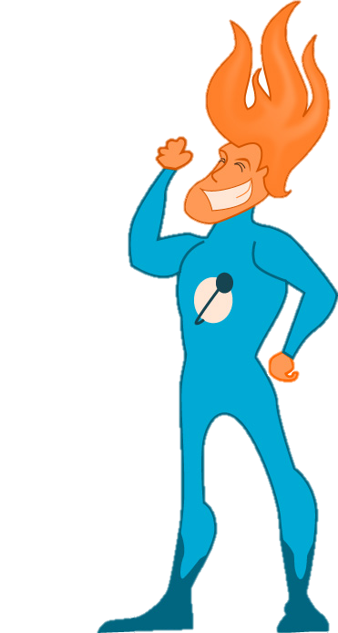
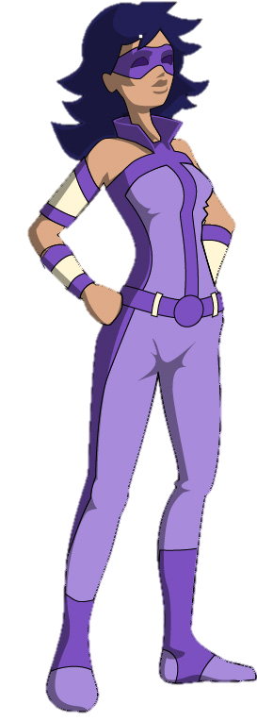
ACKNOWLEDGMENTS:
SUPER-FLAMEMAN
SUPER PURPLEWOMAN
The Creative School team wishes to thank “OpenClipart-Vectors”,
author of the images of the superheroes. You can follow him at:
https://pixabay.com/it/users/openclipart-vectors-30363/

Slide 3
THE CAST:
SUPER FLAMEMAN
SUPER PURPLEWOMAN

Slide 4
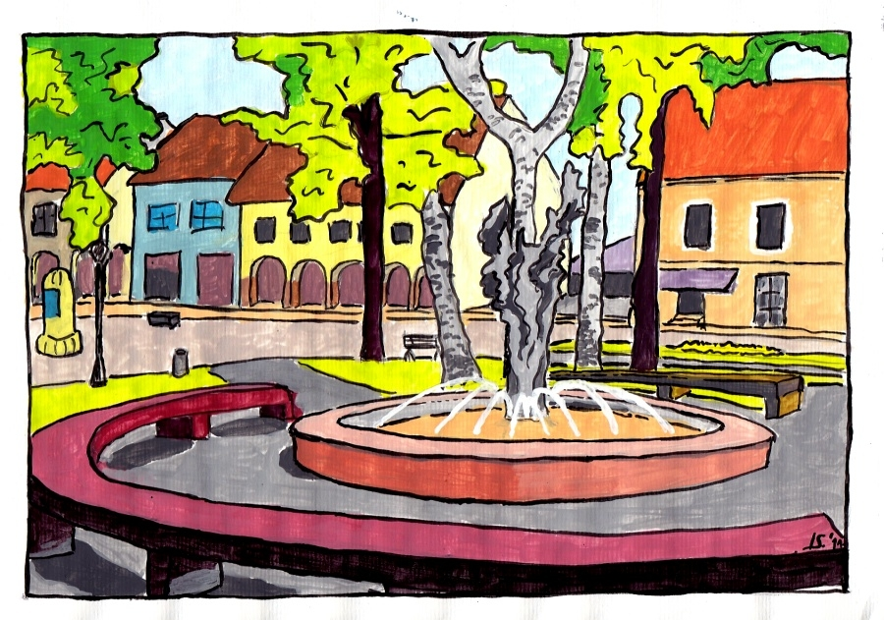
IN A SQUARE IN
YOUR HOME TOWN …

Slide 5
… ONE A SPRING DAY …
Hi, kids! I bet you didn’t expect me to show up in your class!
Do you know
who I am?

Slide 6
DO YOU KNOW WHAT
MY SUPER POWERS ARE ?
NAME SOME!

Slide 7
HALLO,
PURPLE WOMAN !
……OH, LOOK WHO’S HERE …..
FLAME MAN !

Slide 8
FLAME MAN, watch out!!
YOUR HAIR WILL SET THIS SQUARE’S TREES ON FIRE!
AH AH AH AH!!
IT’LL BE GOOD FUN:
I’LL SET THE SQUARE ON FIRE, SO EVERYBODY KNOWS
WHO I AM !
COME ON,
DON’T SHOW OFF!
BE RESPONSIBLE AND KEEP THAT UNRULY MANE OFF
THE TREES !

Slide 9
MY DEAR PURPLE WOMAN,
I DON’T GIVE A DAMN ABOUT YOU OR THIS SQUARE OR THE TREES!!
I DO WHATEVER I WANT, ‘CAUSE
I AM A THE MOST POWERFUL SUPER HERO OF THE UNIVERSE!
AH AH AH!!!
By the way, guess what my super powers are!
FLAME MAN, please,
stop being naughty,
and let’s show our kids here that
WE SUPERHEROES ARE CAPEBLE OF using our powers for THE GOOD.

Slide 10
OK, I’ll play nice…
And I’m sure that our kids here have often imagined they have superpowers, too.
Let’s see….
Kids, IF YOU WERE A SUPERHERO, WHAT WOULD YOUR SUPERPOWERS BE?

Slide 11
WHAT would you use your superpowers FOR ?
WHY ?

Slide 12
What POWERS
do you have in
REAL LIFE ?

Slide 13
Do you have
THE POWER TO MAKE SOMEONE HAPPY ?
IS THAT a power?

Slide 14
What about the power of
TAKING CARE
OF OTHERS ?
HOW do you do that?

Slide 15
What are
your RESPONSIBILITIES when you USE
YOUR POWERS?
WAIT!
We have to talk about RESPONSIBILITIES, first!

Slide 16
Yes, sure, you’re right!
So…. tell them what you always say about superpowers !
What I always say is that…
…. with
GREAT POWER
comes
GREAT RESPONSIBILITY !

Slide 17
What do you think about this statement?
Do you kids AGREE with
PURPLEWOMAN ?
Do you UNDERSTAND what it means ?

Slide 18
What do you think “RESPONSIBILITY” means ?

Slide 19
Is there a difference between RESPONSIBILITY,
DUTY ,
and OBLIGATION ?
Are they synonyms ?
Think of an example for each of them and compare. ..

Slide 20
What are
YOUR RESPONSIBILITIES
in EVERYDAY LIFE ?

Slide 21
Are you responsible for your …TALENTS ?
… SKILLS ?
… ACTIONS ?
Hmmm….. does that imply that we are RESPONSIBLE for our own HAPPINESS?

Slide 22
WHAT or WHOM can you be responsible FOR?
In your opinion,
what’s the difference between
being responsible
“for YOURSELF” and
being responsible “for OTHERS” ?

Slide 23
Do you think RESPONSIBILITIES ARE NECESSARY ?
Is being “responsible” something we can CHOOSE ?

Slide 24
Is there a difference between responsibilities we carry AT OUR OWN CHOICE, and responsibilities we are ENTRUSTED BY SOCIETY ?

Slide 25
WHAT would happen
IF WE HAD
NO RESPONSIBILITIES
at all?
Let’s think….
if I act irresponsibly,
what are the
CONSEQUENCES on SOCIETY ?
What happens to your classmates, your teachers, your family, your friends, the environment, the animals, the plants, the trees in this square…?

Slide 26
Uhmm… talking about society – as a group of people living together - do you think the concept of “RESPONSIBILTY” and “LIBERTY” are somehow connected ?

Slide 27
Being that you know all these new things about “responsibly”, do you think
it is EASY or it is HARD to be
a responsible person?
WHY ?

Slide 28
And you guys, do you think YOU are
RESPONSIBLE or IRRESPONSIBLE persons ?

Slide 29
OK, now…
We have ONE MORE TASK
for you, YOUNG SUPERHEROES-TO-BE !!

Slide 30
…. Let’s prepare
a short comic stripe
about 1 RESPONSIBILITY
you carry
in your everyday life.
You might describe your superpowers, if you wish

Slide 31
YOUR STRIPE:

Slide 32
YOUR STRIPE:

Slide 33
YOUR STRIPE:

Slide 34
Very well done, kids!
You did a great job today!
PURPLE WOMAN AND I
ARE VERY PROUD OF YOU!
Yes! Considered all the responsibilities you carry, you really are
YOUNG SUPERHEROES !

Slide 35
WELCOME TO
THE SUPER HEROES
HALL OF FAME !

Slide 36
THE CAST:
SUPER-FLAMEMAN
SUPER PURPLEWOMAN
YOU

Slide 37
1
THE END

