Slide 1
Open Educational Resources (OER)
Nowadays, everywhere in the world, children and young people need to be trained to face
challenging social, emotional and economical problems they will confront with - as adults -
both in their personal lives and in the context of the wider world.
In order to do so, they must DEVELOP HIGHER LEVEL THINKING SKILLS which, we believe,
WILL FLOURISH IF ENCOURAGED TO BE CREATIVE, INNOVATIVE, INGENIOUS AND ADAPTABLE.
The present Open Educational Resources (OER) have been designed within the Creative School Project, whose objective
is to develop teaching/learning modules for school teachers and students, PROMOTING SELF-DIRECTED LEARNING AND CRITICAL AND VISUAL THINKING SKILLS, using CULTURAL HERITAGE CONTENTS made available by the Institutions and Organizations the Creative School Project Partners belong to.
The BENEFICIARIES of the present Open Educational Resources are:
PRIMARY AND SECONDARY SCHOOL TEACHERS who, through engaging with the Project, will become equipped with the skills necessary to facilitate pedagogical strategies for creativity and critical thinking;
CHILDREN AND YOUNG PEOPLE which will use the OER developed by the Project.
Please note, that OER TOPICS HAVE BEEN SELECTED BY AN INTERNATIONAL GROUP OF TEACHERS AND EDUCATORS from Austria, Croatia, Finland, France, Ireland, Italy and the United Kingdom, through focus groups and surveys.
We hope the present materials enrich your teaching resources and foster creative and critical thinking among students.
https://www.creative-school.eu
The Creative School project has been funded with the support of the European Union and the French National Agency for the Erasmus+ Programme (Grant Agreement 2019-1-FR01-KA201-062212). This publication reflects the views only of the author, and the European Union and the French National Agency for the Erasmus+ Programme cannot be held responsible for any use which may be made of the information contained therein.
Materials can be used according to the: Creative Commons Non Commercial Share Alike license

Slide 2
Topic:
ART HISTORY
Age:
14-18 YEARS

Slide 3
A SURREAL JOURNEY

Slide 4
Idea and graphic design project by:
ICARO RIMONDI, EDEN ICIEK, ANGELICA BOSCHI,
ALESSIA GRANDE, RICCARDO FAZZIOLI, SOFIA PATTINI,
MICHELA MONARI, SARA FACCHINI
~ 3 D, academic year 2020-2021 ~
~ High School of Arts F. Arcangeli ~
~ Bologna, Italy ~
With the support of STEPs srl, Italy

Slide 5
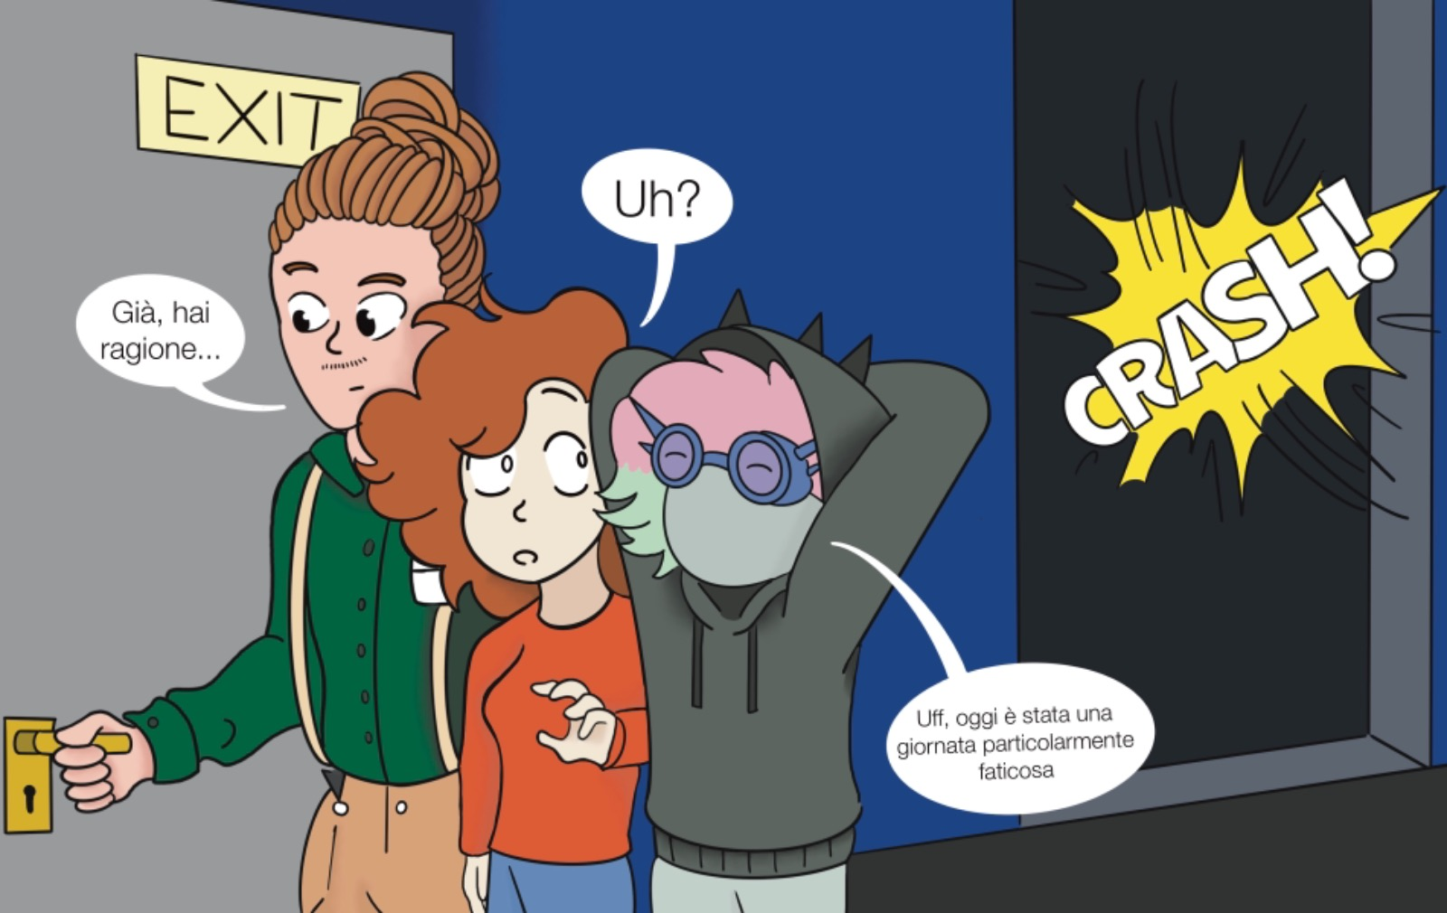
…. ONE AFTERNOON, AT THE MUSEUM, NEARLY AT CLOSING TIME …..
???
Yes, you are right
It was a very tiring day

Slide 6
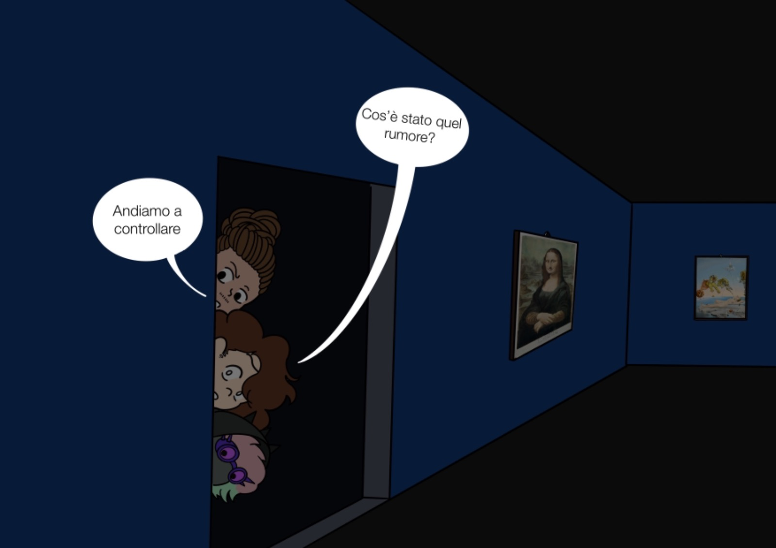
What was that noise?
Let's go and check it out

Slide 7
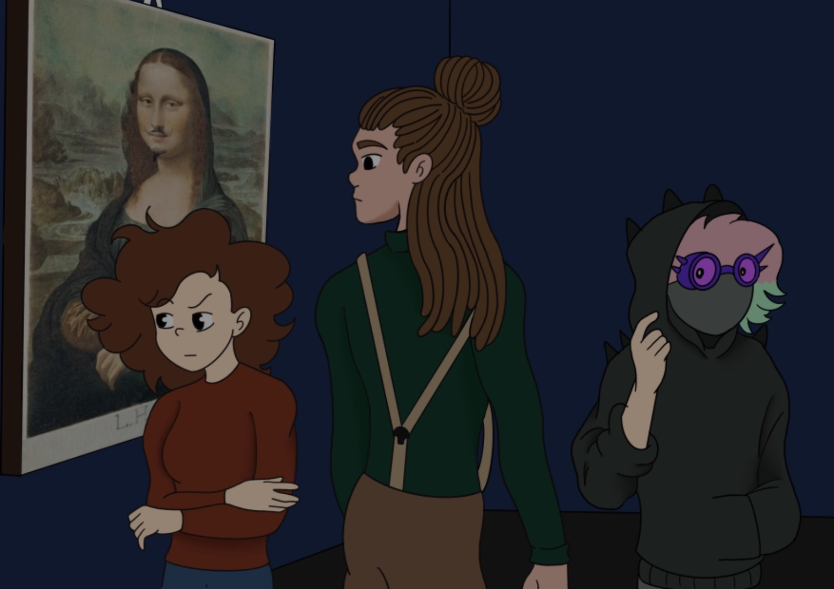

Slide 8
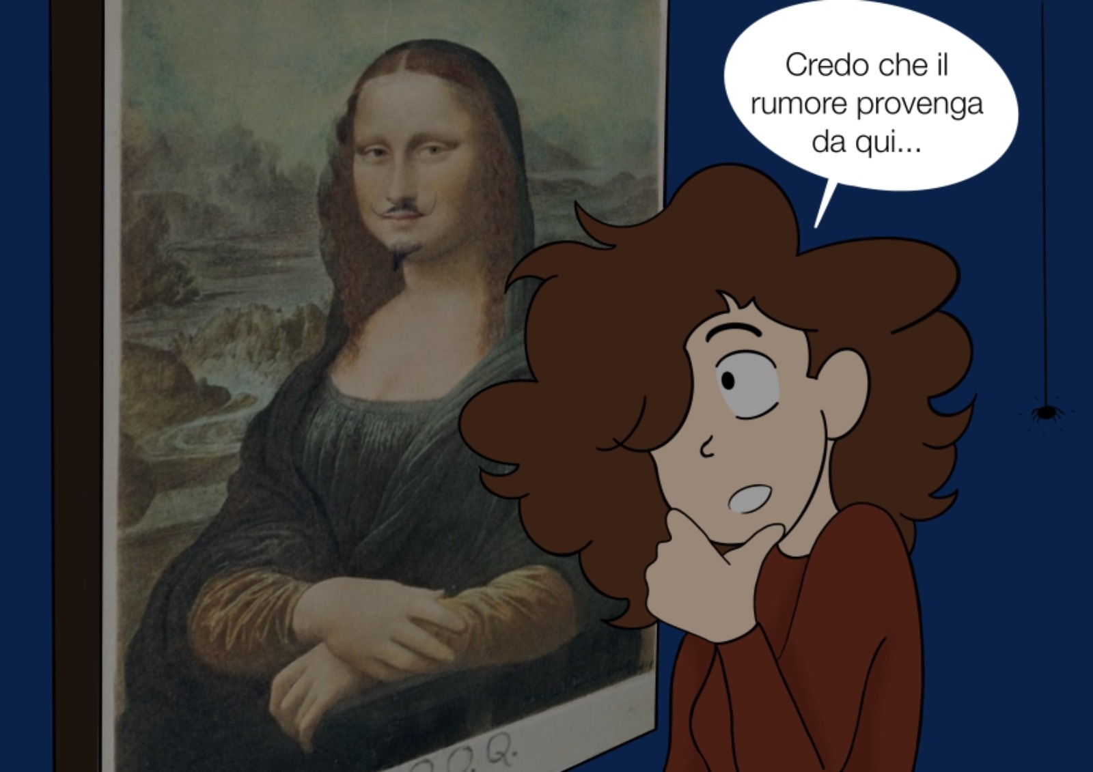
The noise comes from this painting …

Slide 9
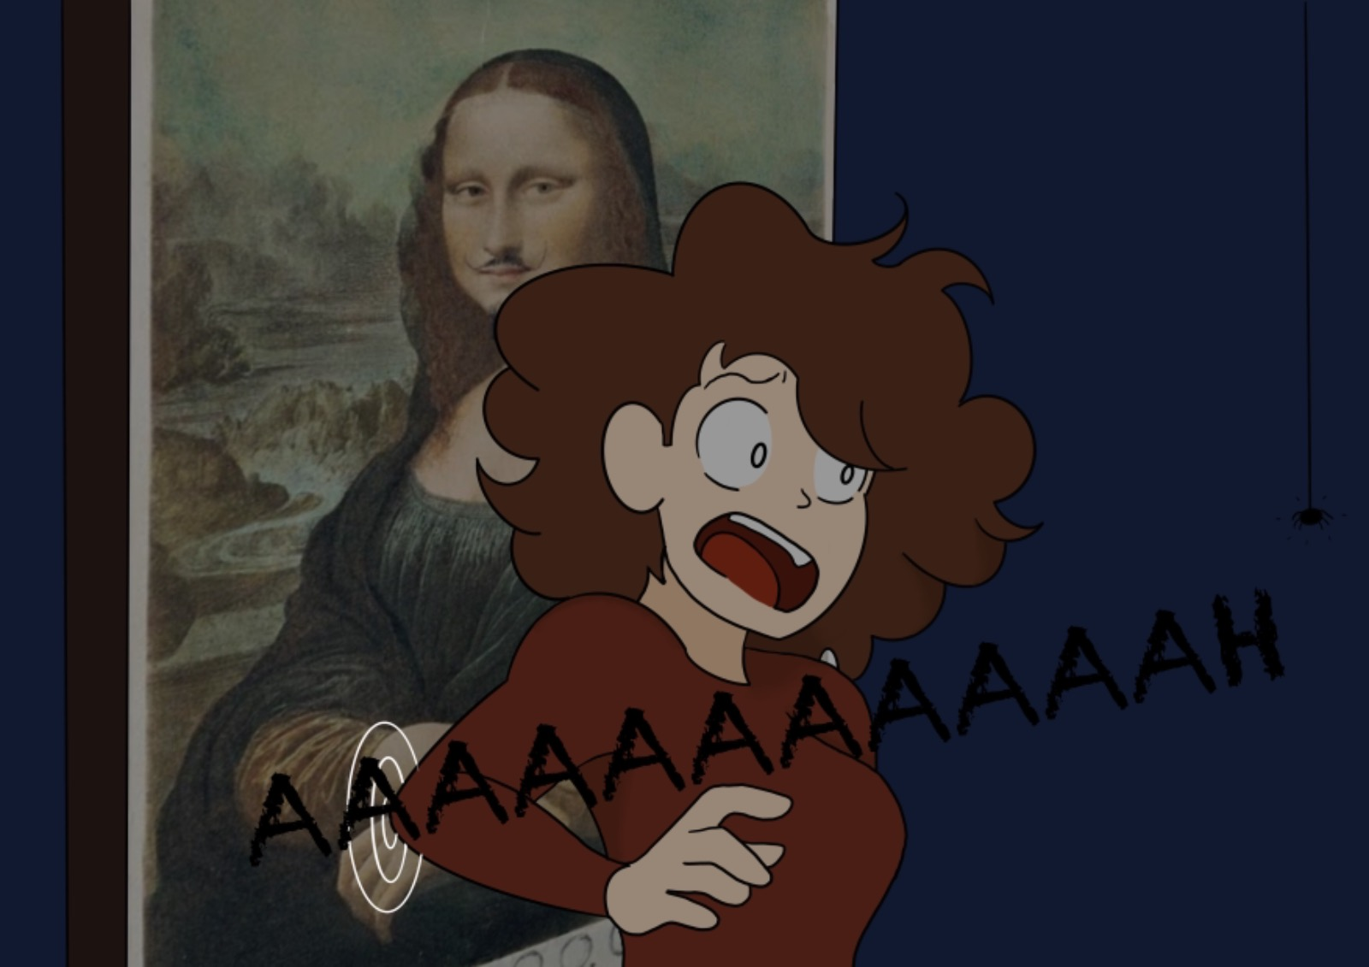

Slide 10
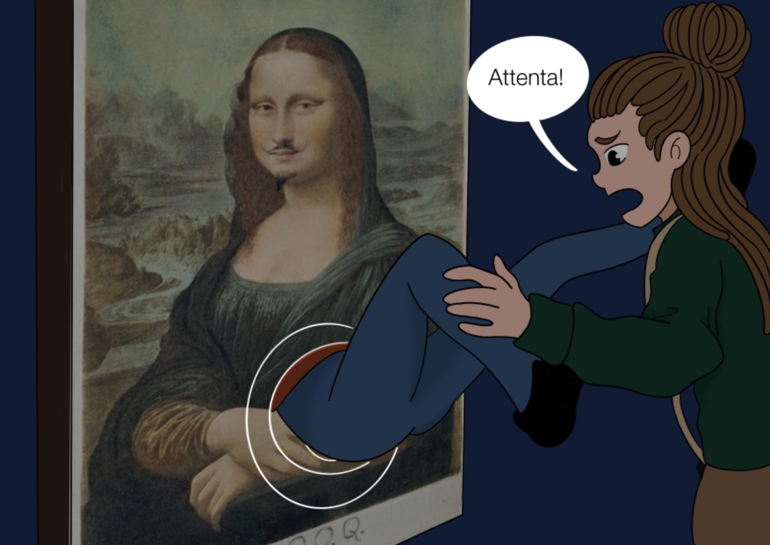
GOSH! What happens?!

Slide 11
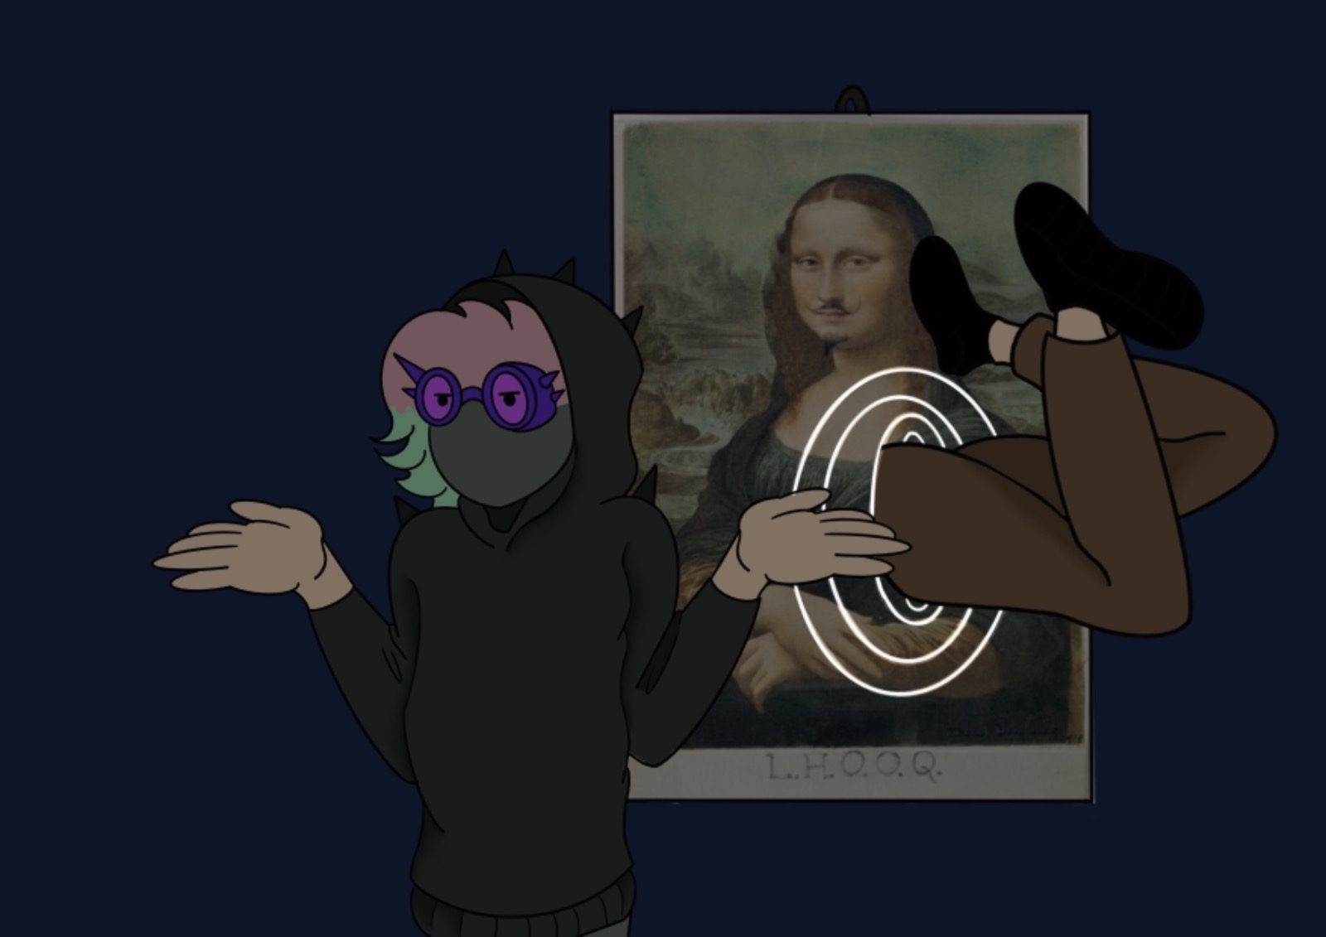

Slide 13
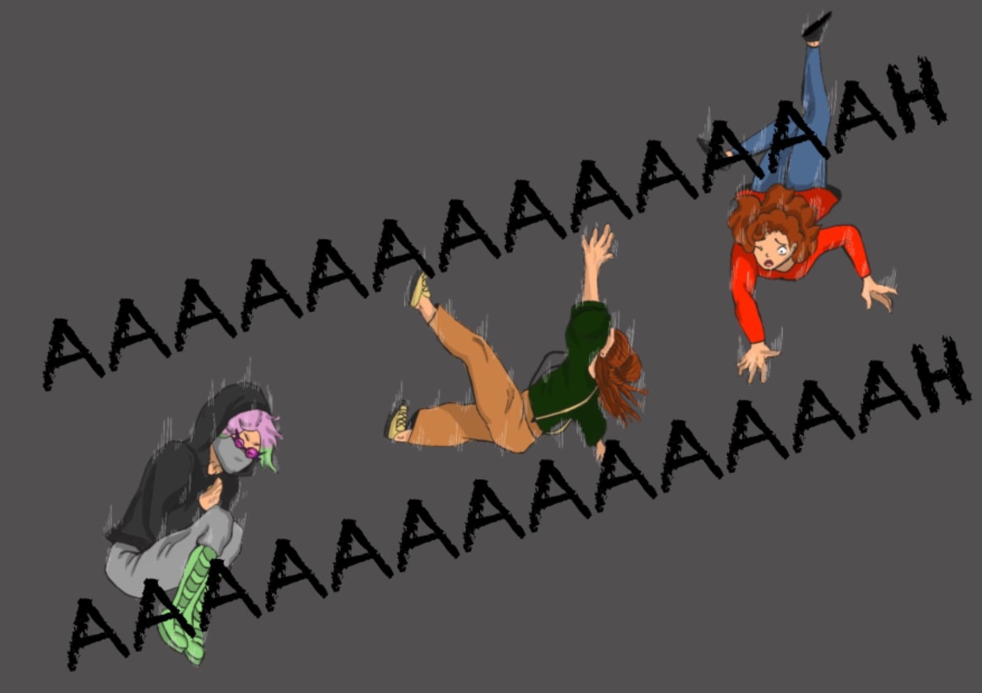

Slide 14
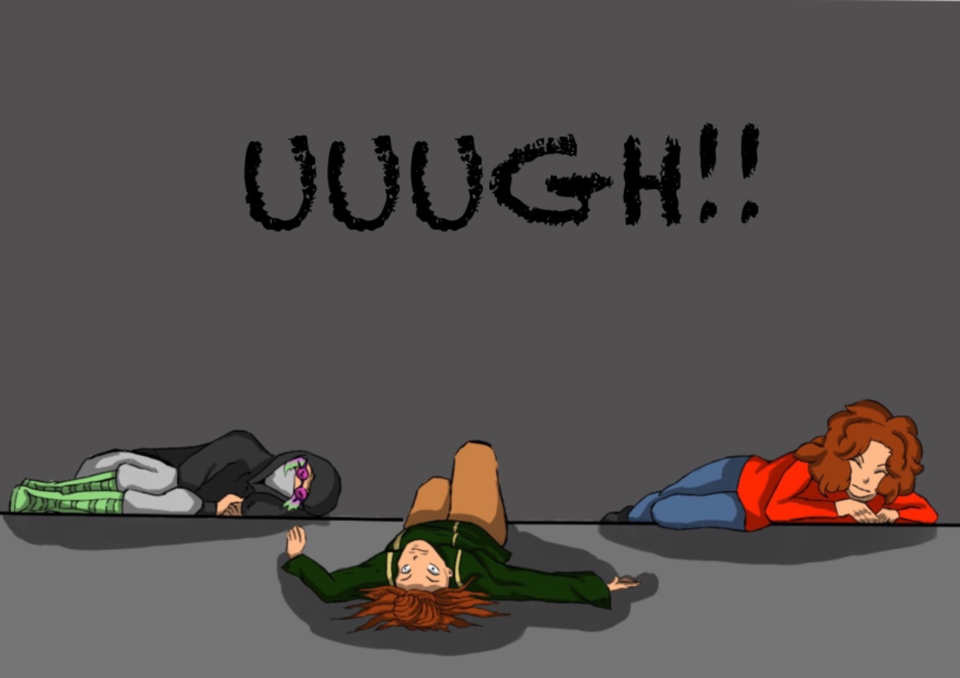

Slide 15
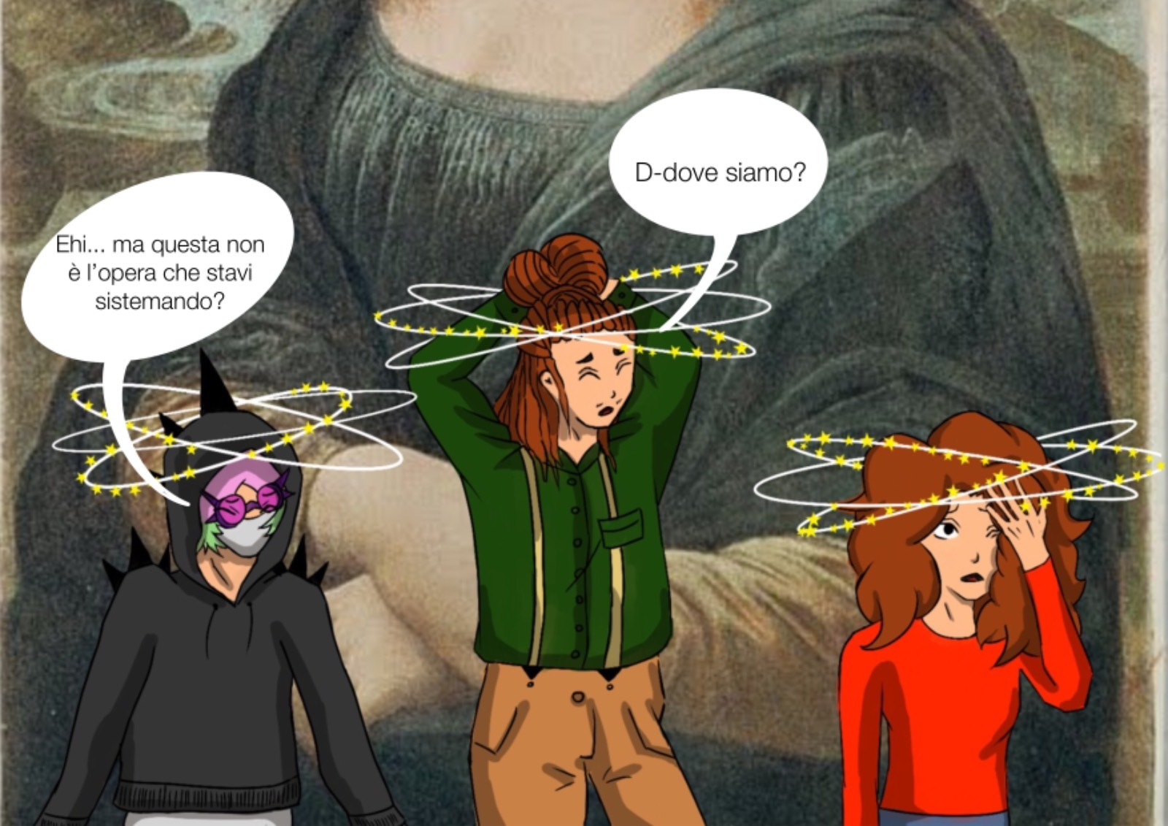
Where are we?
ARGH! Isn’t
this the new
acquisition of the
Museum you were displaying today ?

Slide 16
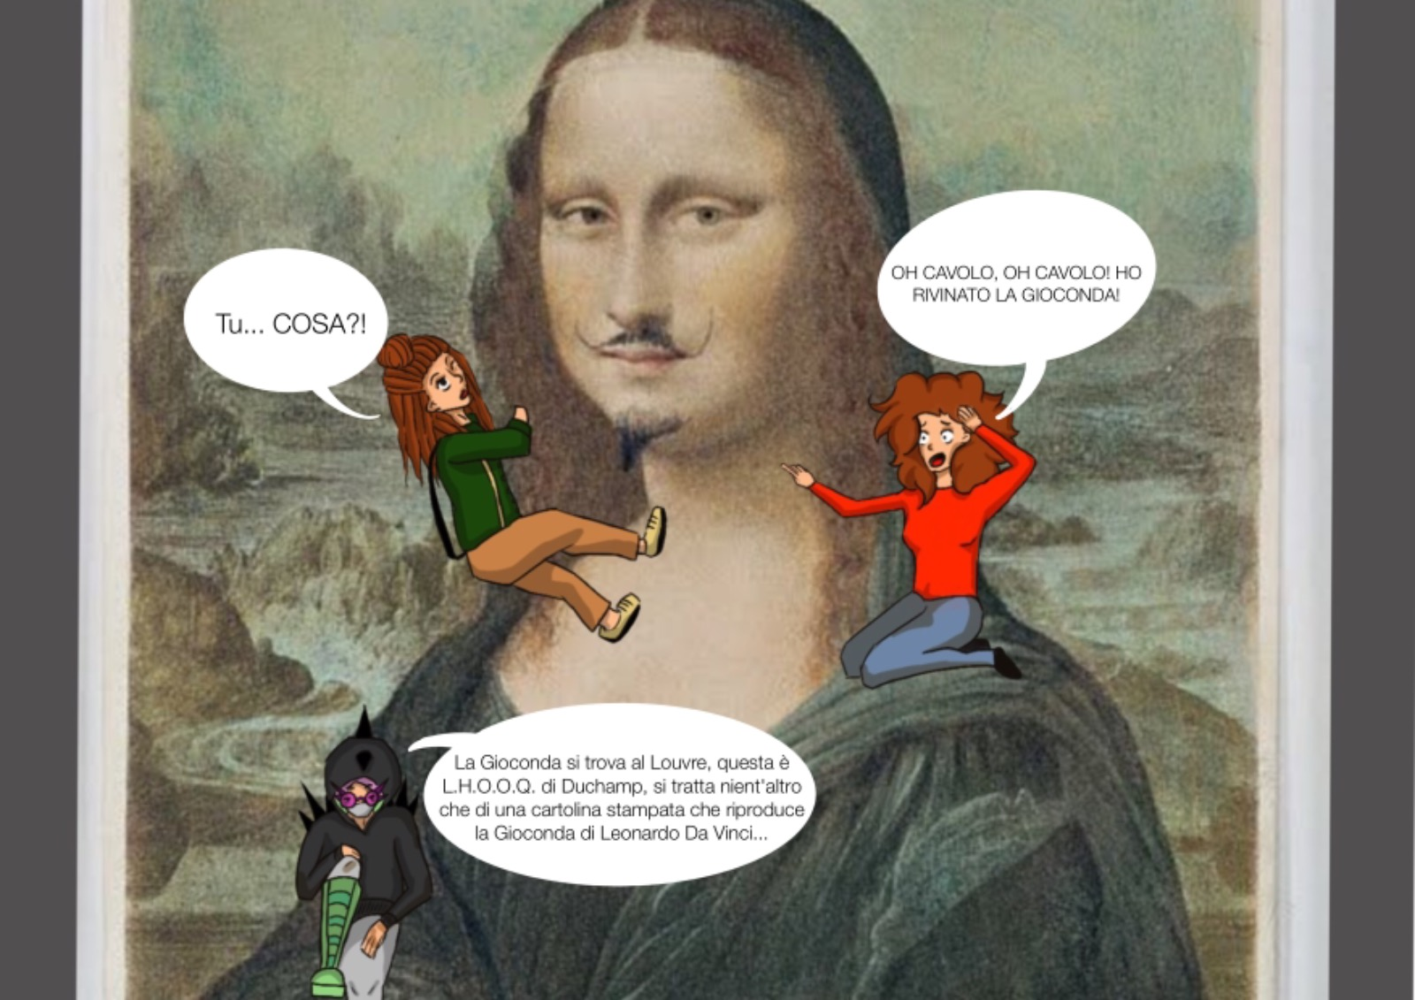
Damn!
I ruined the Mona Lisa
You… what?
No, you didn't. The Mona Lisa is at the Louvre, in Paris. This is Duchamp's L.H.O.O.Q. It is a postcard that imitates Leonardo's Mona Lisa ...

Slide 17
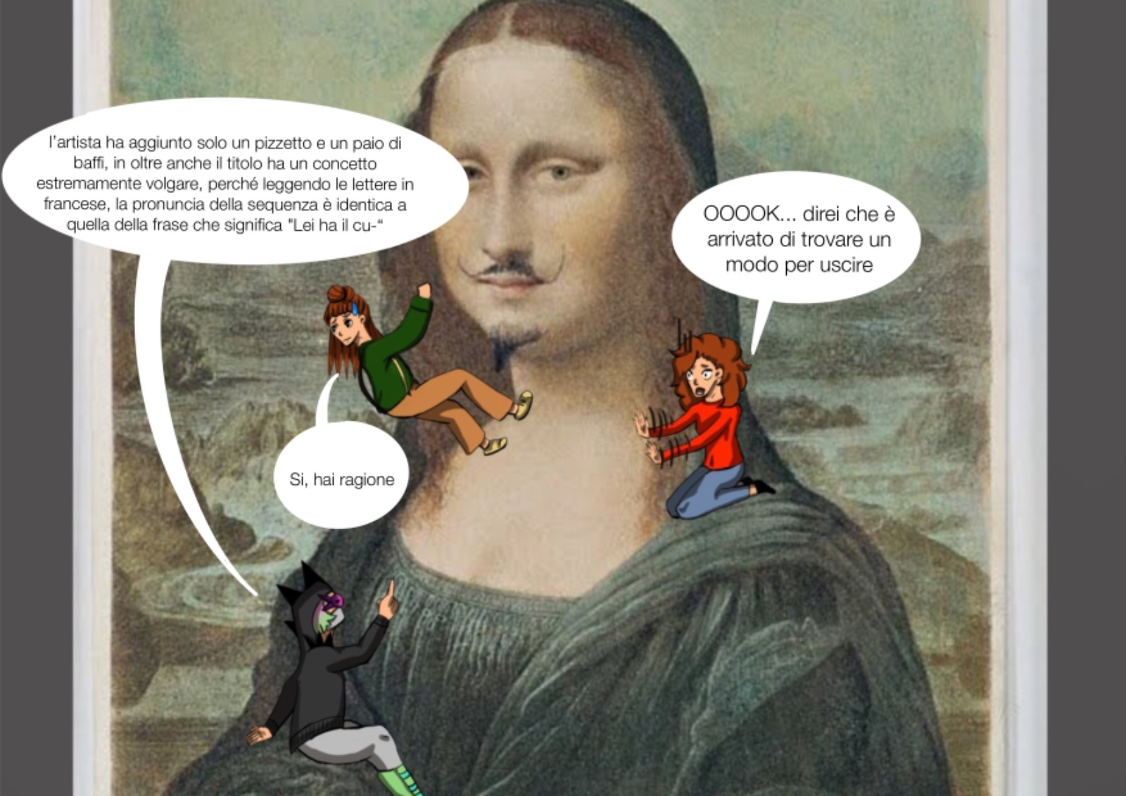
Duchamp added a goatee and a mustache. The work’s title read in French sounds like “Elle a chaud au cul ” which means “Easy girl”
OK ... Very interesting, but I'd say it's time to find our way out!!!
Yes, you are right

Slide 18
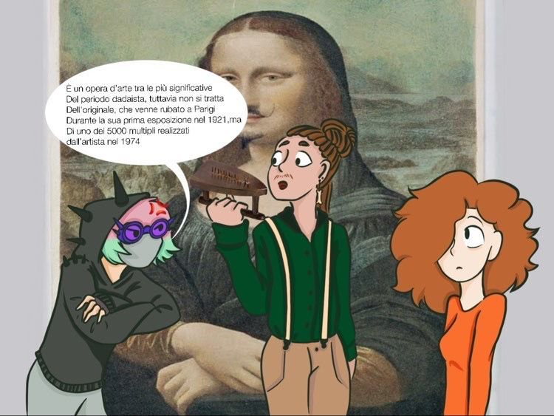
It is one of the most significant works of Dadaism. This is not the original, which was stolen in 1921, but one of the 5000 reproductions made by the artist in 1974

Slide 19
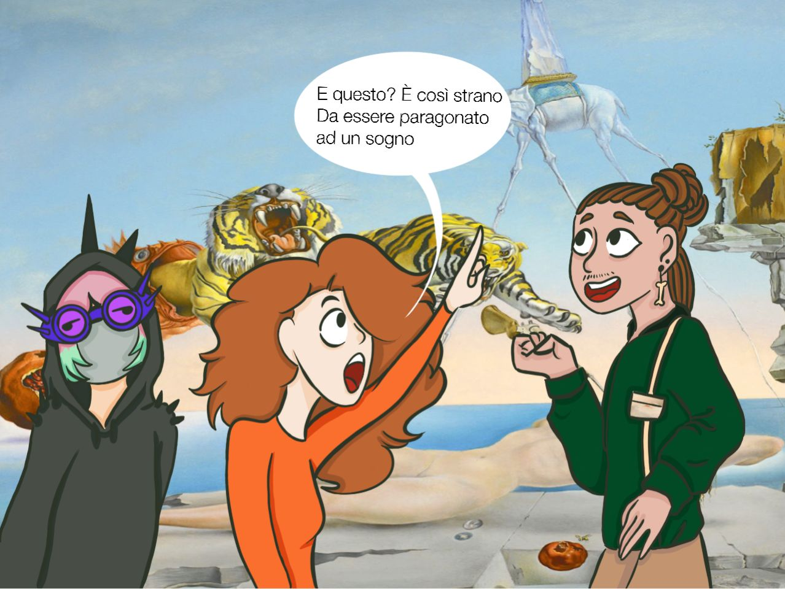
And this? It is so strange that it feels like a dream

Slide 20
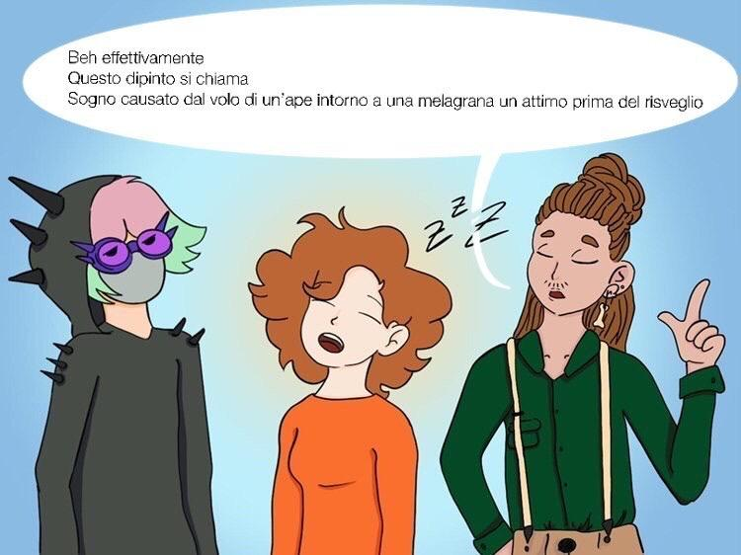
Indeed, this painting is called “Dream Caused by the Flight of a Bee Around a Pomegranate a Second Before Waking”

Slide 21
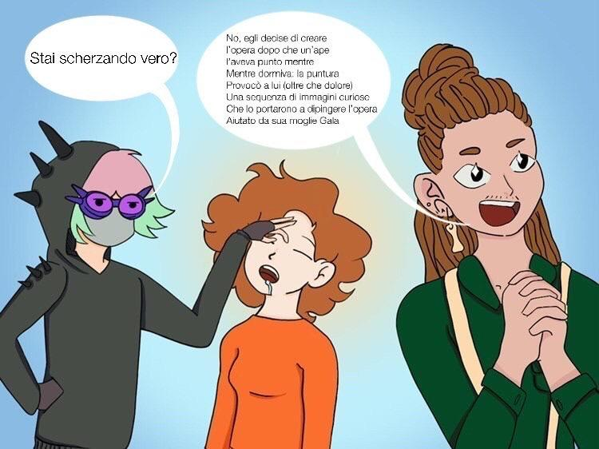
No, I am not. Dalì painted this work after a bee stung him while he was sleeping. The sting caused him a sequence of curious images, which led him to paint the work together with his wife Gaia
You're joking, aren’t you?

Slide 22
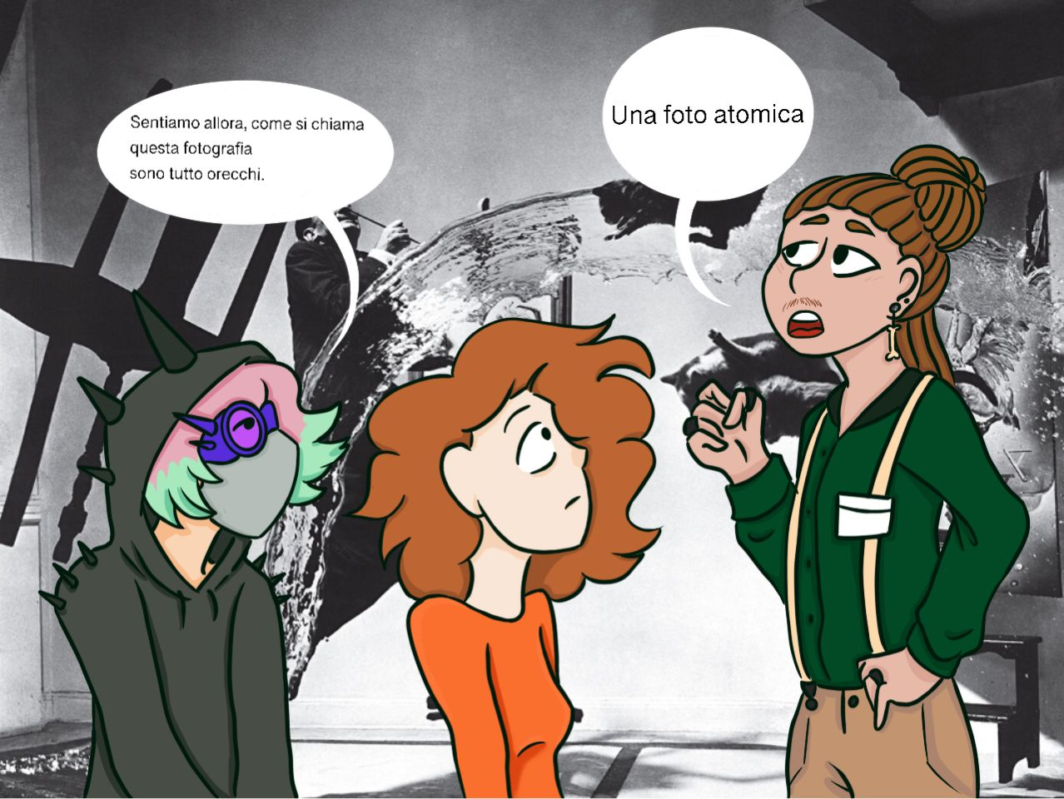
It’s called “Dali Atomicus”
Let's hear what this photo is called. I'm all ears

Slide 23
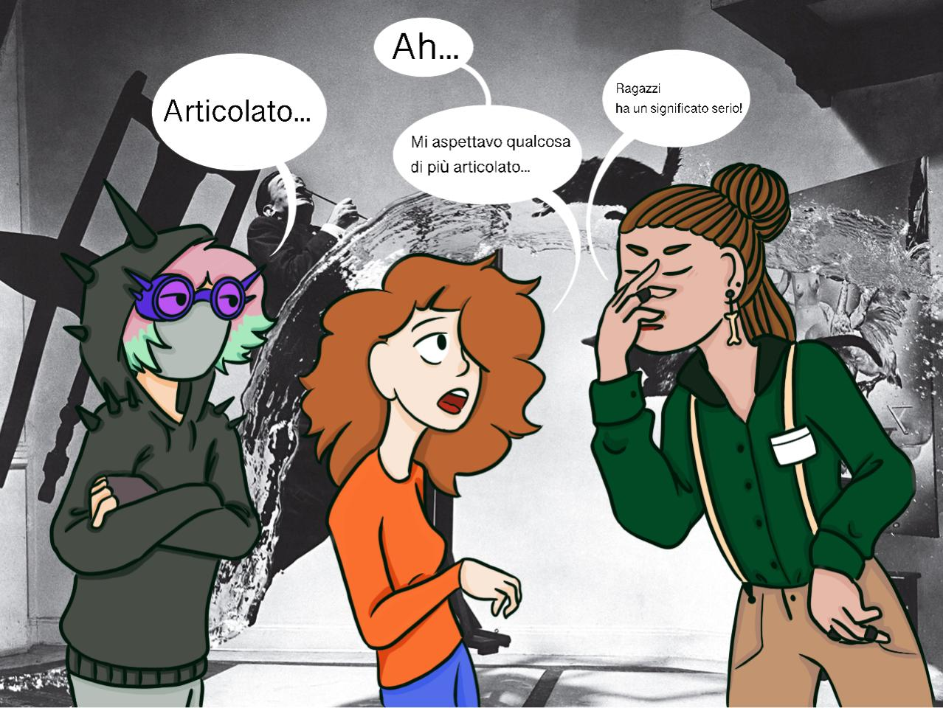
Ah,
Ah ah …More complex…
Guys, it has a serious meaning
I was expecting something more complex

Slide 24
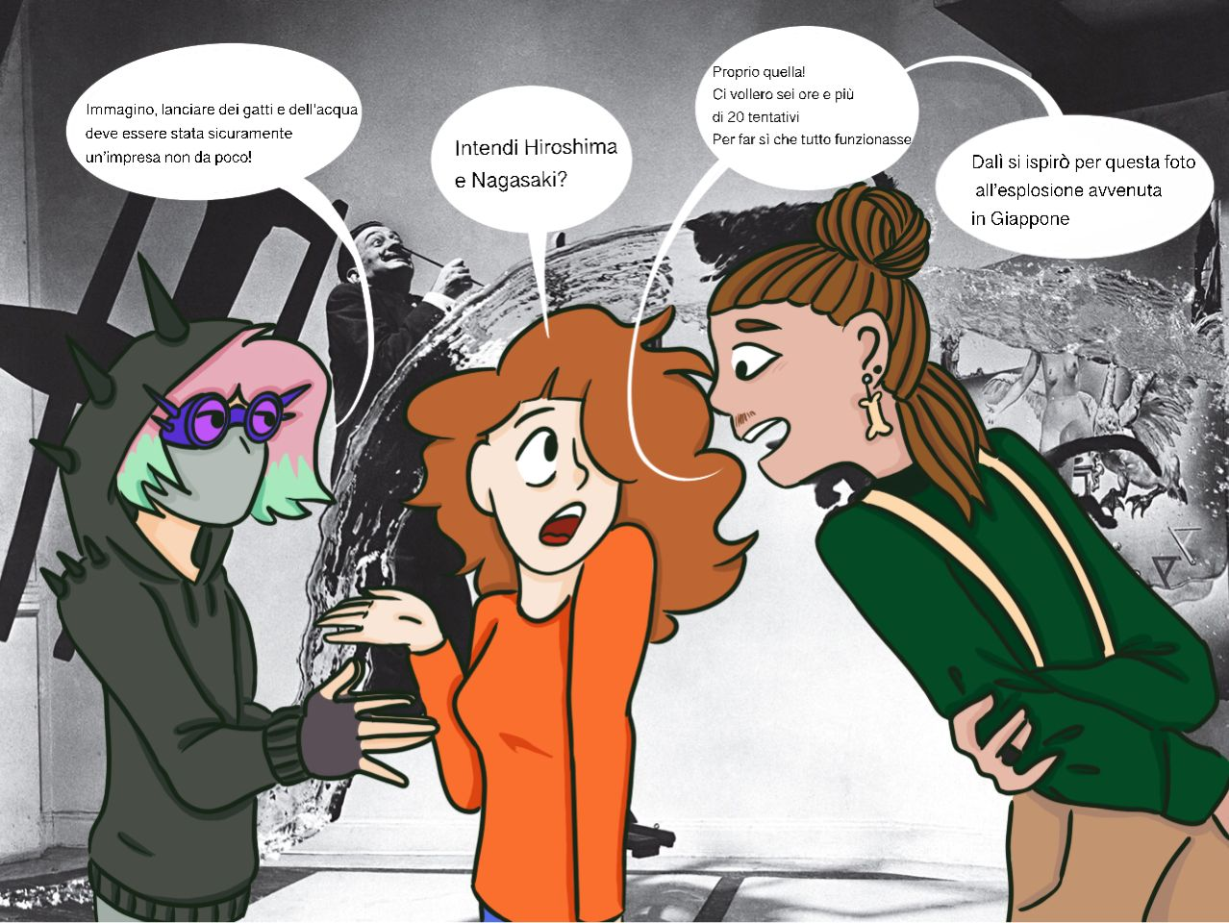
… Sure!!! Throwing in the air cats and water must have been no small feat
Just that. It took Philippe Halsman and Salvador Dalí 28 tries before they got the result expected
Do you mean Hiroshima and Nagasaki?
Dalì was inspired by the explosions that took place in Japan

Slide 25
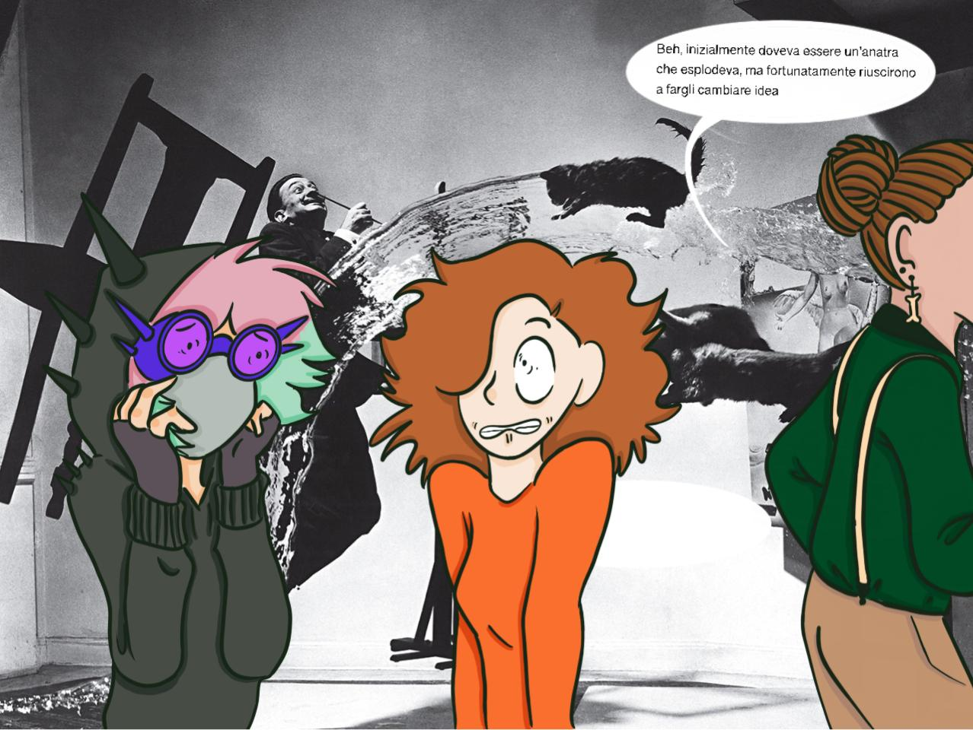
At first, they planned to have a duck exploding, but luckily they changed their mind

Slide 26
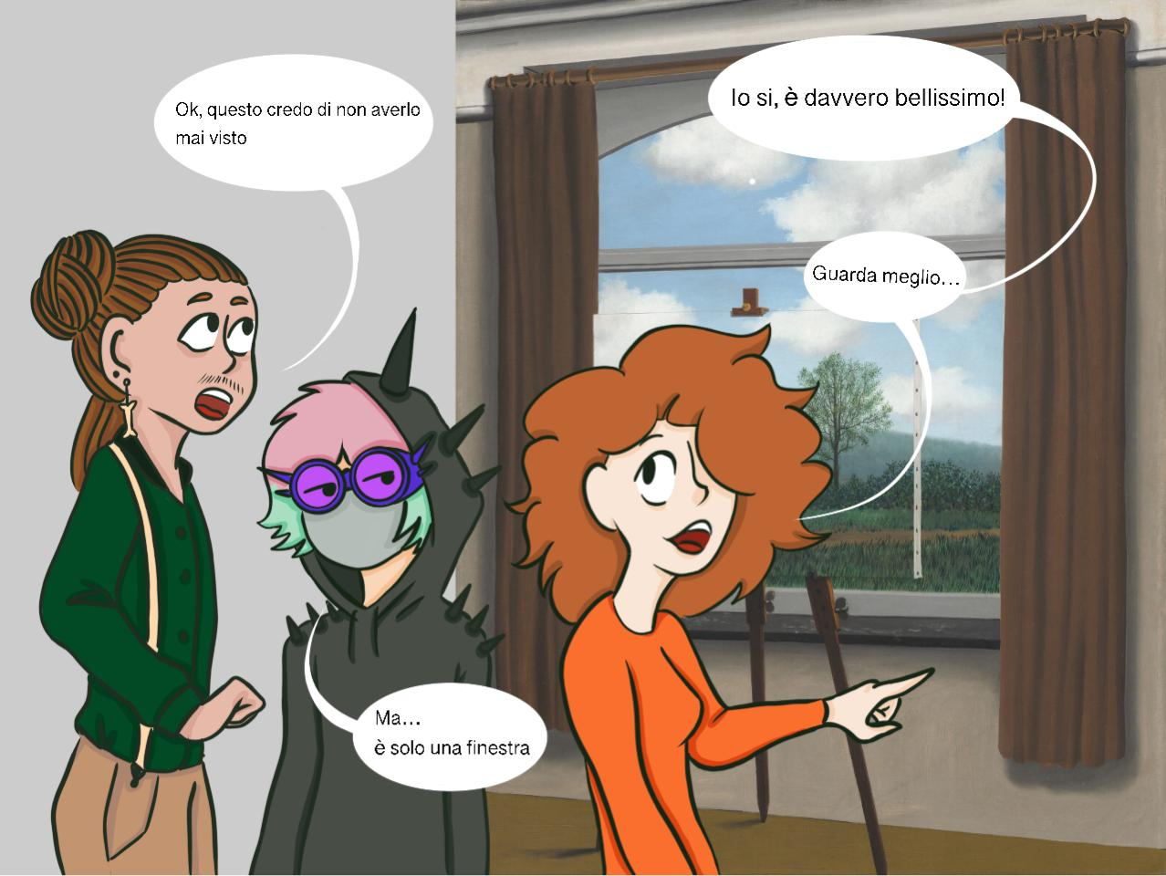
No, it’s not just a window. It’s a beautiful painting.
I can’t see anything here!
Take a better look
…there is just a window!

Slide 27
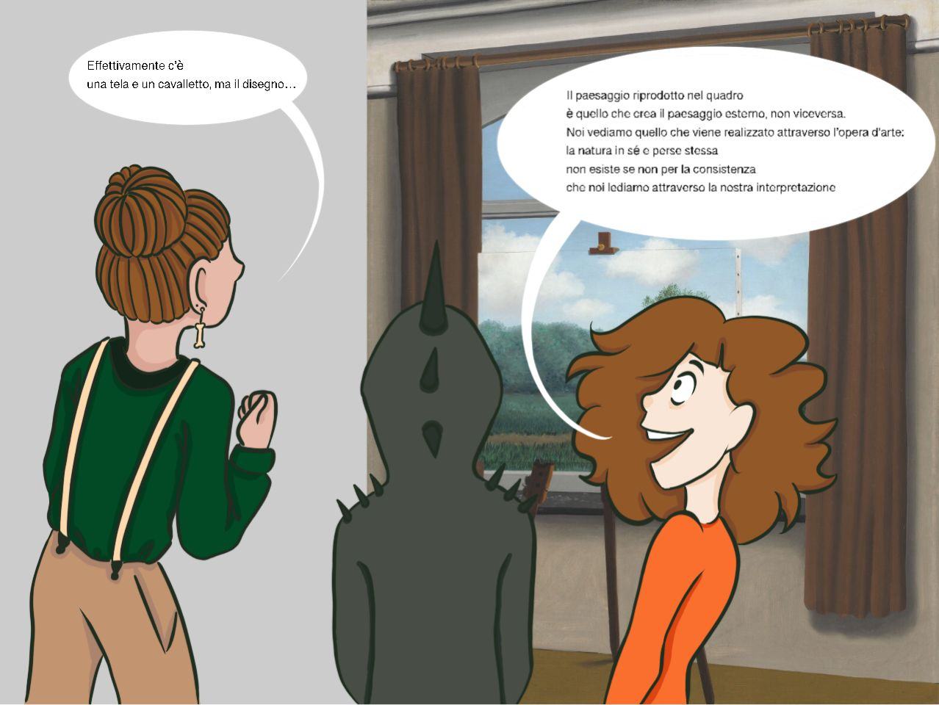
Well… I can see a canvas and an easel, but cannot see any drawing
The landscape reproduced in the painting creates the external landscape, not vice versa. We can see only what is created through an artwork: nature itself does not exist, if not through our interpretation

Slide 28
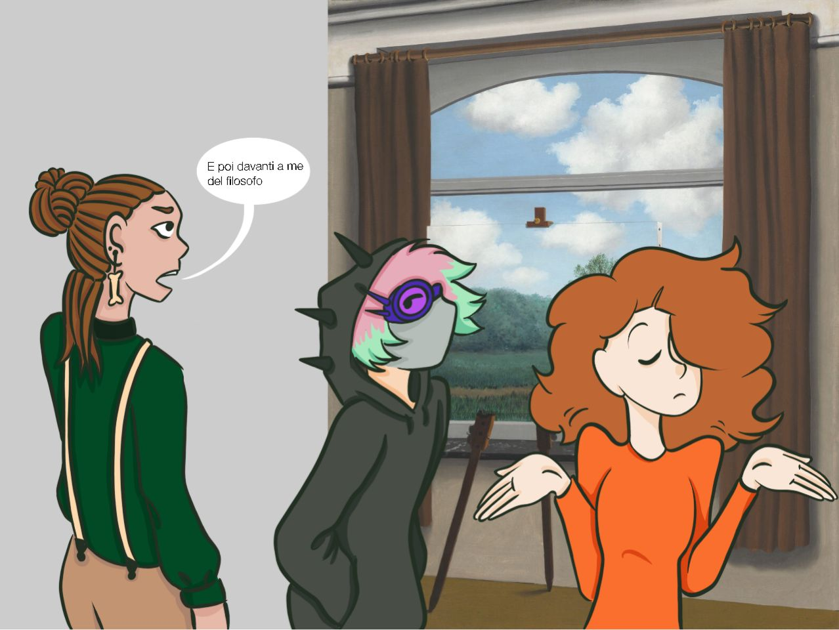
And you say that I am the philosopher!

Slide 29
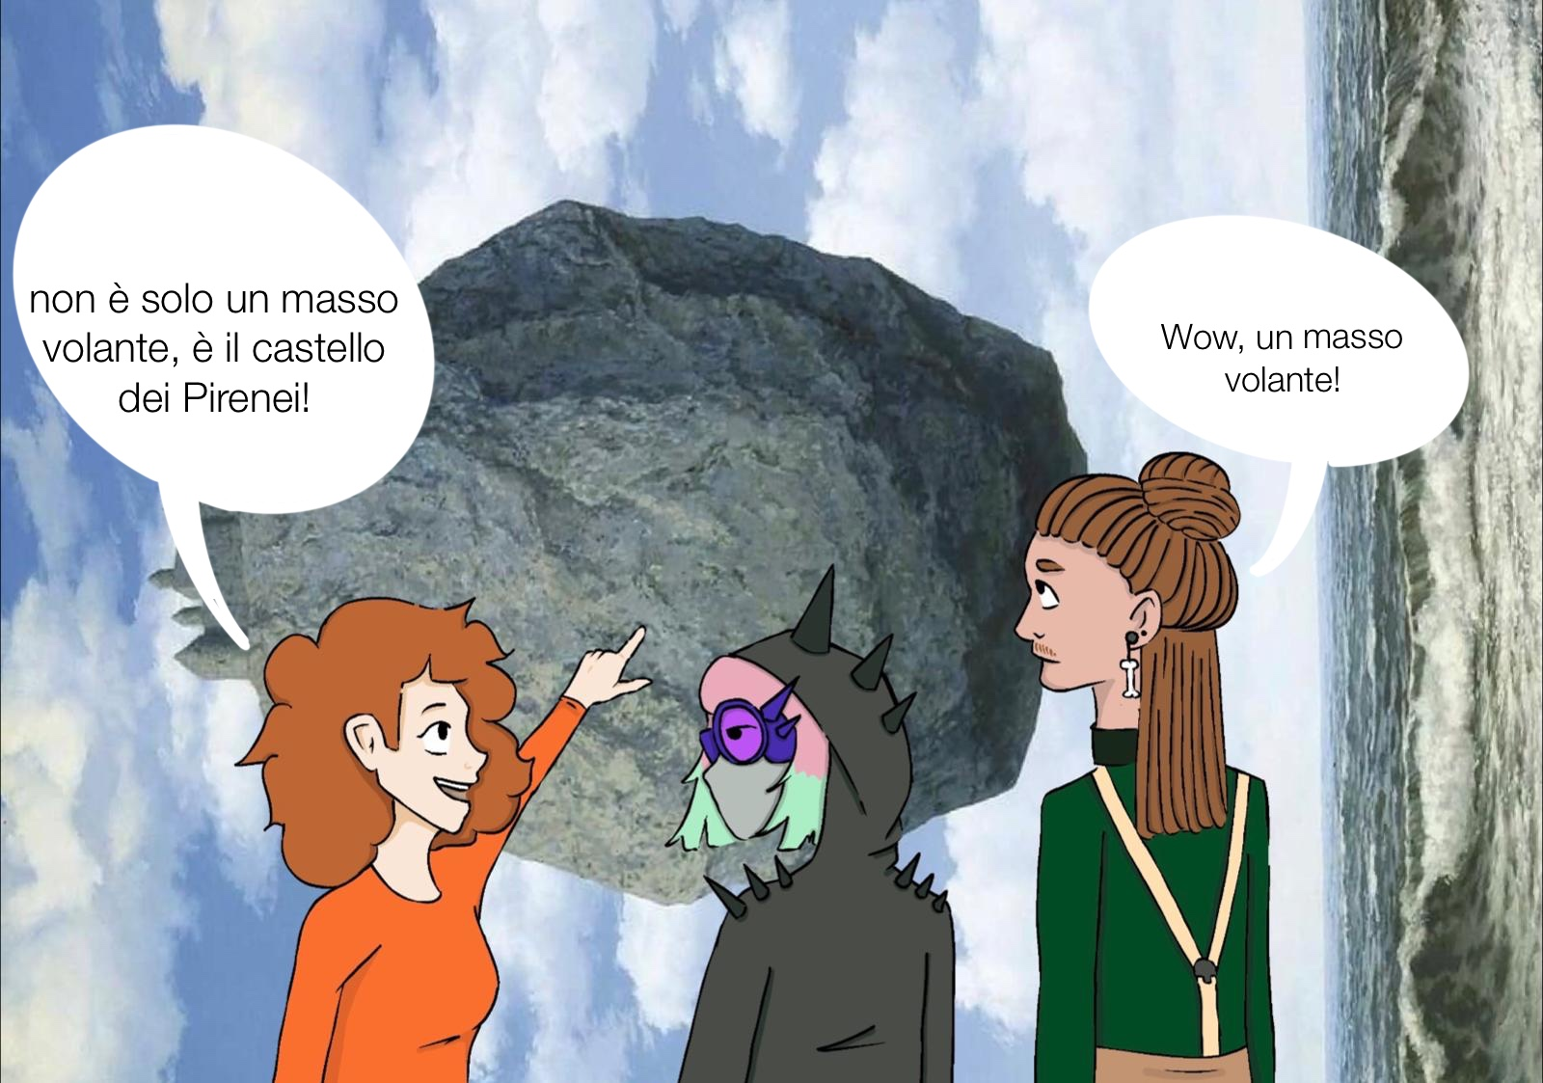
It's not just a flying boulder, it's a castle in the Pyrenees!
Wow, a flying boulder!

Slide 30
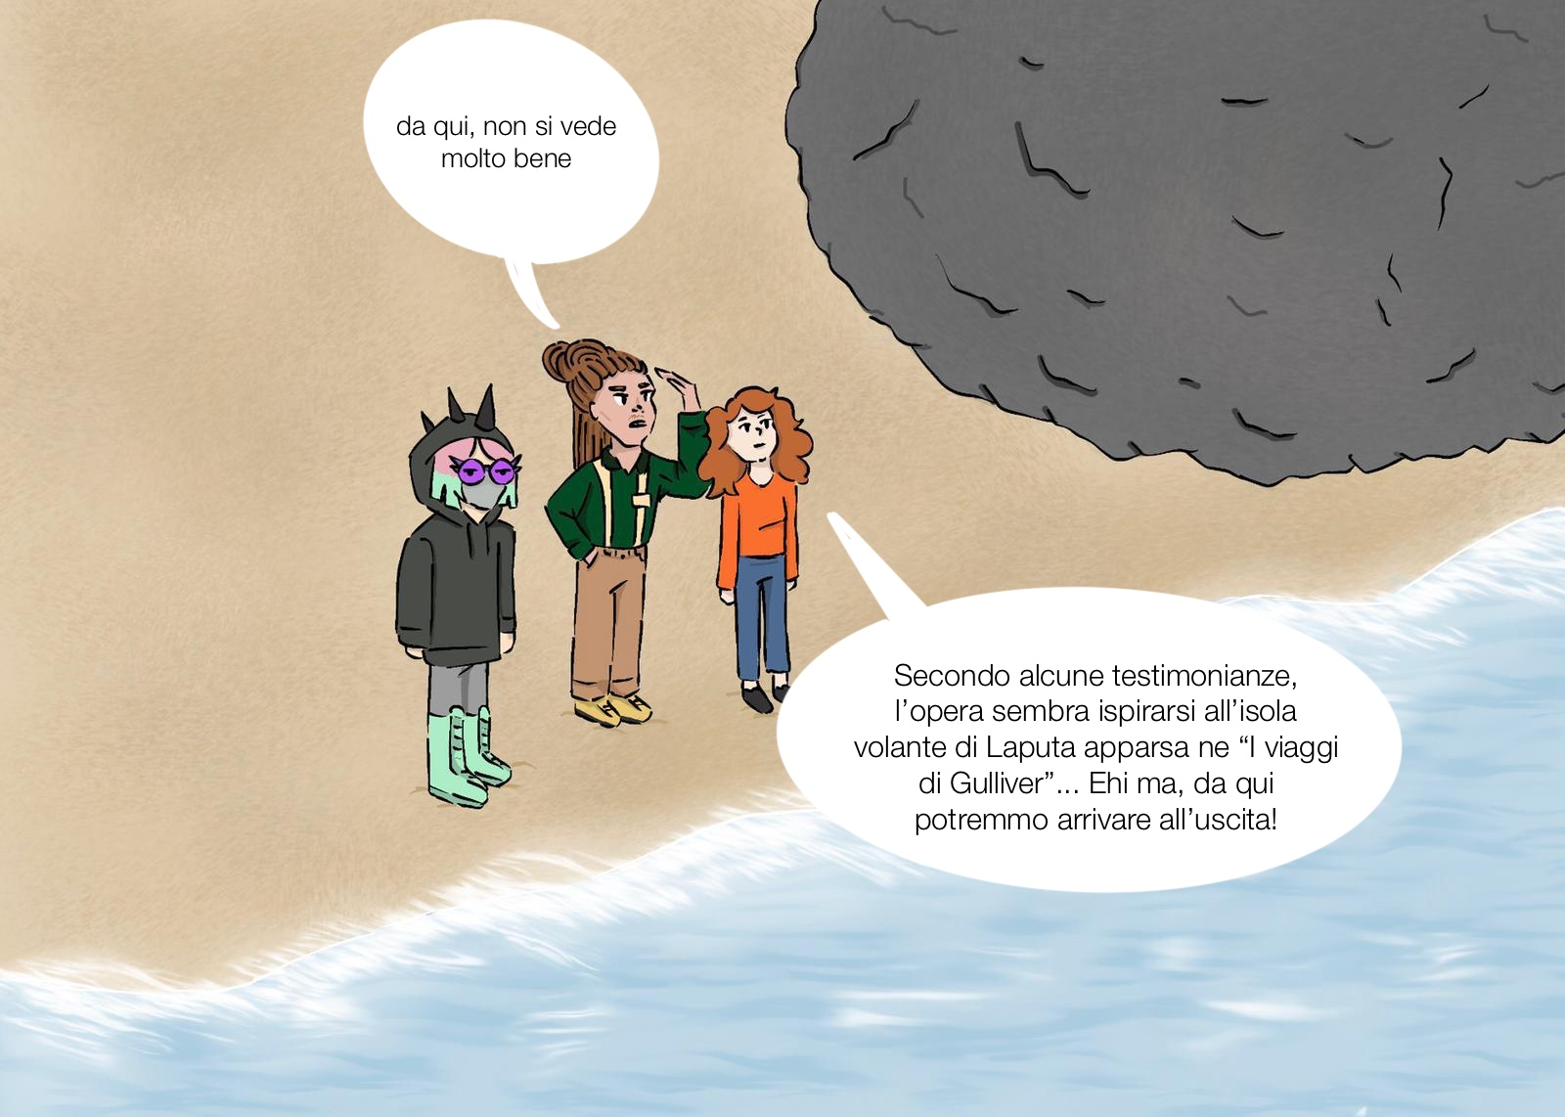
You can't see the castle well from here
According to some, the work has been inspired by the flying island of Laputa from “Gulliver's Travels”. From here we should gain the exit
v

Slide 31
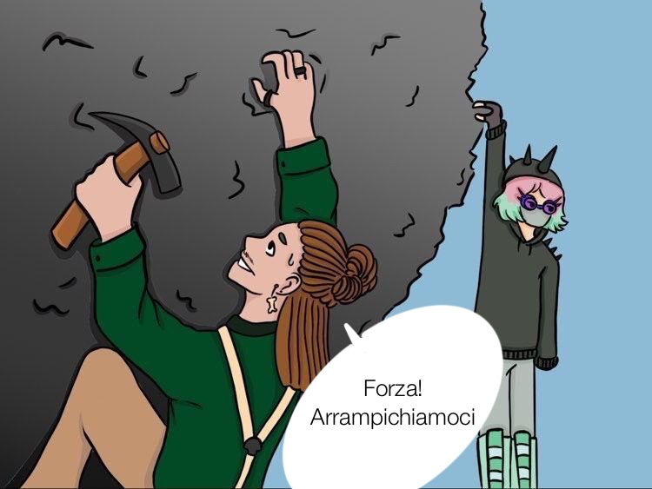
Come on, let's climb

Slide 32
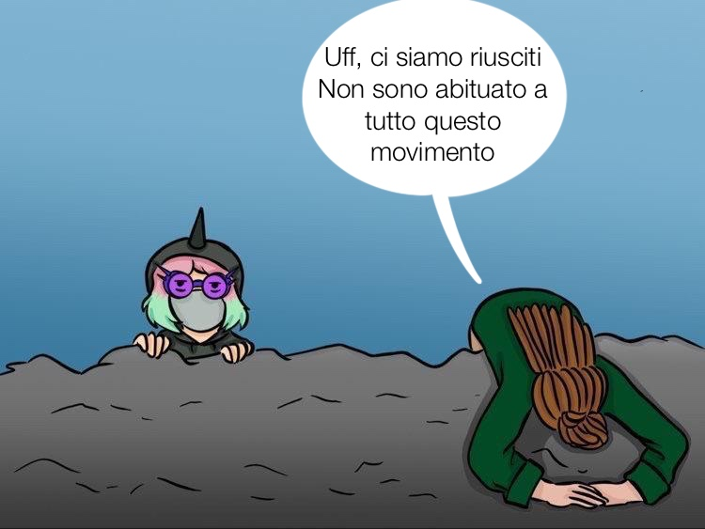
v
Ugh, we made it. I'm not used to all this exercise

Slide 33
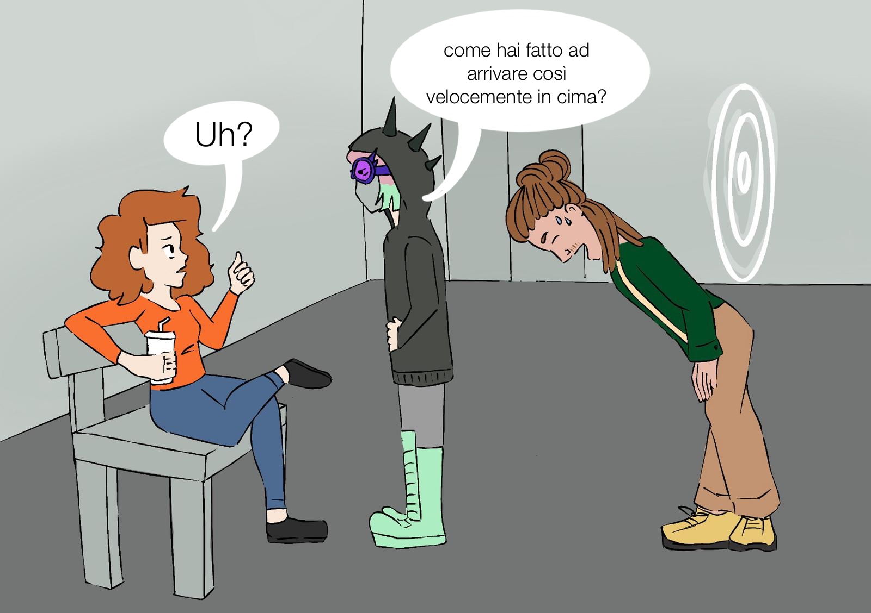
How did you get to the top so fast?
Well?

Slide 34
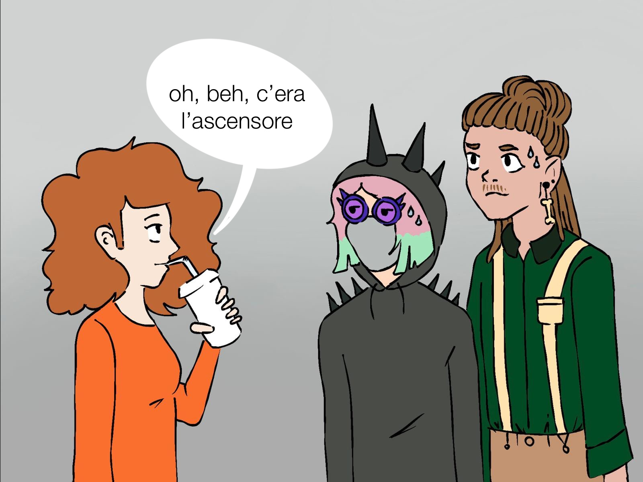
I took the elevator!

Slide 35
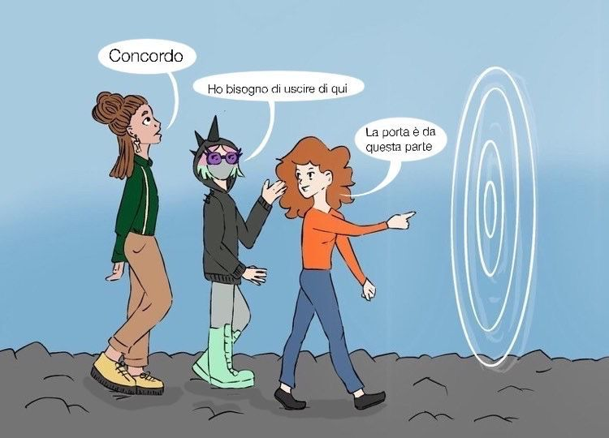
I agree!
I want to get out!
Here is the exit door

Slide 36
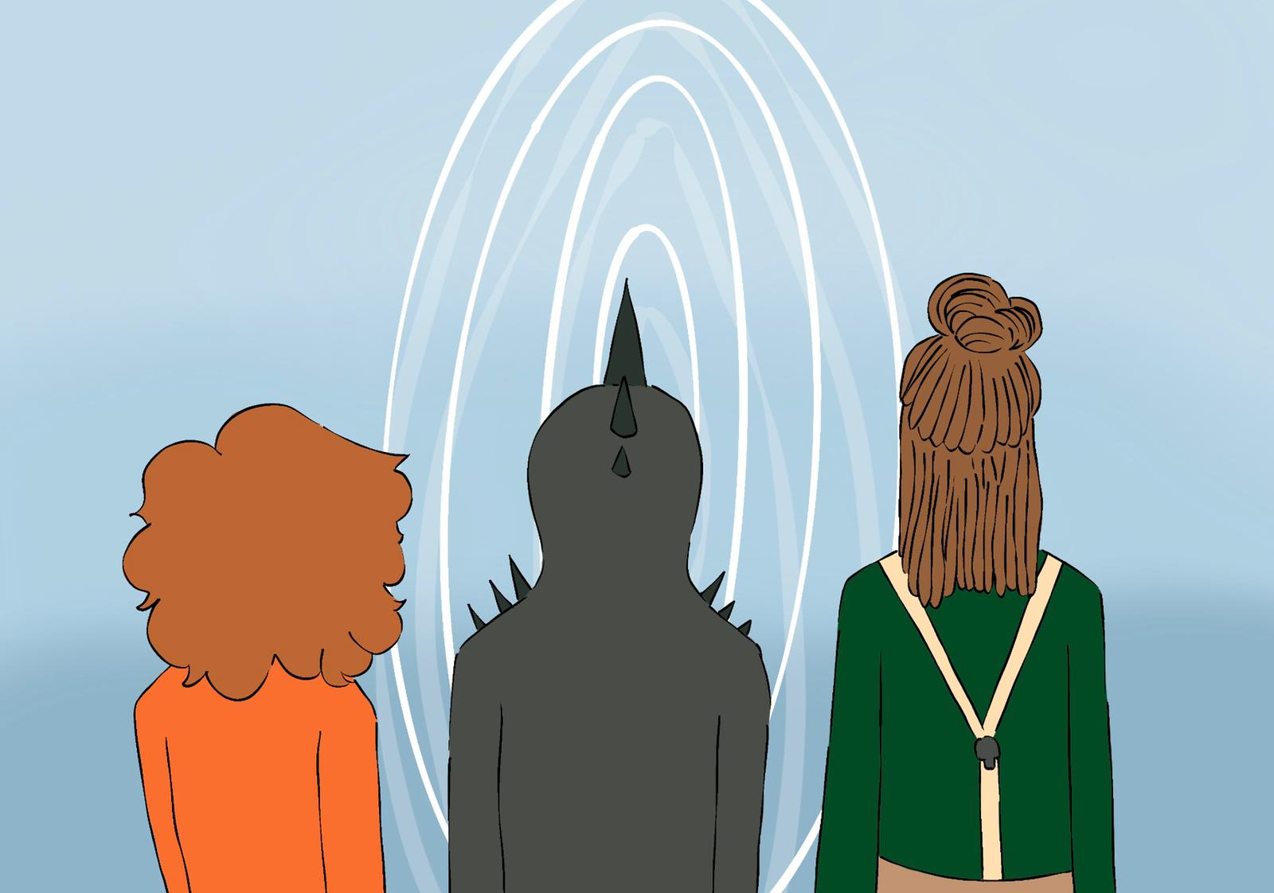

Slide 37
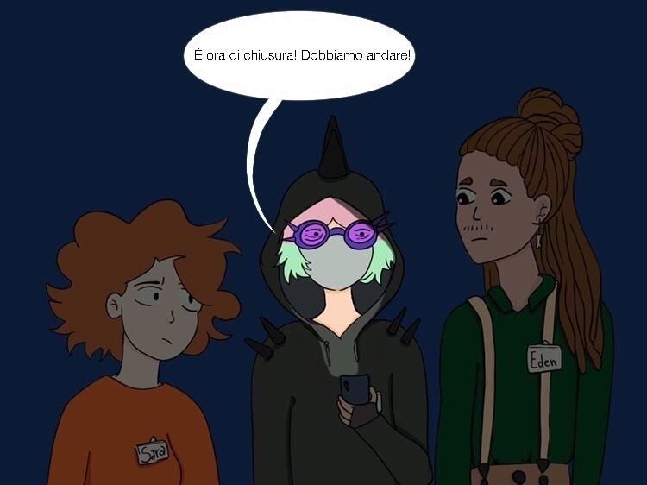
The Museum is about to close.
We’d better hurry up.

Slide 38
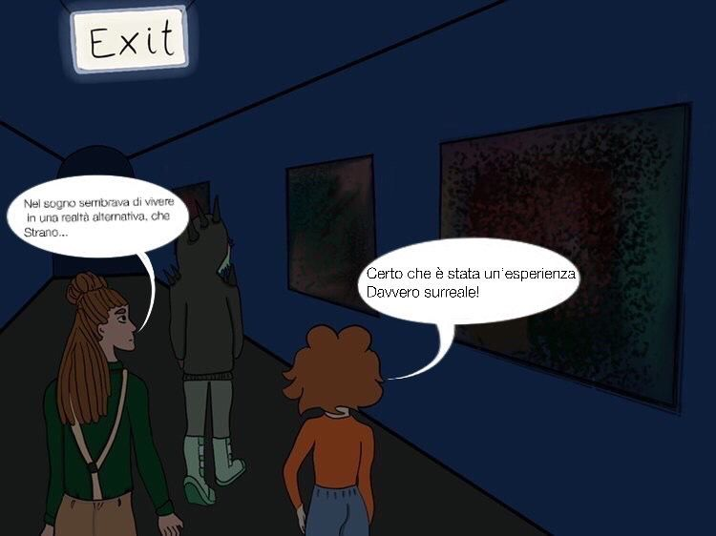
Very exciting!
We really took a close look at those works of art!
It ‘s been a truly surreal experience!
THE END

