Slide 1
Open Educational Resources (OER)
Nowadays, everywhere in the world, children and young people need to be trained to face
challenging social, emotional and economical problems they will confront with - as adults -
both in their personal lives and in the context of the wider world.
In order to do so, they must DEVELOP HIGHER LEVEL THINKING SKILLS which, we believe,
WILL FLOURISH IF ENCOURAGED TO BE CREATIVE, INNOVATIVE, INGENIOUS AND ADAPTABLE.
The present Open Educational Resources (OER) have been designed within the Creative School Project, whose objective
is to develop teaching/learning modules for school teachers and students, PROMOTING SELF-DIRECTED LEARNING AND CRITICAL AND VISUAL THINKING SKILLS, using CULTURAL HERITAGE CONTENTS made available by the Institutions and Organizations the Creative School Project Partners belong to.
The BENEFICIARIES of the present Open Educational Resources are:
PRIMARY AND SECONDARY SCHOOL TEACHERS who, through engaging with the Project, will become equipped with the skills necessary to facilitate pedagogical strategies for creativity and critical thinking;
CHILDREN AND YOUNG PEOPLE which will use the OER developed by the Project.
Please note, that OER TOPICS HAVE BEEN SELECTED BY AN INTERNATIONAL GROUP OF TEACHERS AND EDUCATORS from Austria, Croatia, Finland, France, Ireland, Italy and the United Kingdom, through focus groups and surveys.
We hope the present materials enrich your teaching resources and foster creative and critical thinking among students.
https://www.creative-school.eu
The Creative School project has been funded with the support of the European Union and the French National Agency for the Erasmus+ Programme (Grant Agreement 2019-1-FR01-KA201-062212). This publication reflects the views only of the author, and the European Union and the French National Agency for the Erasmus+ Programme cannot be held responsible for any use which may be made of the information contained therein.
Materials can be used according to the: Creative Commons Non Commercial Share Alike license

Slide 2
Practical approaches to teaching with objects
Self-directed training module
Open Educational Resource prepared for the Creative Schools project
Notes:
Overview of the OER
This self-directed training module will examine the different approaches to teaching with objects with formal education. Starting from the theoretical lens of socio-cultural and constructivist learning theories of Vygotsky, the resource will explore the ways in which objects can be used to scaffold meaning-making in different educational contexts, with a focus on schools, further education and higher education.
The resource introduces the concept of collective thinking, collaborative interaction and sign-making in the meaning-making process, drawing on the work Edwina Taborsky to understand how objects generate meaning and interpretation.
By following the steps in the resource participants will look at the anatomy of an object to explore critical and creative thinking and investigate the use of visible thinking strategies to ‘dissect’ objects. Participants will also be encouraged to consider and discuss the particular challenges and opportunities of delivering multisensory approaches using objects online and how to engage learners virtually.
The resource includes a number of practical activities to illustrate the uses of objects in teaching either in the classroom or the virtual classroom. The practical element will consider the uses of handling objects, replica objects, realia, digital cultural heritage as well as the physical objects from museum collections.

Slide 3
Overview of the module
Summary:
Introduction to object-based learning
Exploring the benefits of object-based learning
Guiding a discussion using objects
Developing Inquiry dialogue and ‘acts of wondering’
Examples of using OBL in discussion
Resources:
Introductory video
PowerPoint
Quiz
Notes:
Overview of the module
Note on terminology – this resource refers to the ‘educator’ this could be a teacher, lecturer or museum educator / facilitator / mediator / guide.

Slide 4
Learning objectives
What is OBL?
Learning outcomes
Describe key features of OBL for use in museum learning
Apply this knowledge and understanding in using OBL with learners onsite / online
Understand when and how to apply different questioning techniques / facilitation skills on OBL online
Understand how to use OBL with learners online / onsite
Types of questions to use when working with OBL online / onsite
Think in a creative and critical way about using objects in the classroom;
Explore different ways of teaching through objects;
Use OBL for interdisciplinary and cross-curricular teaching.

Slide 5
Part 1: Introducing object-based learning

Slide 6
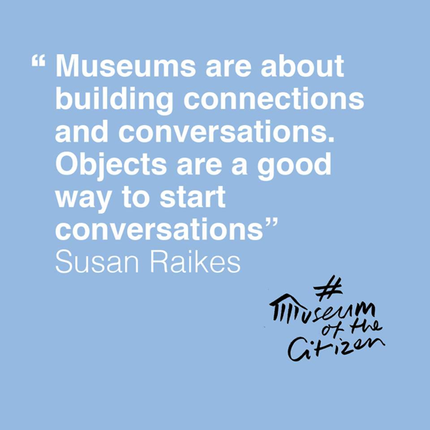
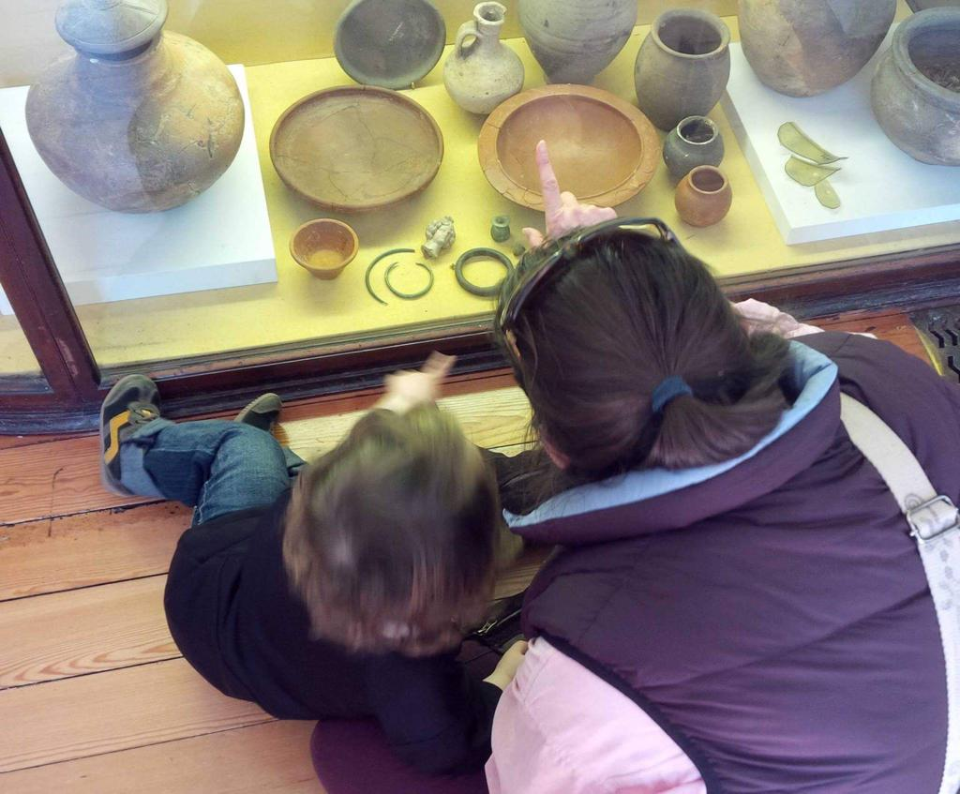

Slide 7
What is object-based learning?
“Object-based Learning (OBL) is a student-centred learning approach that used objects to facilitate deep learning. The use of objects can act as multi-sensory “thinking tools” to promote learning. The objects are used to stimulate the learners’ imagination and to help them apply their understanding to other contexts and problems. The central proposition of OBL is that working with objects mediates and strengthens learning” (Romanek & Lynch, 2008)
Notes:
Definition
OBL draws on social-cultural constructivist learning theory of Vygotsky, where objects (and the educator) are used to scaffold semiotic mediation, drawing on learners experiences and personal knowledge. Object-based learning in a formal learning setting draws on 3 key assumptions: socially-mediated activity design; collective thinking and collaborative interaction. OBL also draw on experiential learning theories of Kolb.

Slide 8
Benefits of OBL: list from www.flinders.au
OBL engages the senses, particularly touch, sight and smell;
OBL accommodates different learning styles;
OBL motivates deep learning;
OBL provides experiential engagement with primary research methods and materials;
OBL exposes students to complexity and ambiguity, to open-ended meanings and differing points of view;
OBL can help students grapple with ‘troublesome’ knowledge;
OBL develops observation skills and visual literacy;
OBL exercises and advances employability skills including critical and creative thinking, problem solving and oral communication skills;
OBL complements digital, lecture and text-based teaching approaches;
OBL promotes interdisciplinary connections and exchange
Notes:
Benefits of OBL(from Flinders University / FUMA)
This is list has been compiled by Flinders University / Flinders University Museum of Art. It is a useful checklist of the key benefits of OBL in formal education settings from schools to universities. Some of these are specific to formal education environments.

Slide 9
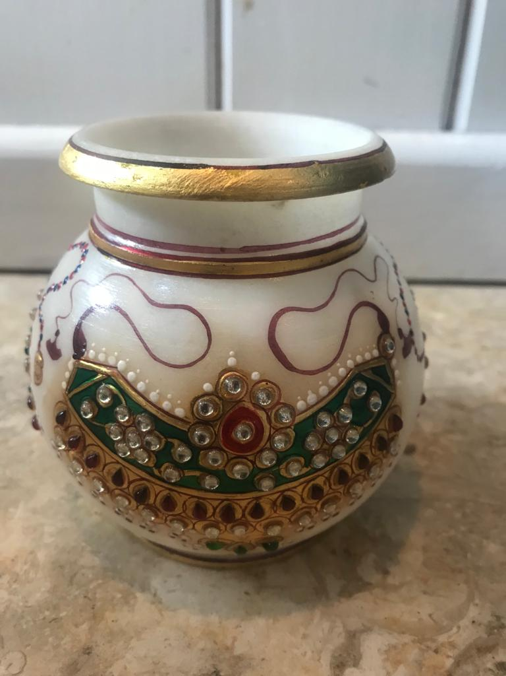
Activity: 20 questions
Choose an object
Write down as many questions as you can about the object eg How old is it?
Count up how many questions you have made.
Can you group the questions into concepts or ideas?
Notes:
20 Questions
Choose an object for this activity
You don’t have to choose a museum object, it can be something from the home, something you bought on a holiday or something you were given.
Write down as many questions as you can about the object
Sometimes it helps to frame this activity as ‘if this object could speak, what could I ask it?
Questions could be: How old is it?
Count up how many questions you have made.
As a guide 10-15 is good; 15-20 is excellent
Can you group the questions into concepts or ideas?
You will find there are common themes that emerge based on the materials; design; ownership; value; age etc.

Slide 10
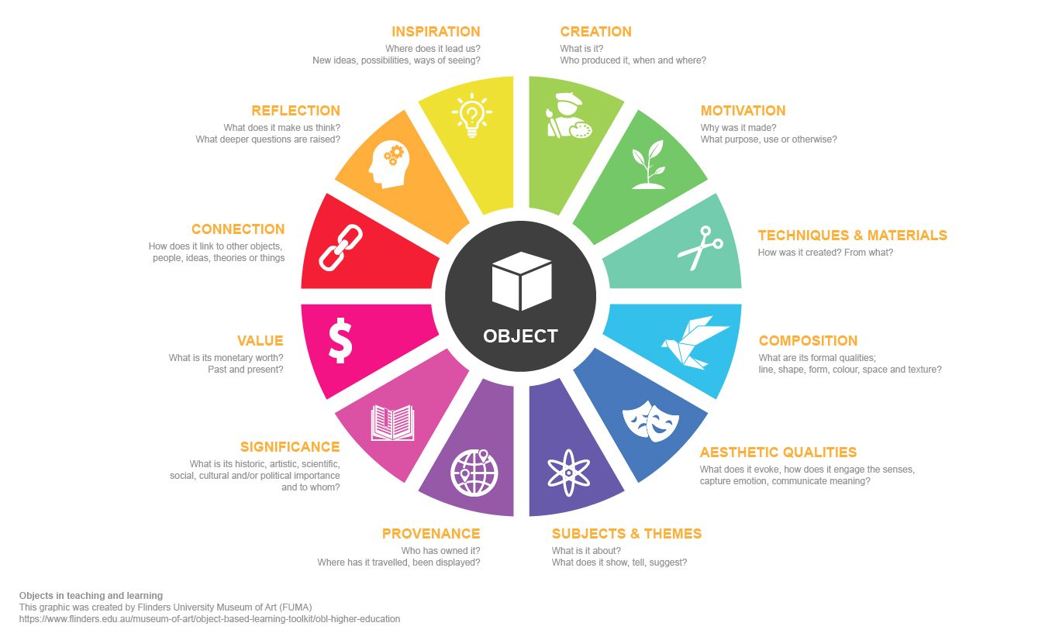
Notes:
The anatomy of an object
This graphic is a wonderful visualization of different ways of understanding and thinking about objects. The previous 20 questions activity.

Slide 11
Part 2: Critical thinking skills and creative inquiry

Slide 12
Critical thinking skills
Knowledge
Comprehension
Application
Analysis
Synthesis
Evaluation
Notes:
Critical thinking skills
There are several different models which approach different critical thinking skills. This list is taken from a popular model used in education based on Bloom’s Taxonomy (1984). There are variations and revisions of this which exchange knowledge for ‘remembering’ and evaluation for ‘creating’. Bloom argued that that there were 6 levels of learning. In Bloom’s original taxonomy there was a clear hierarchy or process through the different ‘levels’. In practical teaching terms, the process isn’t that simplistic and a task may involve some but not all category.
Here is a brief explanation of each category based on Bloom. [Accessed online: https://kodosurvey.com/blog/blooms-taxonomy-levels-learning-complete-post]
Knowledge: This initial level involves recalling basic facts, processes, and methods, or patterns and structures.
Comprehension: This level refers to the learners’ understanding of the ideas and materials presented at the first level. At this stage, they won’t necessarily be able to see the full implications or their knowledge or be able to relate it to other material.
Application: At this level of thinking, learners should be able to use their knowledge and understanding in certain situations.
Analysis: At the analysis level, learners are expected to be able to articulate the relationship between different ideas and be able to breakdown their learning into elements or parts.
Synthesis: This level of thinking involves combining different ideas or elements to create new structures or ideas.
Evaluation: In the original Bloom’s taxonomy, ‘evaluation’ was the highest level of thinking and was thought to require the most complex mental processes. At this level, learners are expected to make judgments about the value of the methods or materials presented to them.
This was revised in 2001.

Slide 13
Activities during the museum visit
LOCATE
Imagine, Reflect and Evaluate
Look
Find out ABOUT
Draw/Make/create
Discuss, Speculate, Deduce
Notes:
Activities during a museum visit or using objects in the classroom
In a very loose way these activities can be mapped onto Bloom’s taxonomy (either the original or revised).
Locate: find
Look:
Find out more:
Deduce, speculate, deduce:
Imagine, reflect and evaluate:
Draw, make, create:
Guiding discussion using Socratic questioning
Clarifying questioning:
Challenging assumptions:
Using evidence in arguments:
Exploring alternative possibilities:
Considering the consequences:
Questioning the questions.

Slide 14
Part 3: Practical examples

Slide 15
Designing activities for OBL
Based on these principles:
Socially-mediated activity design
Dialogic learning
Collective thinking
Collaborative interaction
Critical thinking
Socratic questioning

Slide 16
Activity: Mystery object
This activity is based on the principle of description, speculation and deduction
Select an object – it could be a digital or physical object
Ask the students to describe the object
Next, ask the participants to think about what the object might be
Finally, ask the students to draw some conclusions about the object
Notes:
Activity: Mystery object
This activity is based on concept of Jules Prown about approaches to material culture.
The role of the educator

Slide 17
Activity: Animal, vegetable mineral
Question words:
Who, when, what, where, why, how?
Categories:
Material, shape, colour, size, use / purpose, age, origin, value,
Digging deeper:
What do you think? Why do you think that?
Notes:
Activity: Describing an object

Slide 18
Part 4: Extension activities

Slide 19
Ideas for cross-curricular extension activities
Art: draw, create and make
Dance: pose, move and sway
Design and Technology: design and do
Drama: act out, storytelling, role play, improvisation, freeze frame
Food technology: bake and taste
Geography: draw, map, explore
History: create a diary, write a letter
Literacy: talk for writing, fiction and non-fiction
Maths: count
Music: sing, listen, accompany
Science: investigate and observe
Notes:
Ideas for cross-curricular extension activities
Objects can inspire and fire the imagination. Here is a starting list of follow up activities you can use to develop your students responses to objects.
See the worksheet in the OER for more complete ideas.

Slide 20
Part 5: Summary and links

Slide 21
Summary
Using an object to spark a discussion
Encourage participants to think, evaluate and imagine
Linking museum objects using objects which can be found at home (realia)
Use objects for concept development (eg the raisins / dried fruit)
Drawing on the familiar to the unfamiliar
Encourage participants to share ideas and contribute in a ‘safe space’
Use objects to describe, speculate and evaluate

Slide 22
OBL Links
Introduction to OBL (video): www.smithsonianmag.com/videos/05-object-based-learningmp4/
OBL Toolkit: https://www.flinders.edu.au/museum-of-art/object-based-learning-toolkit/obl-higher-education
OBL / UCL: https://www.ucl.ac.uk/culture/schools/teaching-object-based-learning
Durbin, Morris and Wilkinson (1990), Taborksy (1990); Pearce (1990), Hooper-Greenhill (1999), Fulk and Dierking (2000, 2008), Paris (2002), Lane and Wallace (2007), Romanek and Lynch (2008), Chatterjee (2015)

Slide 23
Critical thinking and questioning links
Critical thinking skills (also known as strategies): https://www.flickr.com/photos/vblibrary/4576825411 (This looks in detail at the types of activities and questions at each stage)
48 Questions: https://www.educatorstechnology.com/2017/01/48-questions-to-help-students-develop.html
Socratic questioning: https://www.teachwithmrst.com/post/socratic-questioning

Slide 24
Part 6: Quiz

Slide 25
Activity: Quiz - thinking about OBL in your practice
What does OBL mean to you in your educational setting?
How would you use OBL in your setting?
Can you think of one example where you might immediately use OBL?
What follow up or extension activities could you do with your learners?

