Slide 1
Open Educational Resources (OER)
Nowadays, everywhere in the world, children and young people need to be trained to face
challenging social, emotional and economical problems they will confront with - as adults -
both in their personal lives and in the context of the wider world.
In order to do so, they must DEVELOP HIGHER LEVEL THINKING SKILLS which, we believe,
WILL FLOURISH IF ENCOURAGED TO BE CREATIVE, INNOVATIVE, INGENIOUS AND ADAPTABLE.
The present Open Educational Resources (OER) have been designed within the Creative School Project, whose objective
is to develop teaching/learning modules for school teachers and students, PROMOTING SELF-DIRECTED LEARNING AND CRITICAL AND VISUAL THINKING SKILLS, using CULTURAL HERITAGE CONTENTS made available by the Institutions and Organizations the Creative School Project Partners belong to.
The BENEFICIARIES of the present Open Educational Resources are:
PRIMARY AND SECONDARY SCHOOL TEACHERS who, through engaging with the Project, will become equipped with the skills necessary to facilitate pedagogical strategies for creativity and critical thinking;
CHILDREN AND YOUNG PEOPLE which will use the OER developed by the Project.
Please note, that OER TOPICS HAVE BEEN SELECTED BY AN INTERNATIONAL GROUP OF TEACHERS AND EDUCATORS from Austria, Croatia, Finland, France, Ireland, Italy and the United Kingdom, through focus groups and surveys.
We hope the present materials enrich your teaching resources and foster creative and critical thinking among students.
https://www.creative-school.eu
The Creative School project has been funded with the support of the European Union and the French National Agency for the Erasmus+ Programme (Grant Agreement 2019-1-FR01-KA201-062212). This publication reflects the views only of the author, and the European Union and the French National Agency for the Erasmus+ Programme cannot be held responsible for any use which may be made of the information contained therein.
Materials can be used according to the: Creative Commons Non Commercial Share Alike license

Slide 2
Climate change investigation
Open Educational Resource
For students from 14 to 18 years old

Slide 3
1. STARTING THE INVESTIGATION
Source: wikimedia commons

Slide 4
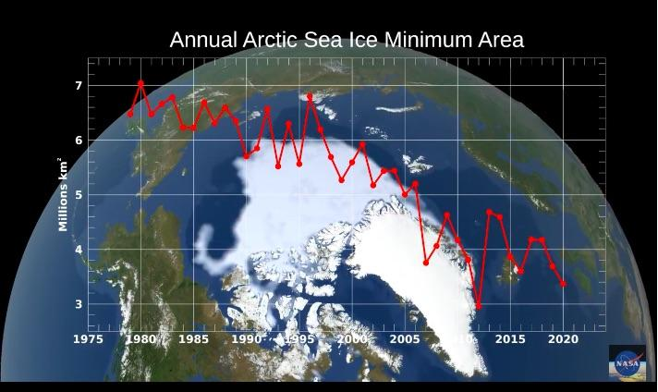
1. Starting the investigation
« Let’s observe the progressive melting sea ice (pack ice) in the North Pole. This is a NASA video showing the evolution of the sea ice surface over the last 40 years. »
« This melting also concerns the glaciers.
We have many fears about melting glaciers. And among our fears, there is the fear of losing part of our archives… which archive do you think is being referred to? ”
Source : NASA Video https://climate.nasa.gov/climate_resources/155/video-annual-arctic-sea-ice-minimum-1979-2020-with-area-graph/

Slide 5
1. Starting the investigation
« Cycles of natural variability are known to play a role in the extent of the Arctic sea ice, but the sharp decline cannot be explained by natural variability alone. Natural variability and rising global temperatures have contributed to the melting of larger amounts of Arctic sea ice. Some specialists predict an ice-free Arctic for at least part of the year by the end of the 21st century. *
* Caption of the video on Nasa’s website
Source : NASA Video https://climate.nasa.gov/climate_resources/155/video-annual-arctic-sea-ice-minimum-1979-2020-with-area-graph/

Slide 6
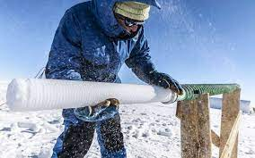
1. Starting the investigation
«This is the picture of the Subglacior project, undertaken by glaciologists from the Laboratory of Glaciology and Geophysics of the Environment (LGGE) and the Grenoble Observatory for the Science of the Universe (OSUG), whose ambition is to go back 1.5 million years!»
Picture of an ice core.
Source: CNRS https://www.sciencesetavenir.fr/nature-environnement/climat/antarctique-remonter-jusqu-a-il-y-a-1-5-million-d-annees_132850

Slide 7
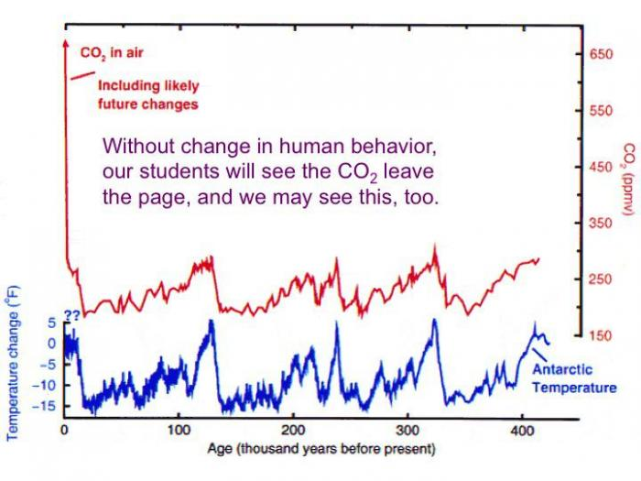
1. Starting the investigation
Figure: Variations in temperature and concentration recorded in Vostok ice core in Antarctica.
« What do you notice? »
Source: Le Laboratoire de Météorologie Dynamique https://www.lmd.jussieu.fr/~crlmd/simclimat/documentation_2019_english/node14.html

Slide 8
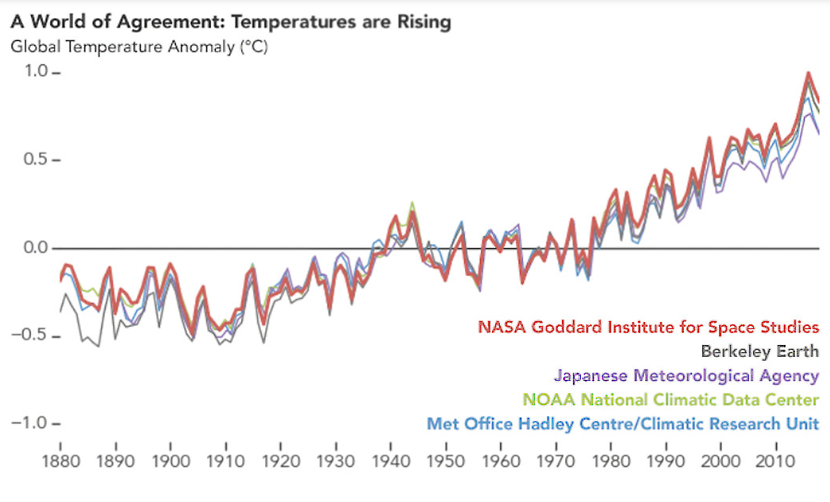
1. Starting the investigation
Focus on the temperatures of recent years
« Let's take a closer look at the trend in recent years: There is an increasing positive deviation from the average. This results in a sudden increase in temperature. »
Source: NASA - https://climate.nasa.gov/scientific-consensus/
Notes:
- Shall you please insert in the Word file a description of this graph?
- It should be made clearer that it represents the revelations made by 5 independents organizations all over the world. This implies that the measurements are not subject to political pressures and are reliable.
- It could also be useful to add the links to the webpages of these organizations.
Shall you add and explanation about what or who Cowtan and Way are? We found that they are two authors but didn’t fully understand the impact of their works.
Shall you add the source of this graph?
Who’s talking? Who pronounces the phrases in blue?

Slide 9
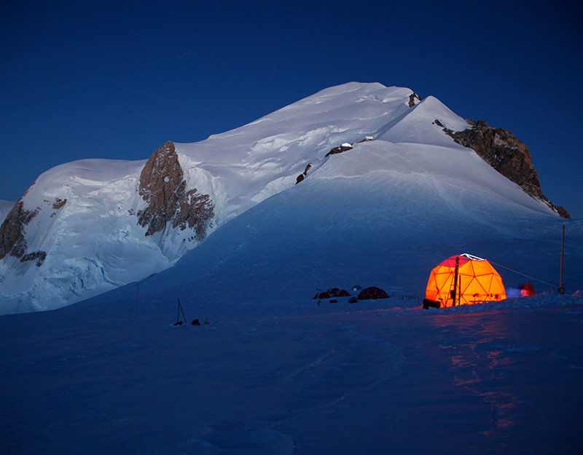
1. Starting the investigation
Focus on the temperatures of recent years
« Ice archives are therefore essential witnesses to the fact that there is currently rapid warming! Moreover, the composition of each air bubble informs us about past atmospheric compositions: this is essential for understanding the mechanisms of the current climate. So we need to preserve them and find out what is causing this sudden warming.
This is the subject of our investigation and I need your help to make rapid progress on this matter. It is urgent! »
Source picture from Air Liquide Magazine

Slide 10
2. THE SUSPECTS

Slide 11
2. The suspects
« What do you think is the cause of global warming?... »

Slide 12
2. The suspects
« Is it the only cause?»

Slide 13
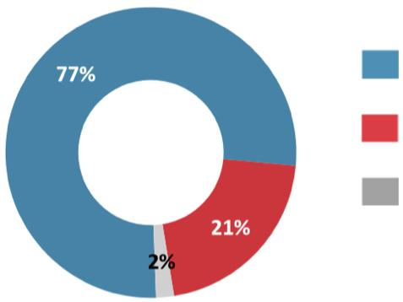
2. The suspects
Results of a survey carried out on a sample of 798 French people.
…that global warming is caused by human activities
…that it is only a natural phenomenon that has always existed
… no opinion
Source: ADEME (French ecological transition Agency) - Social representations of the greenhouse effect

Slide 14
2. The suspects
« Regarding the results of the survey.. What do you think of these results?
If I ask you again: Who thinks that global warming is caused by human activities?
Who thinks that it is only a natural phenomenon that has always existed?
Who thinks it is both?...
Who doesn't know?
What do you think about when we talk about human activities and when we talk about natural factors? »

Slide 15
2. The suspects
« In this high-profile global warming affair, it is indeed sometimes difficult to distinguish between what is true and what is false, to sort out the information...
Moreover, my colleagues have collected a large amount of data on several suspects, and it is up to us to classify and then analyse it in order to evaluate, if possible, the potential involvement of these factors in global warming. »

Slide 16
2. SUSPECT N°1 : THE SUN

Slide 17
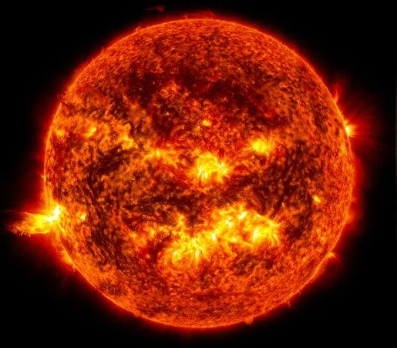
Suspect n°1: the sun
SUSPECT SHEET
Age : 4.57 billion years
Life expectancy : 10 billion years
Diameter : 14 million kilometres
Number : one
Activity : light energy 1360 watts per square metre
Origin : natural
Composition :
73% hydrogen
25% helium
2% other elements
Source: Futura Sciences https://www.futura-sciences.com/sciences/questions-reponses/astronomie-temperature-soleil-6296/

Slide 18
Suspect n°1: the sun
«The Sun alone provides 99.99% of the energy that enters our environment on Earth.
This abundant energy reaches us mainly in the form of radiation, including visible light, infrared and ultraviolet radiation. »
« Who thinks that the sun may be responsible for the current global warming? Why or why not?
« Do you think global warming is a natural or human-made phenomenon?»
Source: Futura Sciences https://www.futura-sciences.com/sciences/questions-reponses/astronomie-temperature-soleil-6296/

Slide 19
Suspect n°1: the sun
« The flow of solar energy received on the Earth's surface and the insolation varies essentially because of the rotational movement of our planet around its axis of rotation, which is the origin of the alternation between day and night. And it also varies with the movement of revolution in its orbit around the Sun, which is the origin of the alternation of seasons.
Source: Futura Sciences https://www.futura-sciences.com/sciences/questions-reponses/astronomie-temperature-soleil-6296/

Slide 20
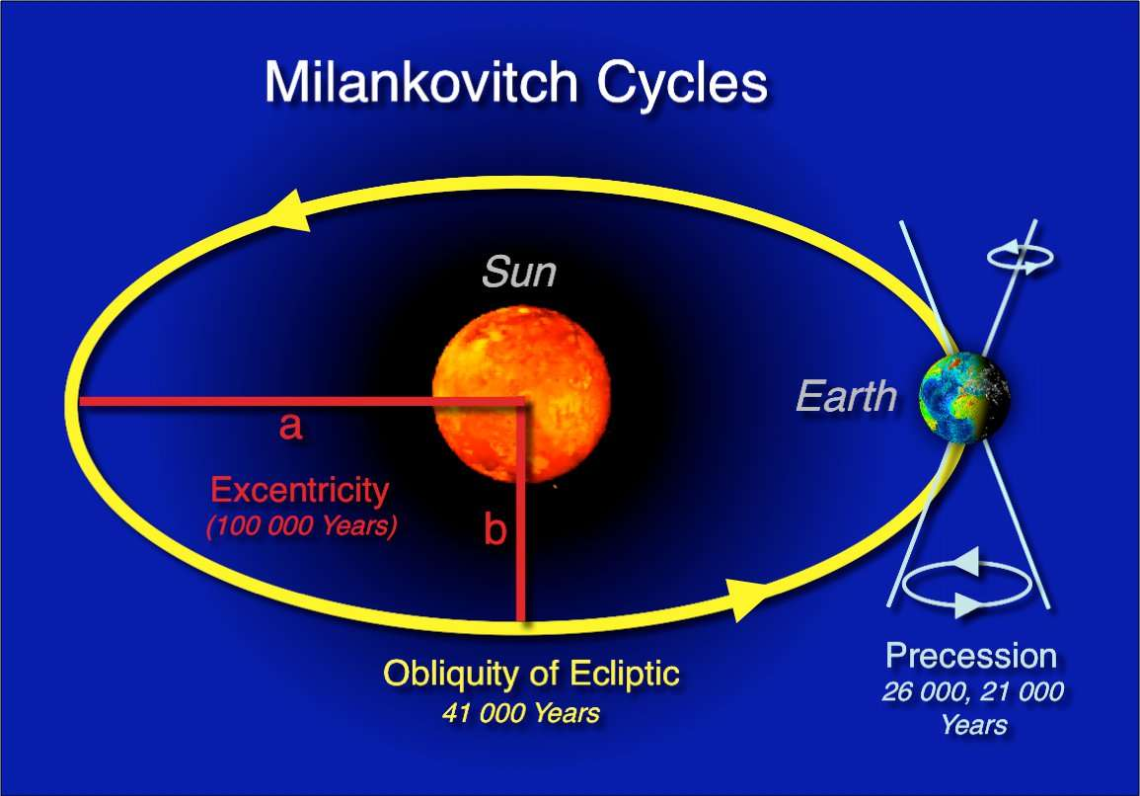
Suspect n°1: the sun
Milutin Milankovitch cycle.
Cycles are perceptible in the climatic archives of ice cores. The flow of energy radiated by the Sun, the irradiance (expressed in W_m-2), was for a long time considered to be constant, hence its name of "solar constant".
It was not until the extremely precise measurements obtained by satellites since the 1960s that it was shown that this 'constant' is in fact variable, but only very slightly on a human scale. »
Source: © Hannes Grobe, Alfred Wegener Institute for Polar and Marine Research

Slide 21
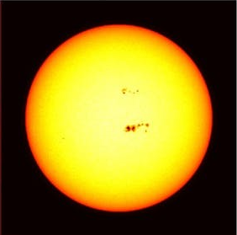
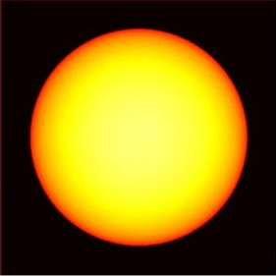
Suspect n°1: the sun
« The sun has been observed and studied for a very long time, but systematically since the beginning of the 16th century, thanks in particular to the diffusion of the astronomical telescope. Here is what can be observed ».. What difference do you see between these two images?.. What hypothesis could we make?
Source: https://www.maxisciences.com/tache-solaire/un-satellite-de-la-nasa-observe-un-enorme-trou-a-la-surface-du-soleil_art39701.html

Slide 22
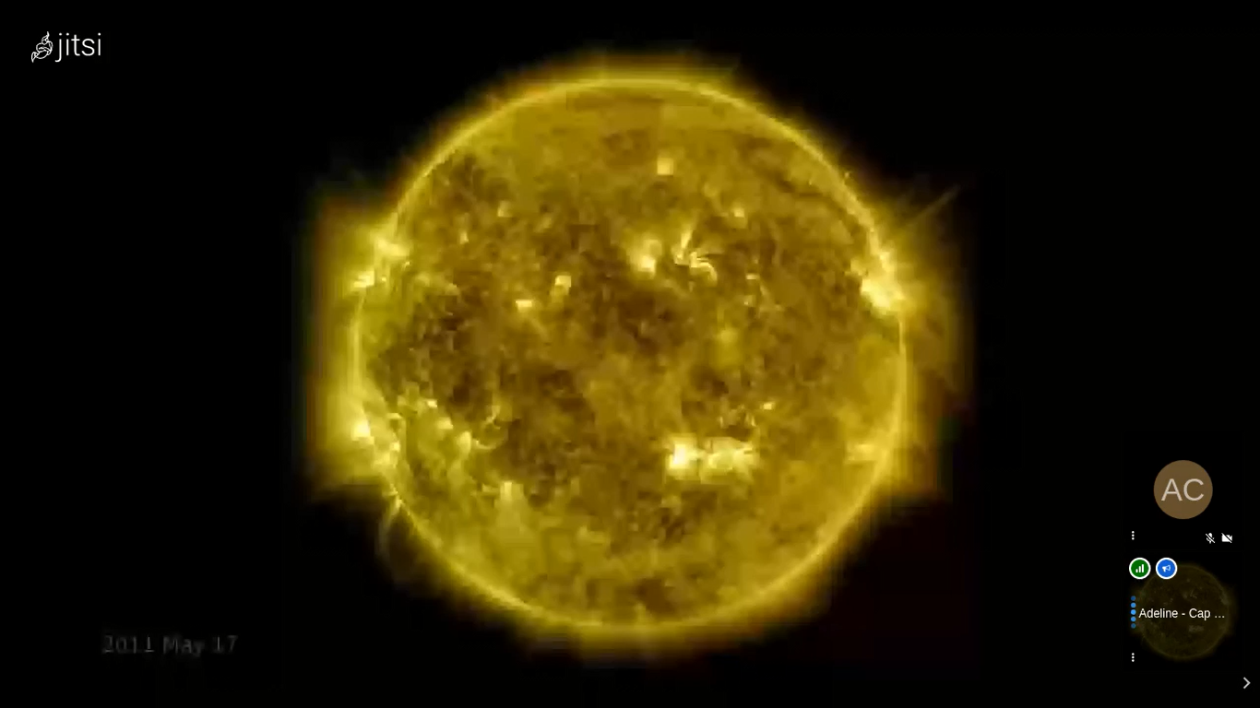
Suspect n°1: the sun
«The main indicator of the Sun's activity are sunspots, episodic dark spots on the surface of the star. Since the 16th century these spots have been counted continuously. This is the most famous time related series. Today, specialised satellites such as Ulisse, Soho (study of the solar corona with an artificial eclipse), Cluster and recently Solar orbiter study the sun more closely. NASA's Solar Dynamics Observatory project has recorded 11 years of solar activity.»
Source : NASA

Slide 23
Suspect n°1: the sun
The solar cycle is an approximately 11-year cycle experienced by the Sun. During the solar cycle, the Sun's stormy behaviour builds to a maximum, and its magnetic field reverses. Then, the Sun settles back down to a minimum before another cycle begins. «Here are the results of all the counts in different parts of the world since the 16th century. You can measure and count. There is inevitably information to recover. »
« What are the results of your observations?
Number
of spots
Years
Source: SILSO graphics (http://sidc.be/silso) Royal Observatory of Belgium 2019 September

Slide 24
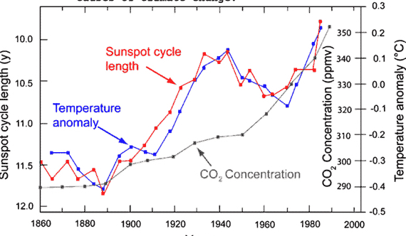
Suspect n°1: the sun
«And where are we today?.. Although we do not know exactly when the current minimum cycle will end, we have nearly three centuries of studies to predict it. On 9th of December 2019, the Space Weather Prediction Center (SWPC) announced that it would occur in April 2020, give or take six months. We are therefore at the very beginning of the 25th cycle in a secular period with rather low activity. Now we need to know whether this activity has an impact on solar radiation. »
Here is a second graph. What can we learn from it?
Sunspot cycle length
Source : https://coyoteblog.com/coyote_blog/tag/sunspot-cycle-length

Slide 25
Suspect n°1: the sun
Answer
«There is a correlation between the number of sunspots and the solar irradiance. But the variation in irradiance remains very small. Today we are at the very beginning of a new 'decadal' cycle and in a period of low global activity (secular cycle). Therefore, we are in a period of low irradiance. However, the temperature is rising independently of this activity. »
Sunspot cycle length
Source : https://coyoteblog.com/coyote_blog/tag/sunspot-cycle-length

Slide 26
Suspect n°1: the sun
“Where does the sun fit in: suspect or natural phenomenon? »

Slide 27
Suspect n°1: the sun
«However scientists consider that this activity can have an impact on regional temperatures. The most striking feature of the evolution of solar activity over the last few centuries is the absence of sunspots during a large part of the 17th century (the Maunder Minimum: MM). This was at the beginning of the Little Ice Age (there were only about 50 sunspots (instead of the usual 40-50,000)) and there is a general concensus* that the corresponding cooling is due to this phenomenon.» * Other parameters explain this cooling today, notably intense volcanic eruptions (Indonesian volcano Samalas). »

Slide 28
2. SUSPECT N°2 : THE GREENHOUSE EFFECT

Slide 29
Suspect n°2: the greenhouse effect
«The greenhouse effect is warming of Earth's surface and troposphere (the lowest layer of the atmosphere) caused by the presence of water vapour, carbon dioxide, methane, and certain other gases in the air.»

Slide 30
Suspect n°2: the greenhouse effect
«Two thirds of the energy from the sun is absorbed by the atmosphere, soil and ocean. The remaining third is reflected directly back to space by clouds, aerosols, the atmosphere and the earth's surface... It is in the atmosphere that the greenhouse effect, often cited when talking about global warming, occurs. »

Slide 31
Suspect n°2: the greenhouse effect
« Do you think that the greenhouse effect could be a suspect? »

Slide 32
Suspect n°2: the greenhouse effect
« If so, do you think the greenhouse effect is a recent phenomenon?
If not, when do you think the greenhouse effect was discovered?...
Let me introduce you 3 scientific experiments »

Slide 33
Suspect n°2: the greenhouse effect
First experiment by Joseph Fourier
“In the early 19th century, scientists had a suspicion that the earth’s atmosphere had the ability to keep the planet warm by transmitting visible light but absorbing infrared light (or heat), and that human activity could change the atmosphere’s temperature. One such scientists was Joseph Fourier who in his 1827 paper mentioned “the progress of human societies” having the potential to – in the course of many centuries – change the “average degree of heat Based on the heliothermometer invented by Saussure a few years earlier, Fourier gives the first description of what we call today the greenhouse effect: "the temperature is increased by the interposition of the atmosphere, because the heat finds less obstacle to penetrate the air, being in the state of light, than it finds to pass back into the air when it is converted into obscure heat".”
«

Slide 34
Suspect n°2: the greenhouse effect
Second experiment performed by Eunice Foote in the mid-19th century. E. Foot is one of the first American women scientists.
Source: Illustration Andrea D'Aquino

Slide 35
Suspect n°2: the greenhouse effect
«In 1856 Foote conducted a series of experiments that demonstrated the interactions of the sun's rays on different gases. She used an air pump, four mercury thermometers, and two glass cylinders. First she placed two thermometers in each cylinder, then by using the air pump, she evacuated the air from one cylinder and compressed it in the other. Allowing both cylinders to reach the same temperature, she placed the cylinders in the sunlight to measure temperature variance once heated and under different moisture conditions. She performed this experiment on CO2, common air, and hydrogen…
Source: Icons by Scribble.Liners

Slide 36
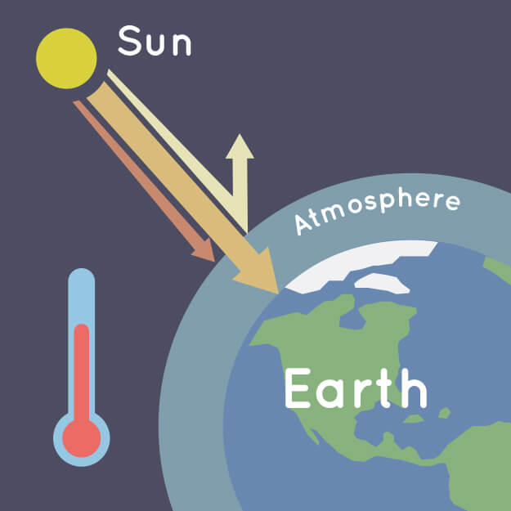
Suspect n°2: the greenhouse effect
“ …of the gases she tested, Foote concluded that carbon dioxide (CO2) trapped the most heat, reaching a temperature of 125 °F (52 °C). From this experiment, she stated « The receiver containing this gas became itself much heated—very sensibly more so than the other—and on being removed [from the Sun], it was many times as long in cooling. » Looking to the history of the Earth, Foote theorized that "An atmosphere of that gas would give to our earth a high temperature; and if, as some suppose, at one period of its history, the air had mixed with it a larger proportion than at present, an increased temperature from its own action, as well as from increased weight, must have necessarily resulted. »
Source : Illustration from NASA/JPL-Caltech

Slide 37
Suspect n°2: the greenhouse effect
Third experiment by John Tyndall
In 1859, Fourier’s theoretical musings were turned into experiments, when John Tydall, an Irish physicist, published his study investigating the absorption of infrared in different gases. This was the first experiment showing how heat absorption by the atmosphere could lead to temperature rises, and that certain gasses such as water vapor, methane, and CO₂ absorb more heat than others. Tyndall experiments were inspired by experiments made by Pouillet and he didn’t know about Foote’s experiments”

Slide 38
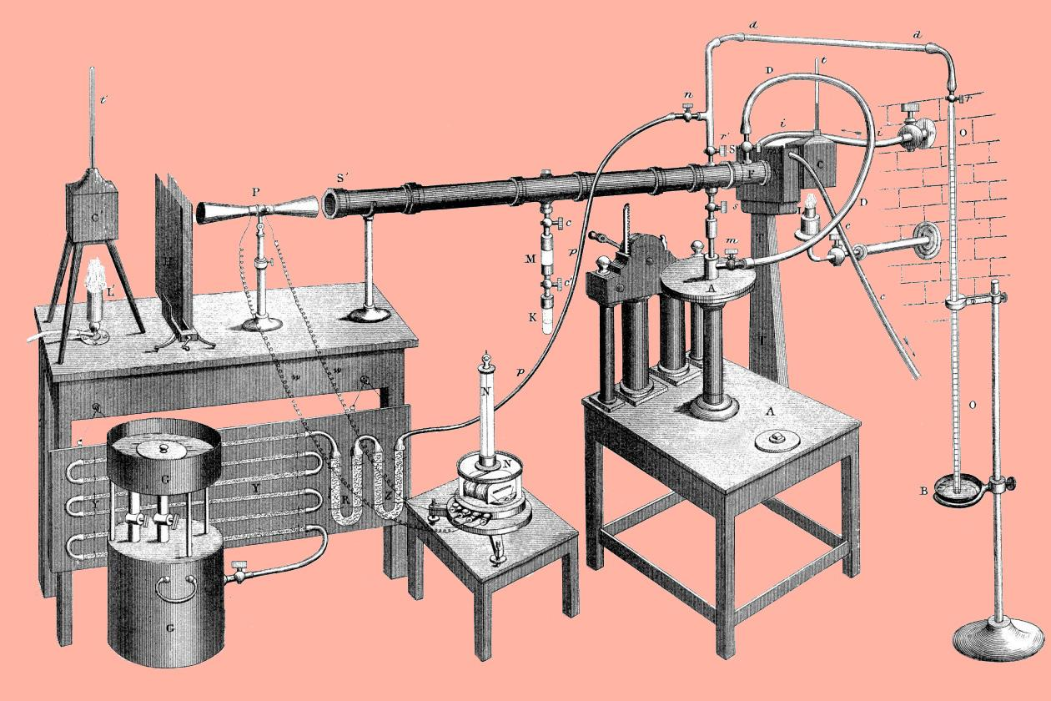
Suspect n°2: the greenhouse effect
Third experiment : John Tyndall's setup for measuring radiant heat absorption by gases.
37
Source : Wikimedia Commons

Slide 39
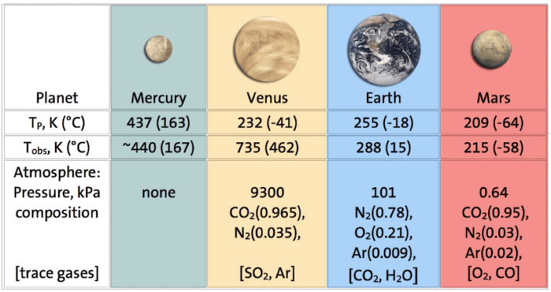
Suspect n°2: the greenhouse effect
Following these experiments, here are the characteristics of the 3 closest telluric planets to the sun - the range of surface temperatures show the importance of the presence of the atmosphere and its composition.
Table of the characteristics of the 3 closest telluric planets to the sun
Tp = Predicted surface temperatures
Tobs = Observed Surface Temperature
kPa : kilopascal
38
Source : American Chemical Society

Slide 40
Suspect n°2: the greenhouse effect
«To conclude, do you think the greenhouse effect is responsible for the current global warming?»

Slide 41
Suspect n°2: the greenhouse effect
«Indeed, the greenhouse effect is an "effect" and therefore, by definition, cannot be responsible. We cannot therefore classify it as a suspect. We must now study the suspects behind the increase in greenhouse gases effect.»

Slide 42
Conclusions
" It would seem that each of theses 2 suspects has its share of responsibility, but that humans are responsible for unprecedented levels of greenhouse gases emissions and climate change… »

Slide 43
Conclusions
« Moreover, the CCXG (Climate Change Expert Group) has been working on this issue : carbon dioxide accounts for by far the largest share of radiative forcing since 1990, and its contribution continues to grow at a steady rate. Carbon dioxide alone would account for a 36-percent increase in radiative forcing since 1990. Here below on the figure the results they obtained.»

Slide 44
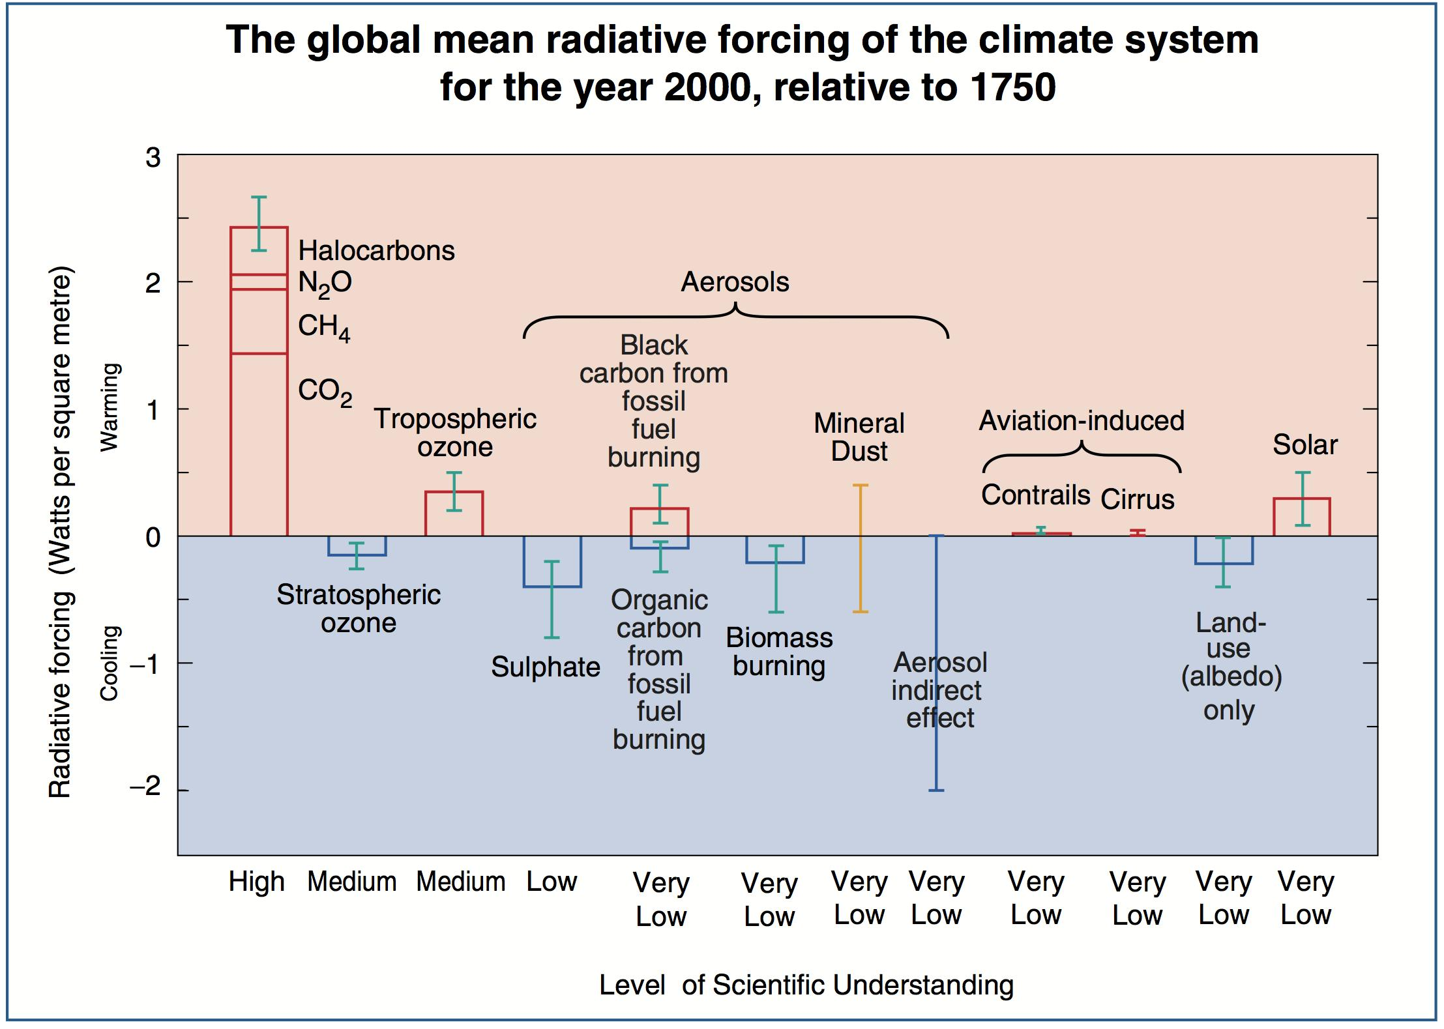
Conclusions
Source: 2001 IPCC Third Assessment report (TAR)

Slide 45
Conclusions
« Great work! »
«Your results are in line with those of the scientists! »

