Slide 1
Open Educational Resources (OER)
Nowadays, everywhere in the world, children and young people need to be trained to face
challenging social, emotional and economical problems they will confront with - as adults -
both in their personal lives and in the context of the wider world.
In order to do so, they must DEVELOP HIGHER LEVEL THINKING SKILLS which, we believe,
WILL FLOURISH IF ENCOURAGED TO BE CREATIVE, INNOVATIVE, INGENIOUS AND ADAPTABLE.
The present Open Educational Resources (OER) have been designed within the Creative School Project, whose objective
is to develop teaching/learning modules for school teachers and students, PROMOTING SELF-DIRECTED LEARNING AND CRITICAL AND VISUAL THINKING SKILLS, using CULTURAL HERITAGE CONTENTS made available by the Institutions and Organizations the Creative School Project Partners belong to.
The BENEFICIARIES of the present Open Educational Resources are:
PRIMARY AND SECONDARY SCHOOL TEACHERS who, through engaging with the Project, will become equipped with the skills necessary to facilitate pedagogical strategies for creativity and critical thinking;
CHILDREN AND YOUNG PEOPLE which will use the OER developed by the Project.
Please note, that OER TOPICS HAVE BEEN SELECTED BY AN INTERNATIONAL GROUP OF TEACHERS AND EDUCATORS from Austria, Croatia, Finland, France, Ireland, Italy and the United Kingdom, through focus groups and surveys.
We hope the present materials enrich your teaching resources and foster creative and critical thinking among students.
https://www.creative-school.eu
The Creative School project has been funded with the support of the European Union and the French National Agency for the Erasmus+ Programme (Grant Agreement 2019-1-FR01-KA201-062212). This publication reflects the views only of the author, and the European Union and the French National Agency for the Erasmus+ Programme cannot be held responsible for any use which may be made of the information contained therein.
Materials can be used according to the: Creative Commons Non Commercial Share Alike license

Slide 2
Subject:
Environment, Natural Sciences
Topic:
Biodiversity; Conservationism; Visual Arts
Age range:
7-11 years

Slide 3
Idea and graphic design project by:
Matilde Biondi and Sara Borella
~ 3 D, academic year 2020-2021 ~
~ High School for Arts F. Arcangeli ~
~ Bologna, Italy ~
With the supervision of STEPs srl - Italy

Slide 4
THE ADVENTURES OF
MAX, SAMIR AND BUZZYETTE

Slide 5
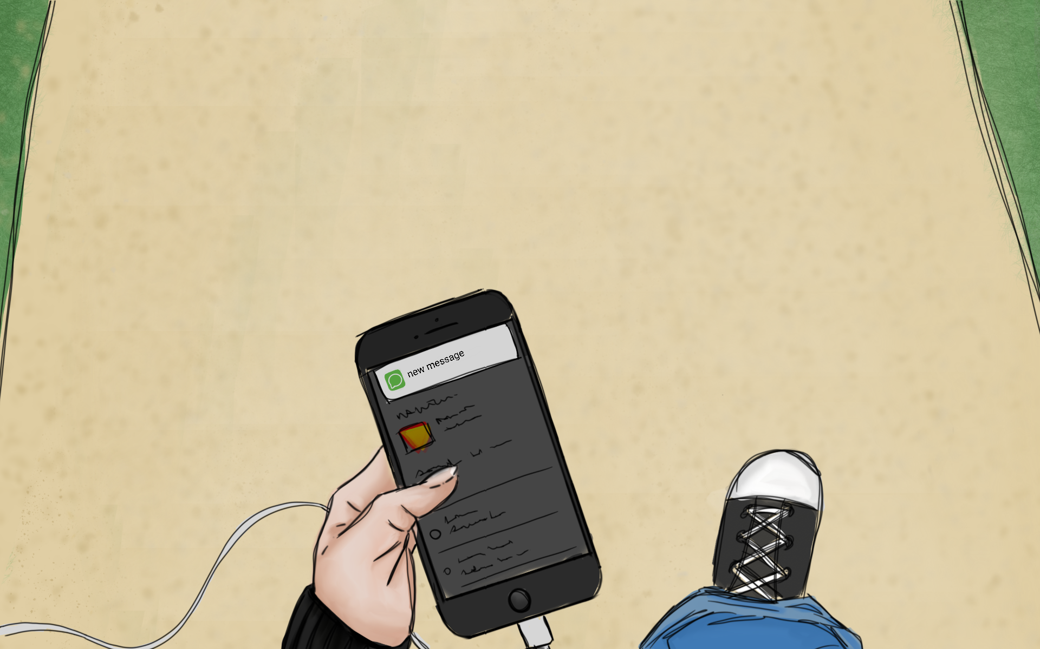
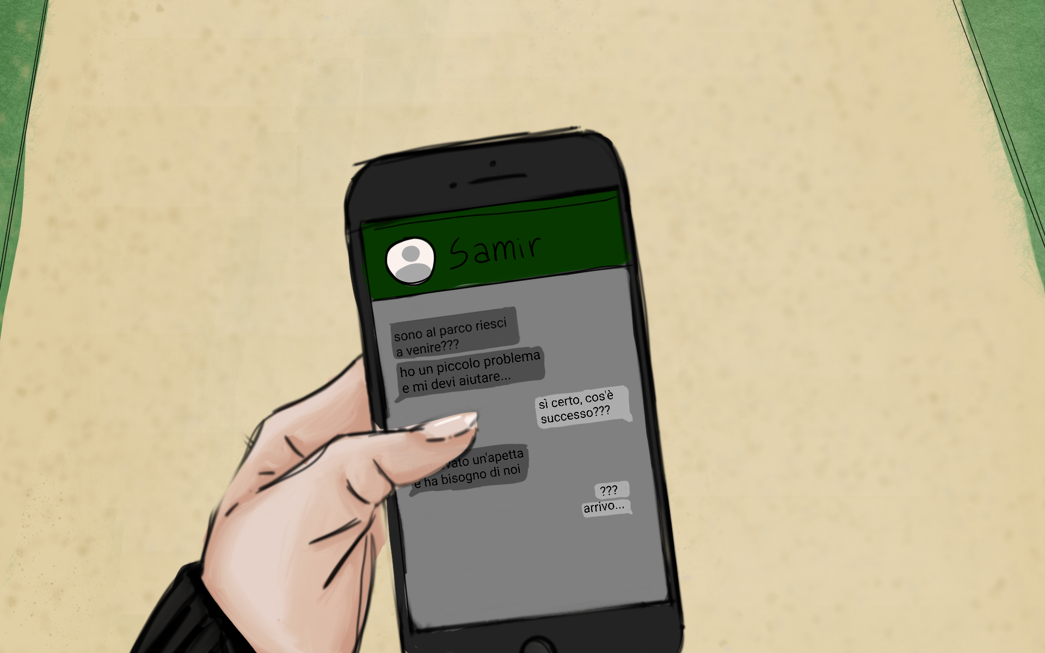
MAX IS ON HIS WAY BACK FROM SCHOOL, WHEN HE GETS A MESSAGE FROM HIS BEST FRIEND SAMIR , ASKING FOR HELP…..
“I’VE FOUND A LITTLE BEE IN DANGER! SHE NEEDS US!! COME!!”
“What??!! A bee..??”

Slide 6
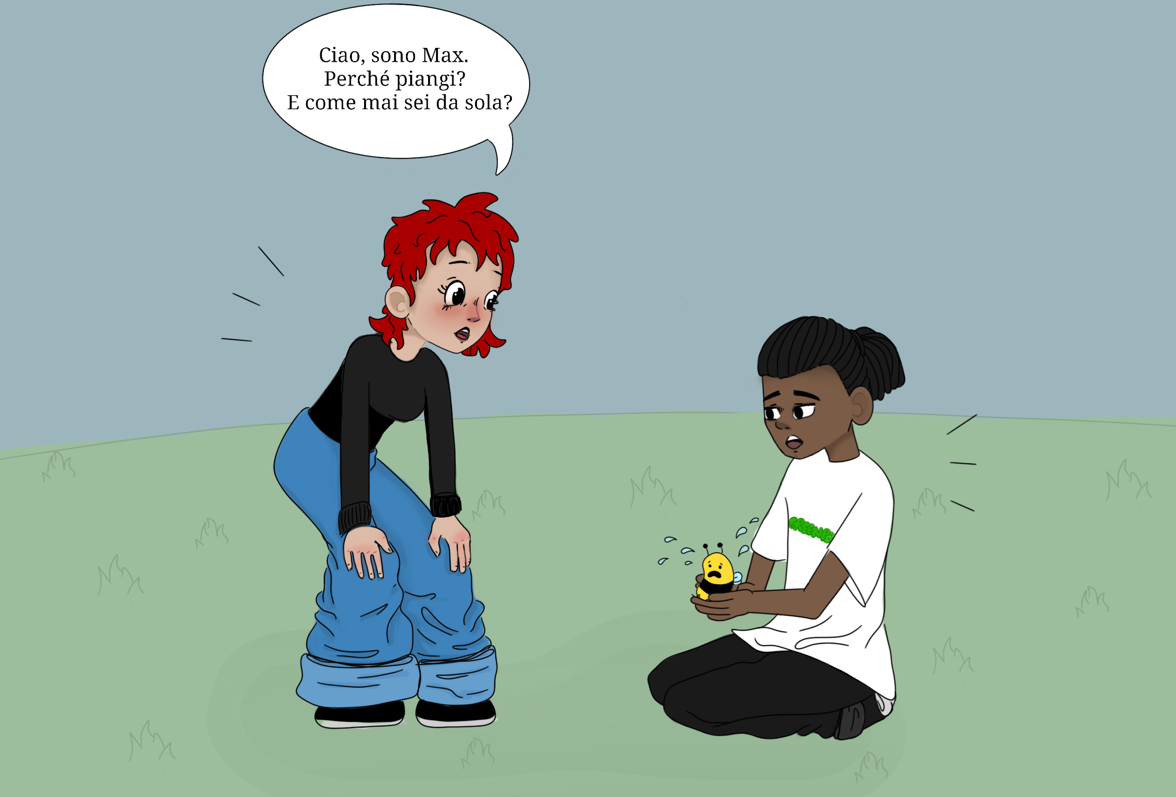
What happens? Why are you crying? Why are you alone?
Hallo little bee, I’m Max. And this is my friend Samir.
What’s your name?
Ohhh, this is a
VERY BAD PIECE OF NEWS !!
How do we do with no bees???
My name is Buzzyette.
All the bees of my hive are leaving the city BECAUSE THE AIR IS TOO POLLUTED HERE IN TOWN.
I am so sad!! I don’t want to leave, so I’m hiding from the other bees.

Slide 7
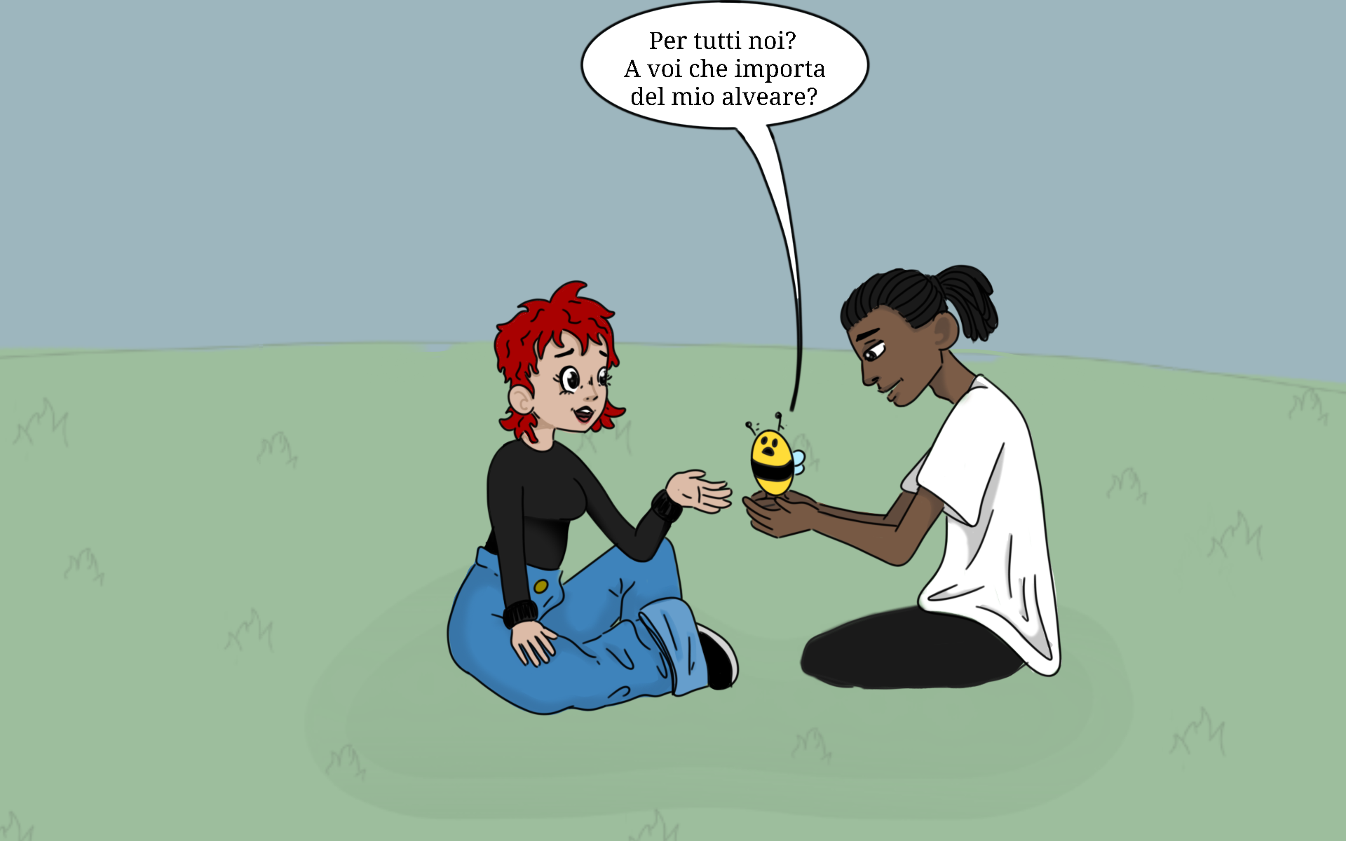
Samir is right!
HOW WILL WE SURVIVE WITH NO BEES ?
I don’t understand that.. What do YOU CARE ABOUT MY HIVE?
What does BIODIVERSITY mean?
BIODIVERSITY depends on you, as the greatest part of our FOOD !

Slide 8
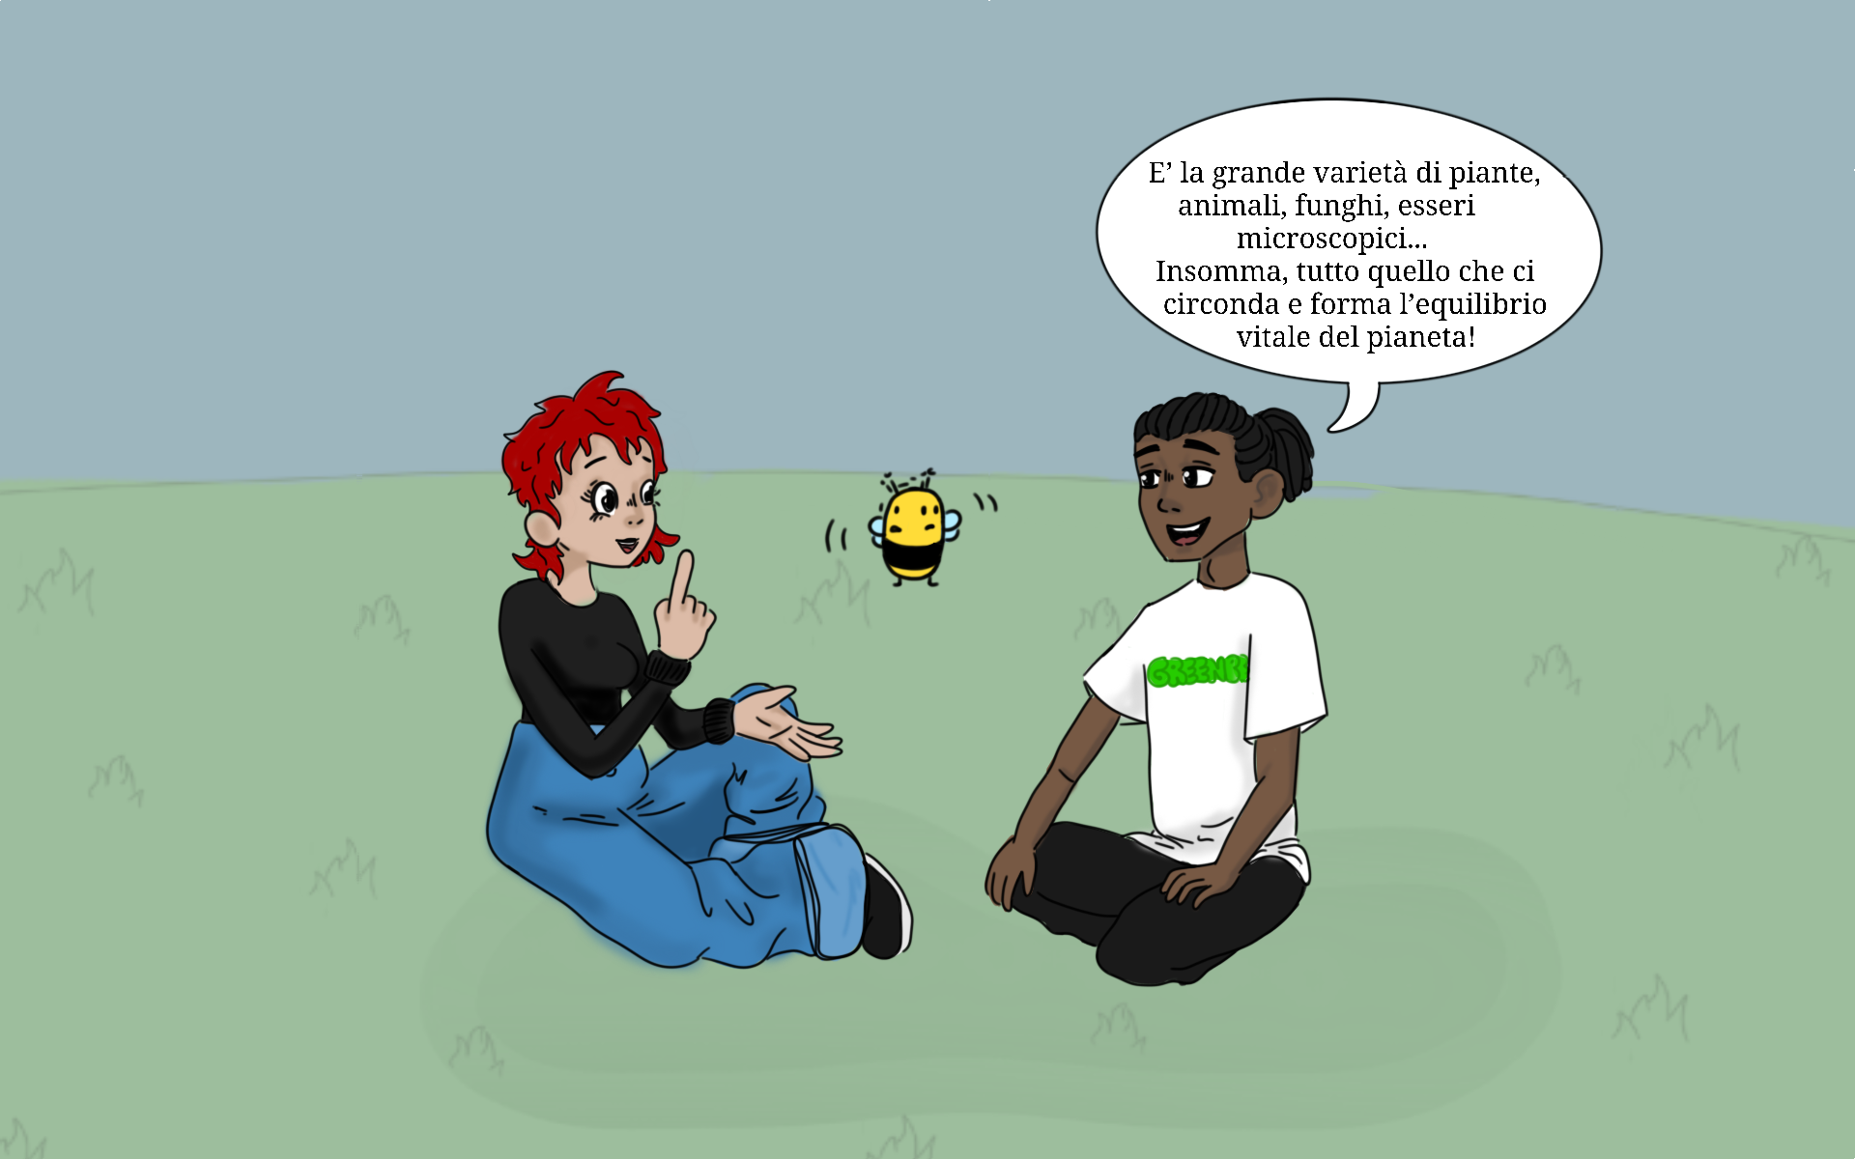
I don’t understand...
I am puzzled…..
WHAT HAVE I TO DO with biodiversity?!?
I ONLY FLY FROM FLOWER TO FLOWER to drink nectar!
BIODIVERSITY refers to all the VARIETY OF LIFE that can be found ON EARTH (plants, animals, fungi and micro-organisms) as well as to the COMMUNITIES that they form and the HABITATS in which they live.
When all these living beings SHARE the same ecosystem in HARMONY, the SYSTEM keeps itself IN A BALANCE.
And what does BALANCE mean??
And whom should I SHARE my hive with?

Slide 9
Ok, Buzzyette, listen!
Insects and other animals like you, when they fly from flower to flower to drink nectar, they POLLINATE FLOWERS. Pollinated flowers became FRUITS and animals and humans eat those fruits.
Yes, sure, Samir !
So many questions, Buzzyette !
We will answer them all, won’t we, Max??
So, WITHOUT INSECTS LIKE YOU, there will be almost
NO FOOD for humans and animals.

Slide 10
Yes, Samir talked about BALANCE,
which means that
LIVING BEINGS ARE NOT THREATENED BY HUMANS …
….. THEY REPRODUCE
And so Nature is in a BALANCE, ah ah ah!
… THEY DON’T GET SICK OR DIE out of pollution …….
… THEY DON’T GET KILLED BY HUMANS ….
OK, OK I got it !
But Samir said also something about BALANCE ??

Slide 11
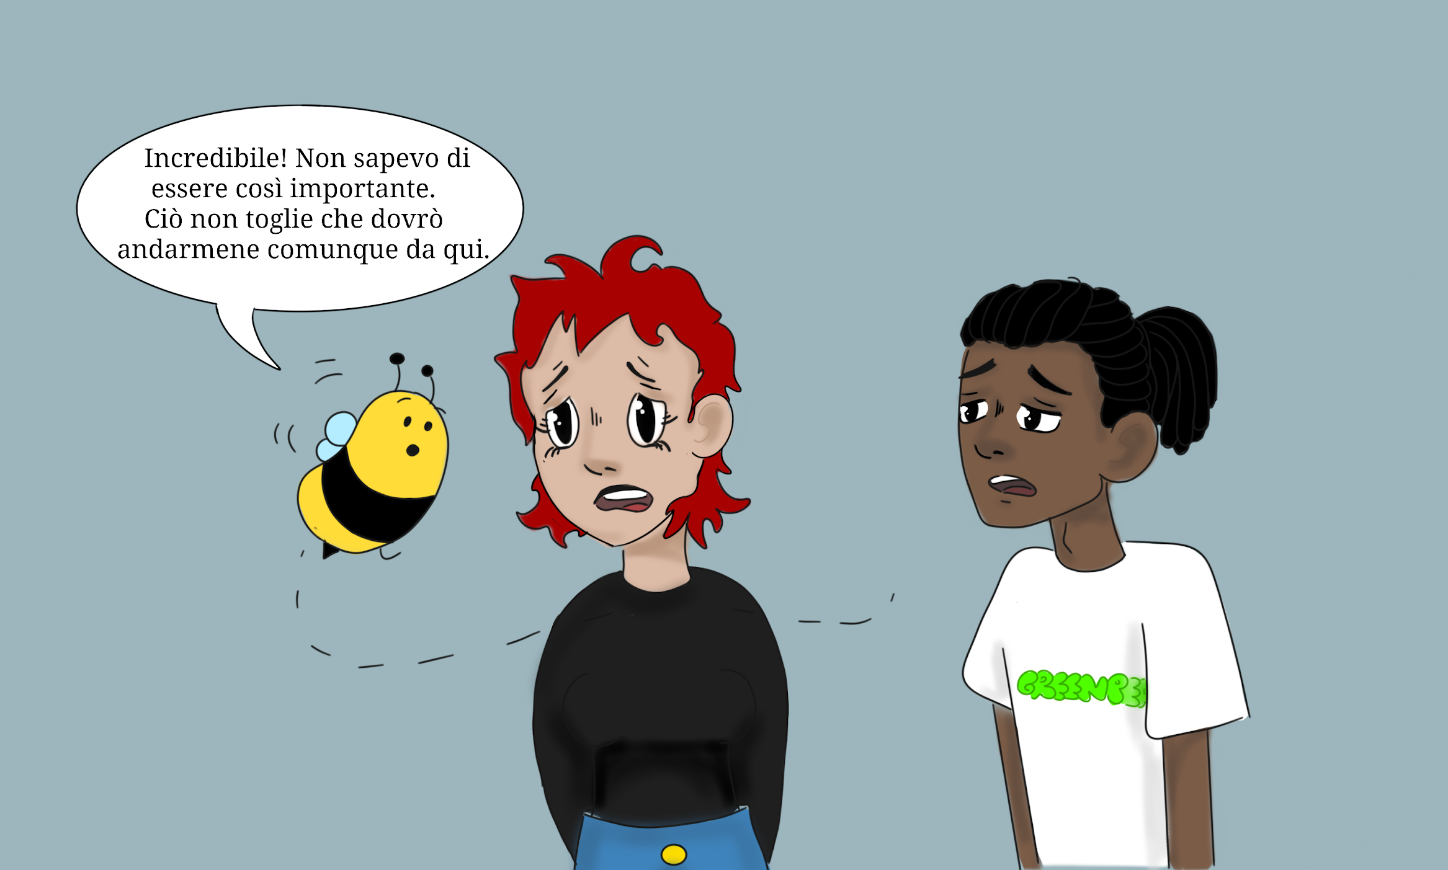
What happens, is that Nature is losing its biodiversity and balance due to HUMAN ACTIVITIES, and thus BEES DIE.
The most danguerous factors are CLIMATE CHANGE and PESTICIDES.
Yes, you’re right! !
This is why us bees are FLYING AWAY !

Slide 12
… would you please tell me now whom I am supposed to share my hive with ??? Apart with my friends the bees???
Our hive is already overpopulated !! ….
…. I don’t want to be rude, but I am not to eager to share my hive with some
snoring bad guy!!
Ok, we’ve talk about biodiversity, ecosystems and their balance…

Slide 13
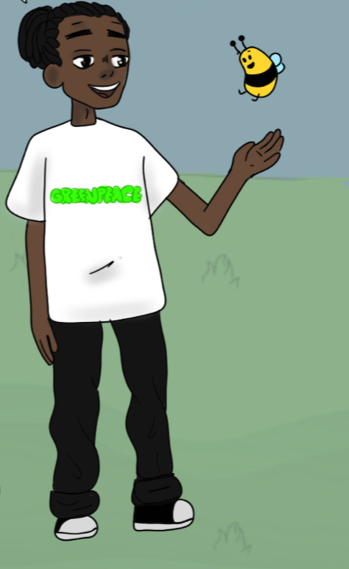
AH AH AH !!!
YOU ARE SO VERY AMUSING, MY FRIEND !!!! You got it totally wrong,
ah ah ah !!!!
Nobody is willing to share a room with a stinging lot!!!!
Let’s ask our friends here,
reading our story:
Friends, MAKE A LIST of some living beings (either animals or plants) that are FLATMATES WITH BUZZYETTE.
You can get some ideas in the next page, but there are many many more examples !

Slide 14
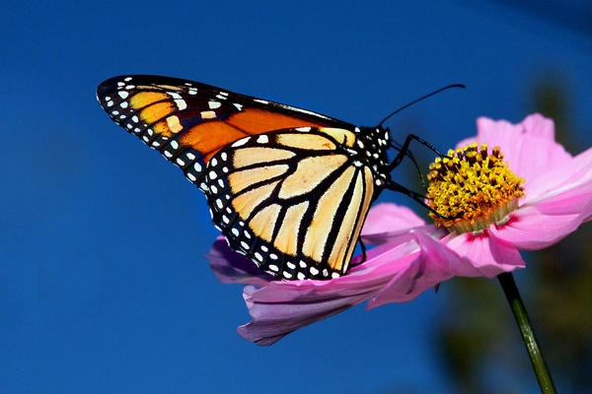
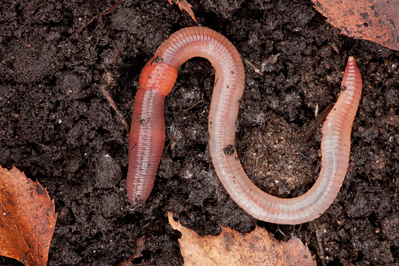
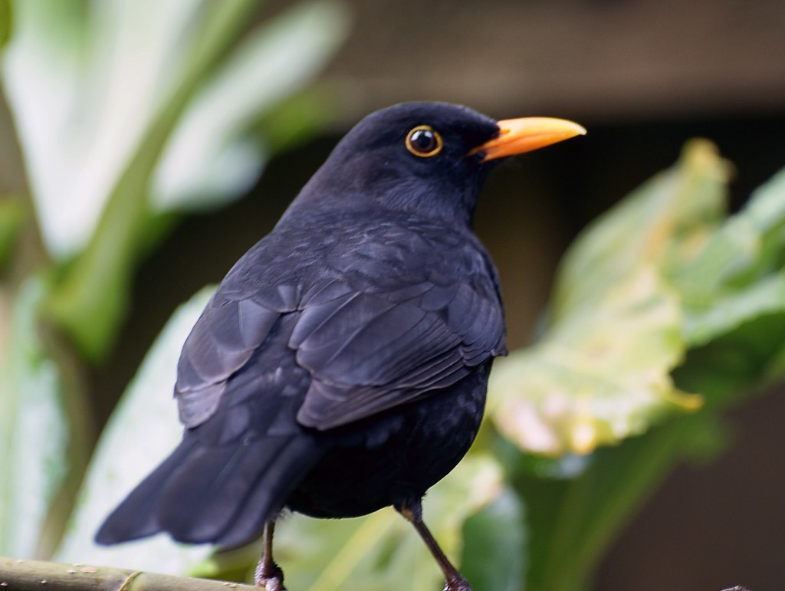
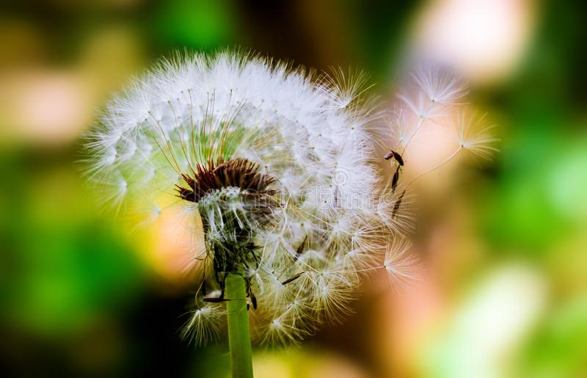
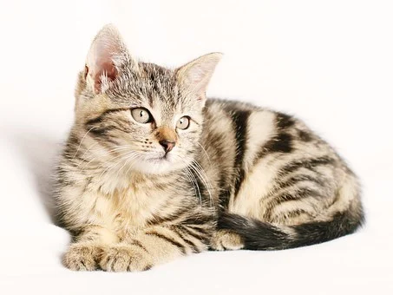
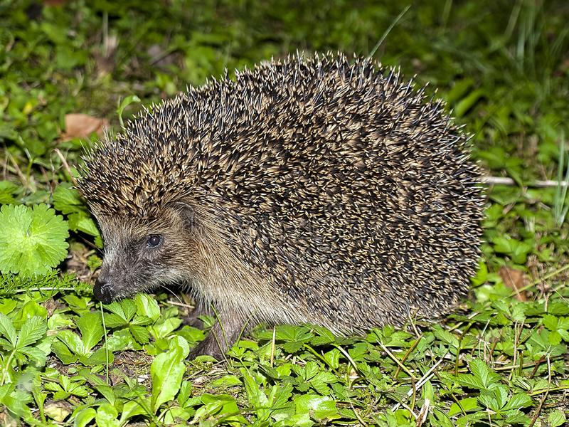
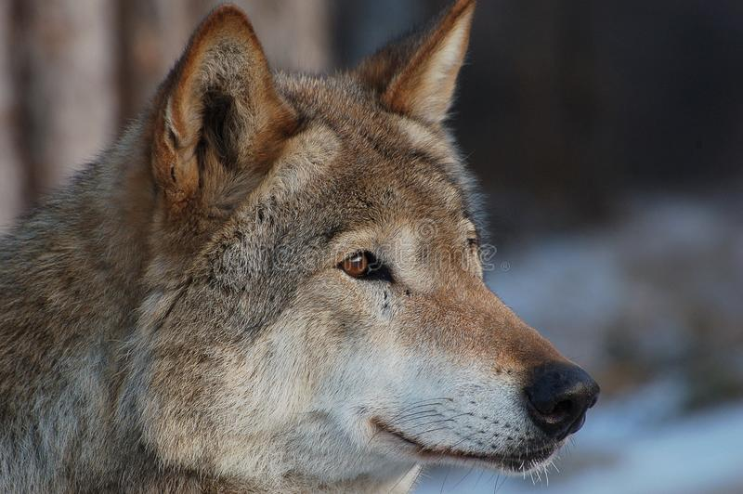
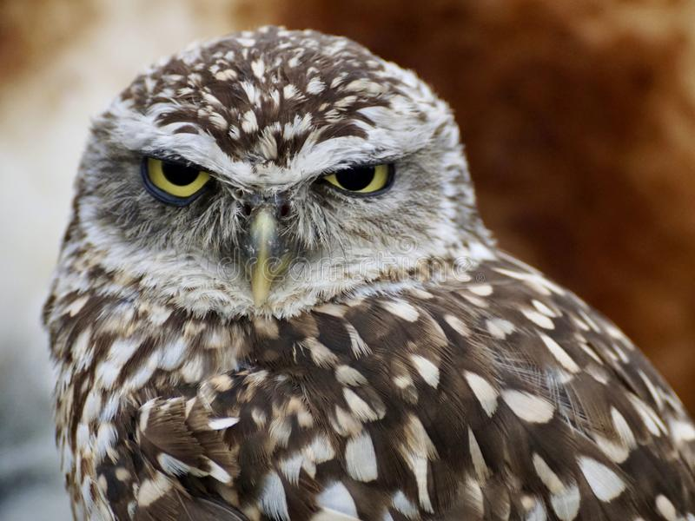
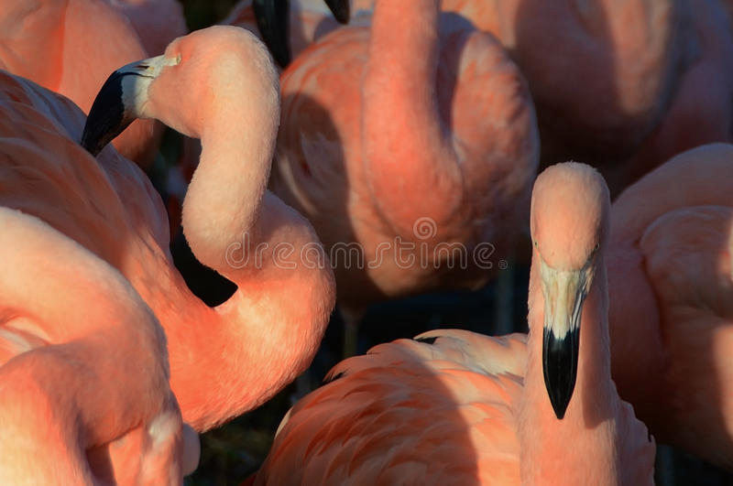
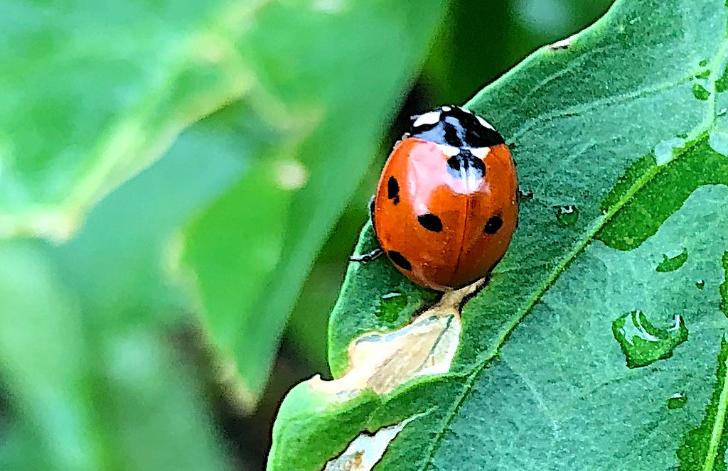
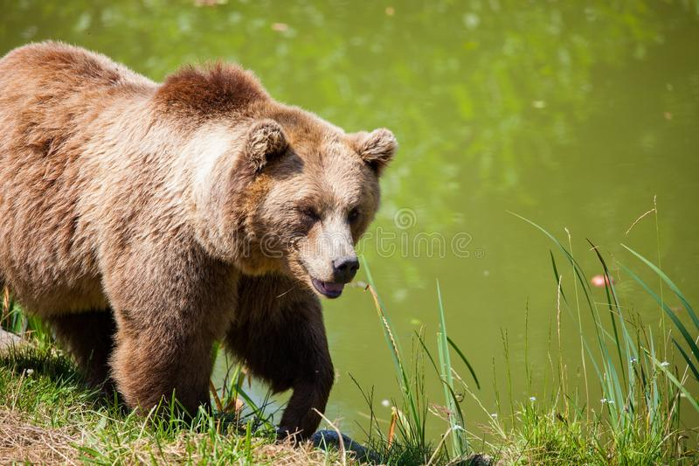
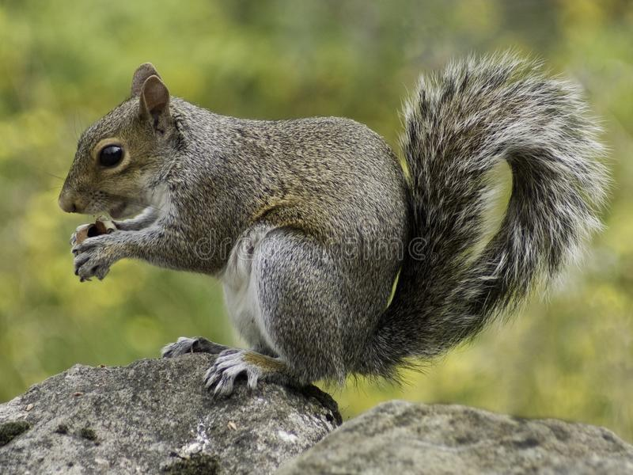
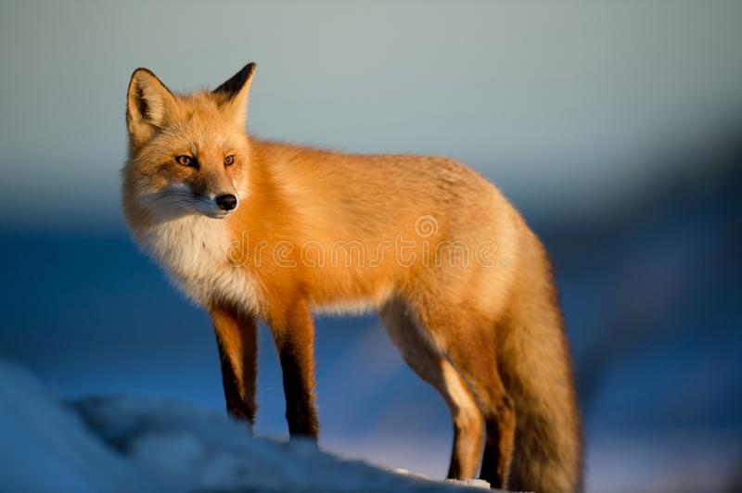
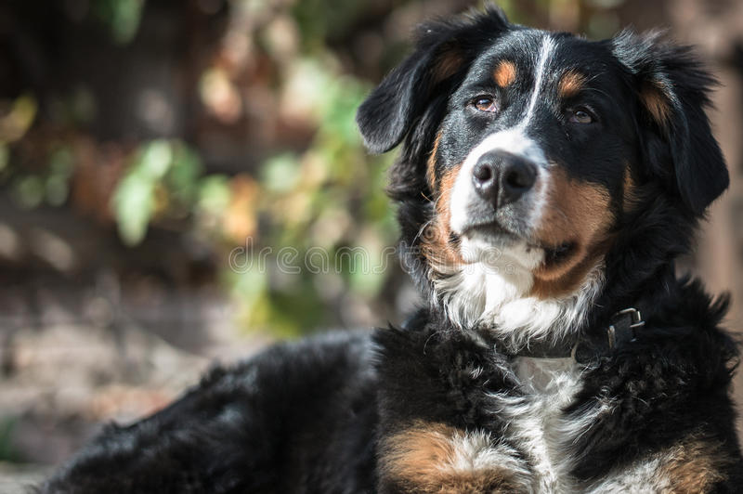

Slide 15
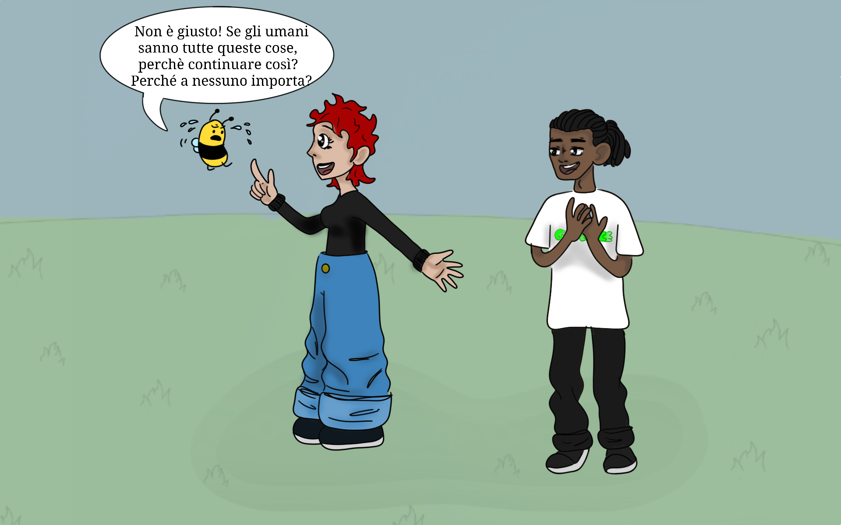
Don’t feel lonely Buzzyette!
There are thousands of
PEOPLE FIGHTING FOR BEES,
aren’t they, Samir?
Wow, we’re very important!
So, WHY HUMANS KEEP ON POLLUTING THE EARTH?
WHY DON’T YOU TAKE ACTION?
Sure, Max! For example, people from GREENPEACE like me, have done a lot to reduce the use of pesticides in agricolture.
WHY NOBODY CARES ABOUT BEES ?

Slide 16
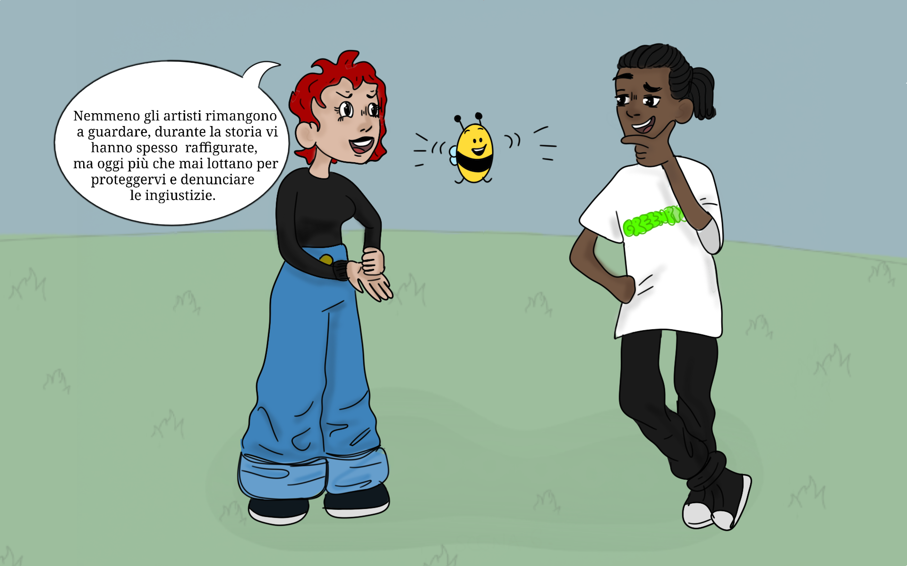
Also ARTISTS
play a great role: they FIGHT to protect bees and STAND UP against injustices with they ARTWORKS.
Let’s go together to look at some artworks, then!!
WOW!
I’m eager to see what artists do for us !

Slide 17
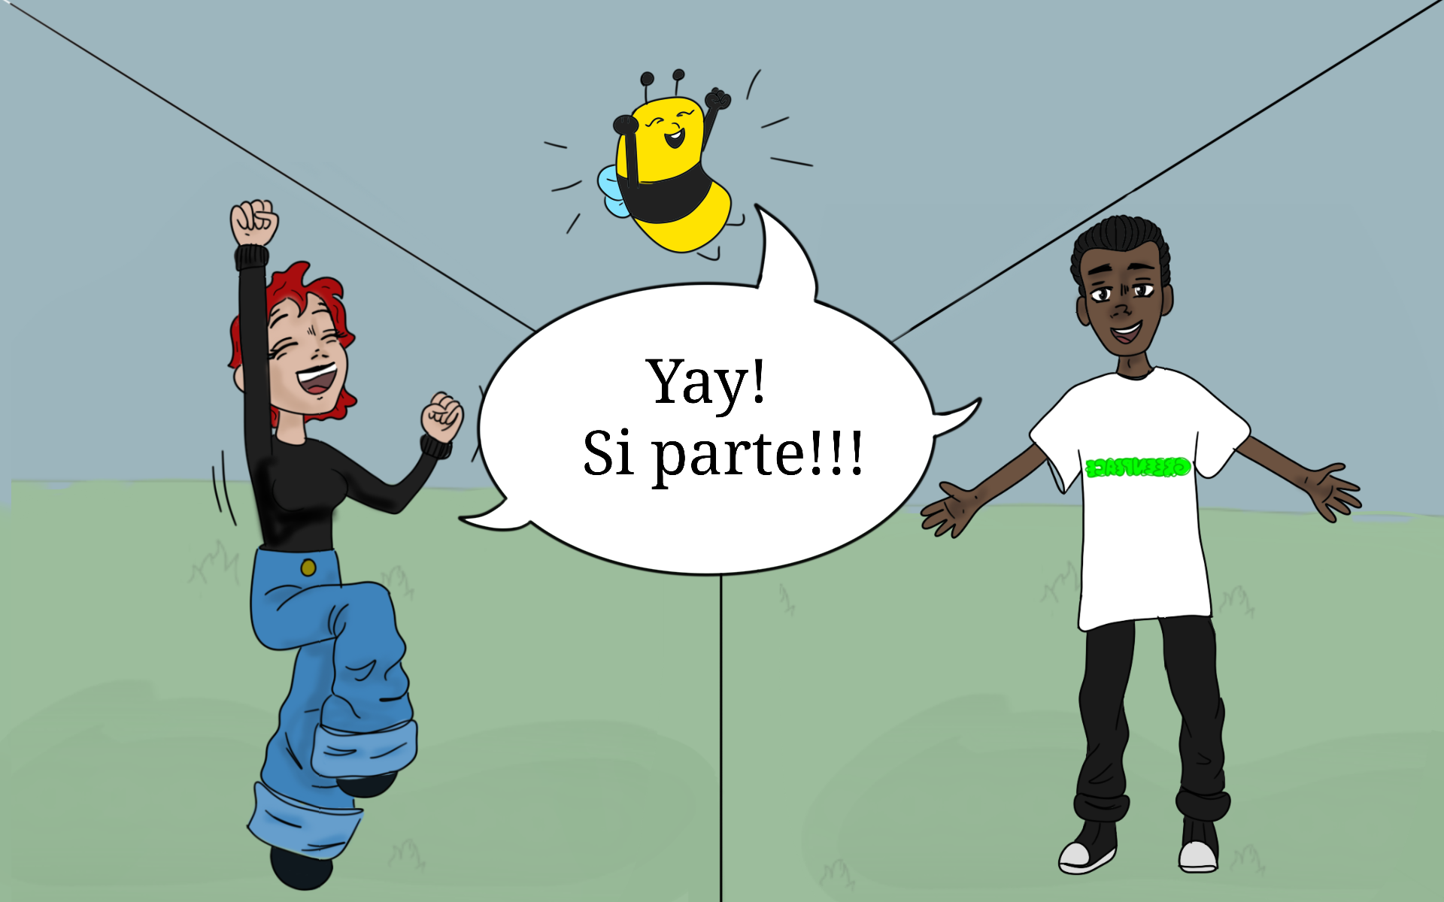
YAY!
Let’s go !!!

Slide 18
Our tour begins with an artist named ……

Slide 19
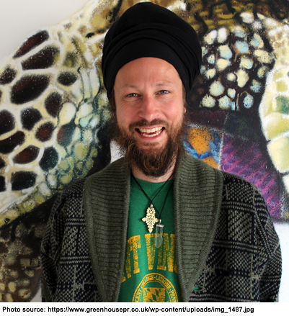
LOUIS MASAI
Louis is a British artist. His parents had a restaurant.
Besides cooking, Louis’ dad other passion was painting.
When his dad was painting, Louis used to go to his dad’s studio and do his homework there.

Slide 20
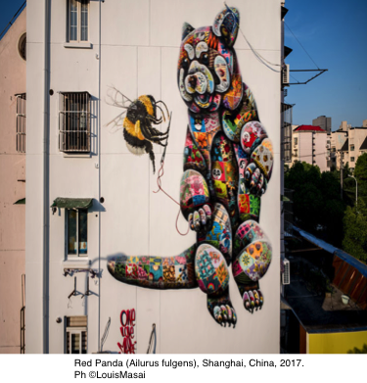
WHAT DOES LUIS TELL US?
Louis Masai through his paintings tell us about ANIMALS and THEIR ENVIRONMENT and tell us about the DANGERS CAUSED THEM BY HUMANS.
Louis is a very special artist:
quite OFTEN HE PAINTS ON WALLS…and NOBODY SHOUTS AT HIM for doing so! !!!!
Would you believe it ?!
Look at the picture on the right, and at those in the following pages !!!!!

Slide 21
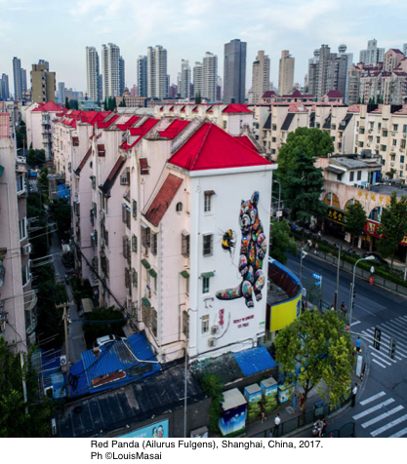
One curious thing:
This kind of art is renowned all over the world with the English expression “STREET ART”.
In your opinion, why is it call that way?
… We give you a hint…. Look at the picture on the right, and think about what are these artists’ favourite “canvases”.

Slide 22
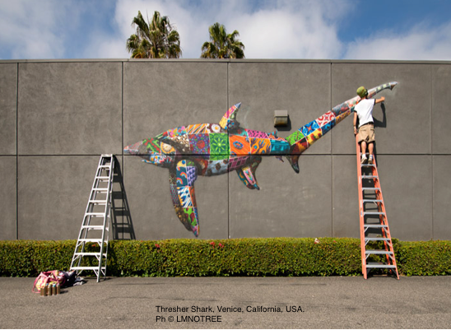
One more curious thing:
Can you say which tools are necessary to paint a mural?

Slide 23
Yes, sure !!!
Come with us and see !
Did you say that Louis cares about bees ?

Slide 24
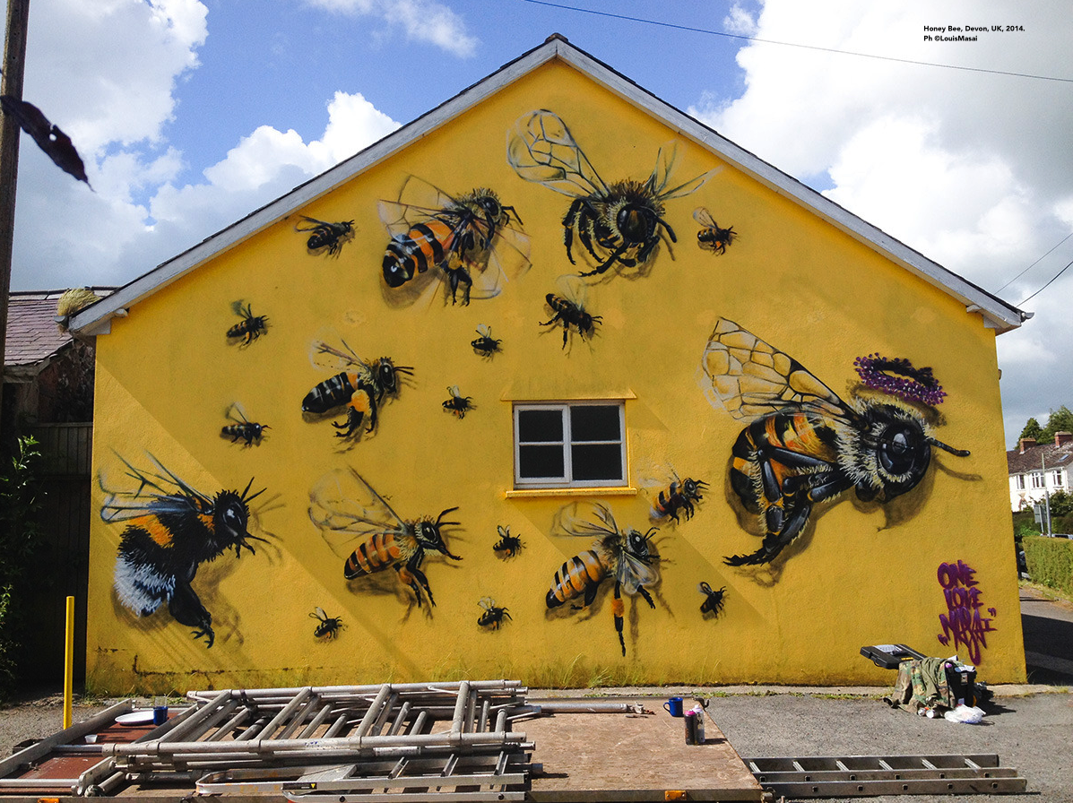
WOW!!! Louis has painted us beautifully !
He’s painted also the QUEEN BEE.
Can you spot her?

Slide 25
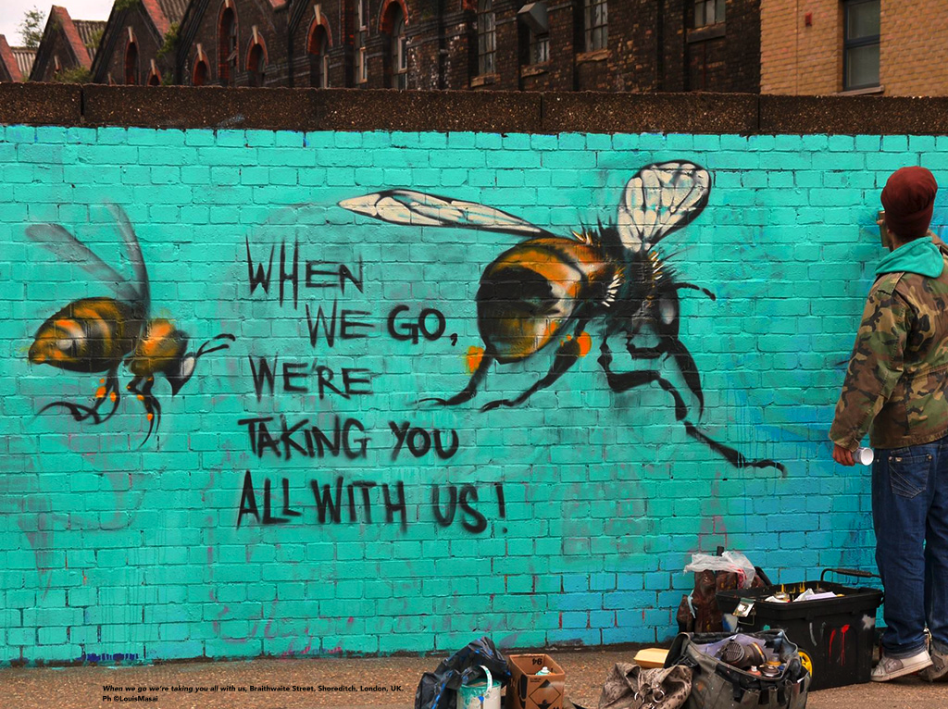
Louis on this wall has written :
“WHEN WE GO, WE’RE TAKING YOU ALL WITH US”
NOTE FOR TRANSLATORS: the words “WHEN WE GO, WE’RE TAKING YOU ALL WITH US” must be translated into your national language. Please delete these instructions afterwards.
What does it mean, Buzzyette ?

Slide 26
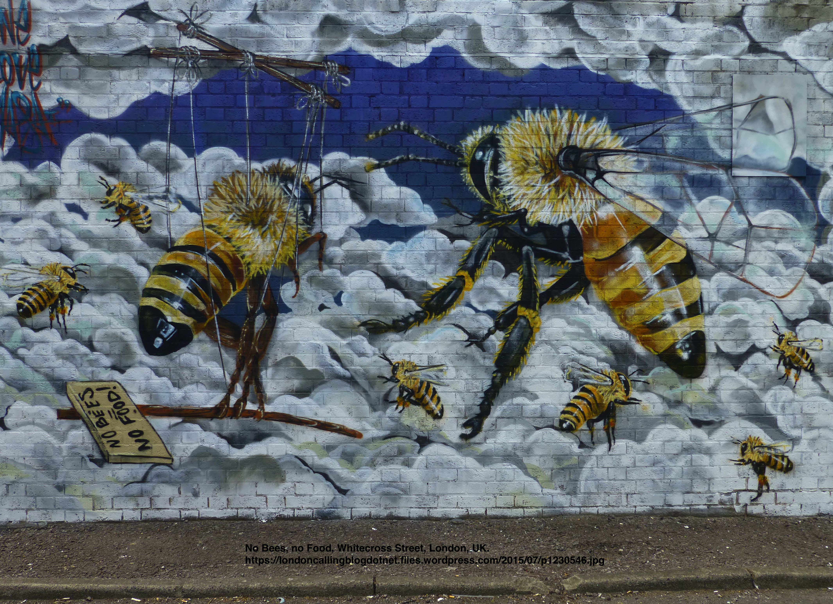
This sign says:
“ NO BEES,
NO FOOD ” !
Buzzyette, by now you know, right, why Louis wrote this ?

Slide 27
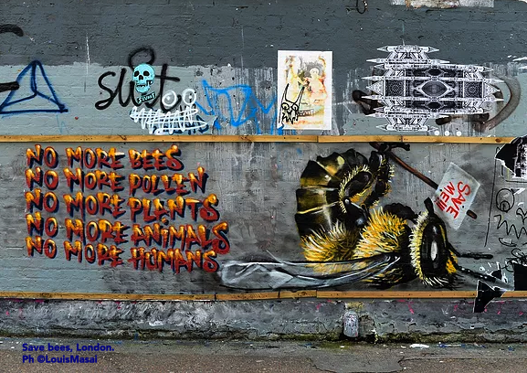
The bee carries a sign saying: :
“ NO BEES,
NO FOOD” !
Buzzyette, you now know why Louis has written so, don’t you?
NOTE FOR TRANSLATORS: the words “NO BEES, NO FOOD” must be translated into your national language.
Please delete these instructions afterwards.

Slide 28
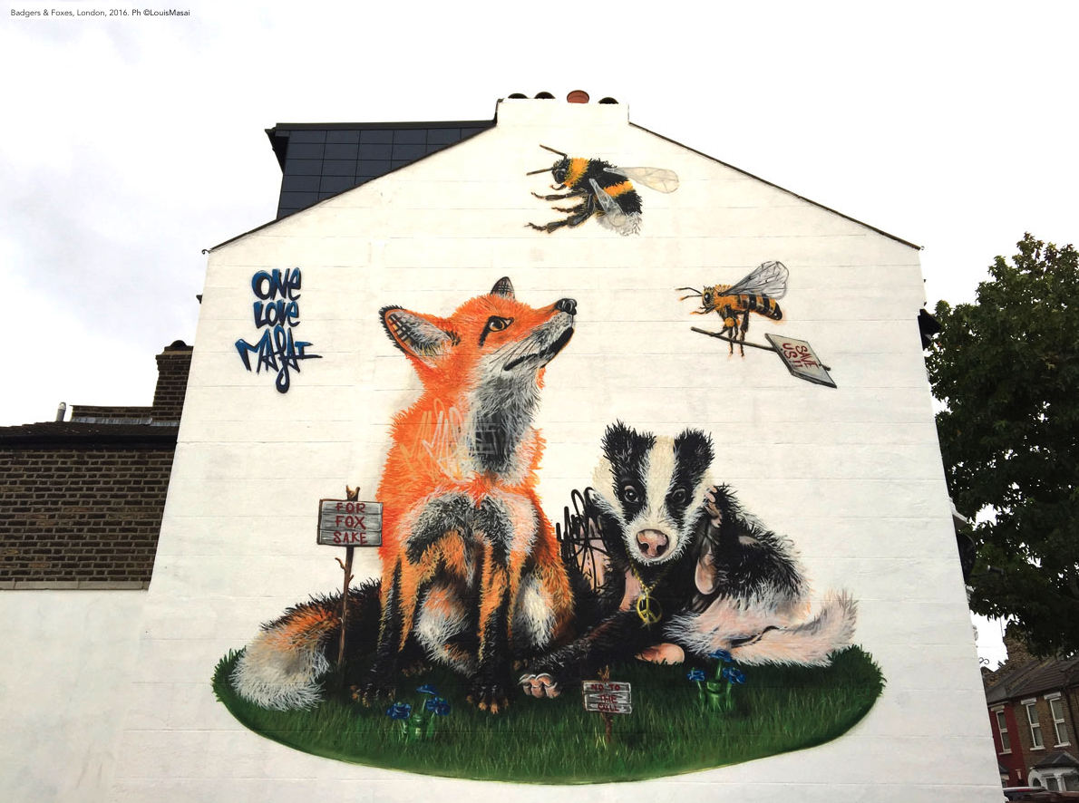
What animals has Louis painted on this house wall ?

Slide 29
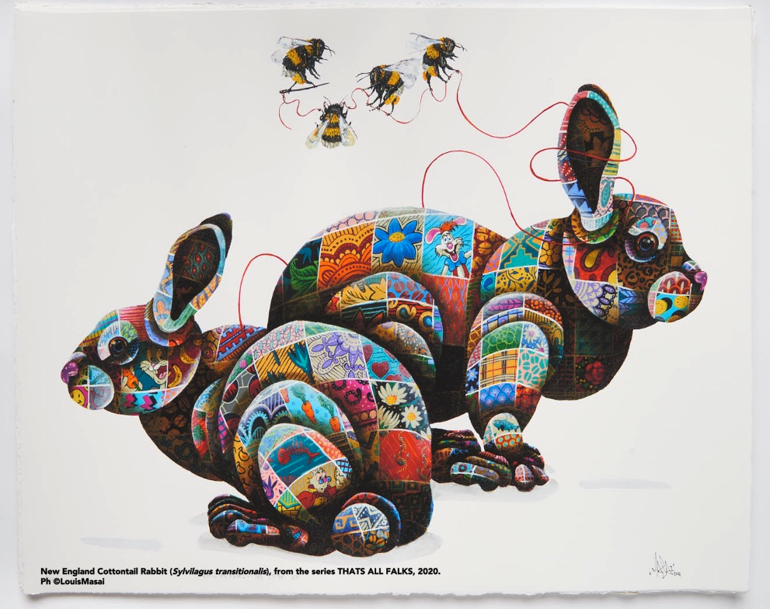
Buzzyette,
I have another question for you. WHY Louis paints THREADS AND NEEDLES all aroung his animals ?
What does it mean in your opinion ?

Slide 30
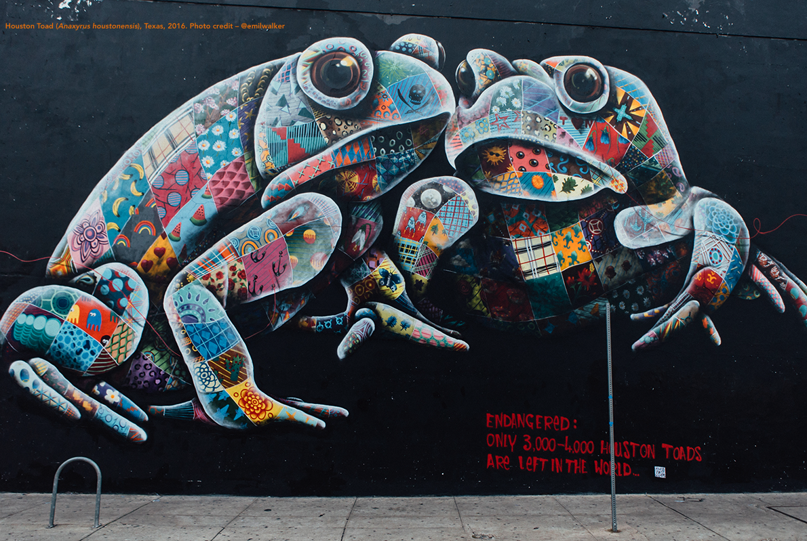
Which animals has he painted on this wall here ?

Slide 31
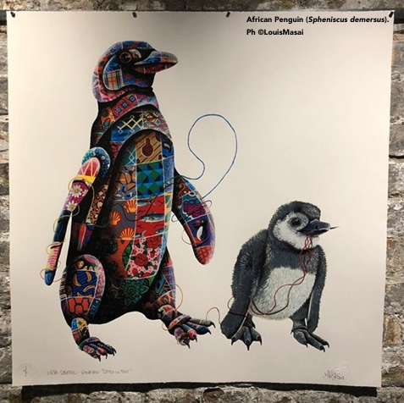

Slide 32
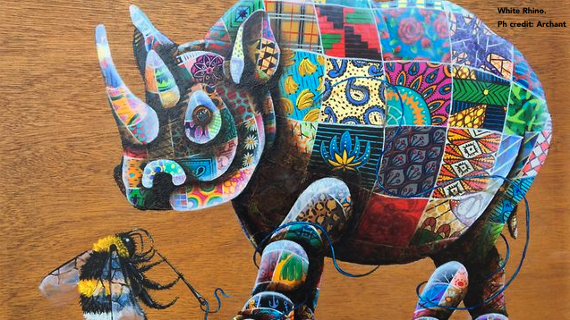
Look:
What is the bee doing ?

Slide 33
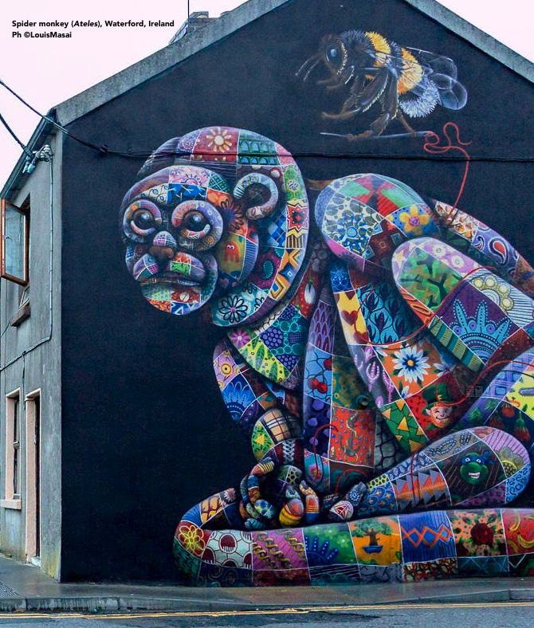
And here ? Who do you see? What are they doing?

Slide 34
THAT WAS SO GREAT!!
THANK YOU
LOUIS MASAI
for fighting for us !!!!
… Well, yes, Louis cares about all animals and plants that are in danger.
….. Samir, you said that Louis Masai is involved in more environmental issues, right?
What for example?

Slide 35
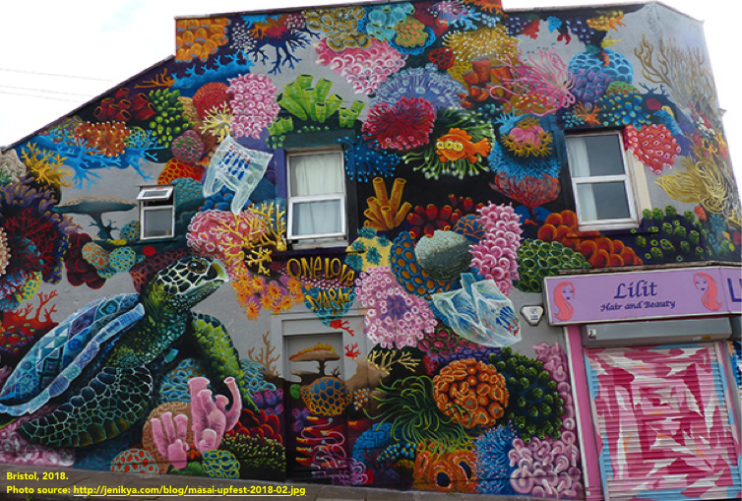
Louis cares about MARINE BIODIVERSITY:
OCEANS, SEABEDS,
REEFS and all animals and living beings living in the water.
See how many marine creatures he has painted on this wall.

Slide 36
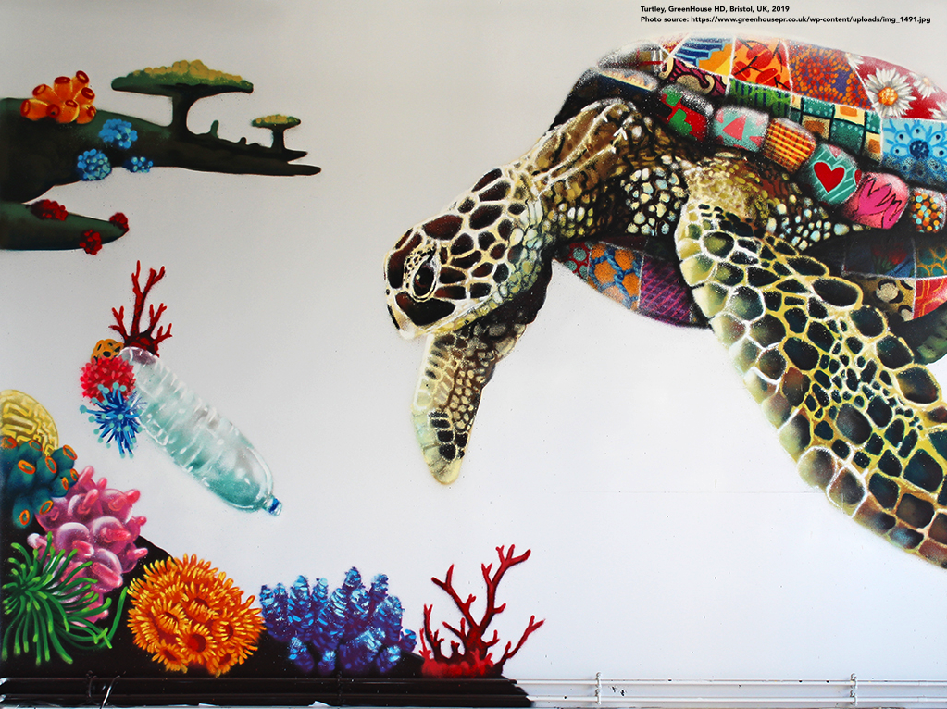
Why do you think this turtle is in danger ?
What do turtles rely upon for their survival?

Slide 37
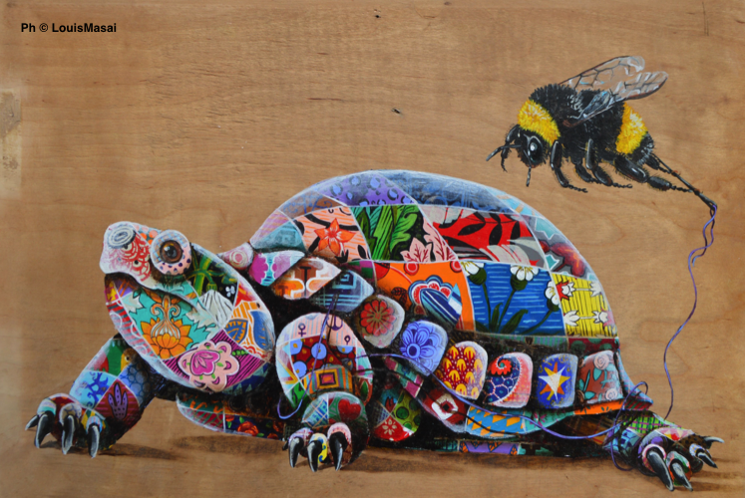
I am important
for turtles’ life, too?!?!

Slide 38
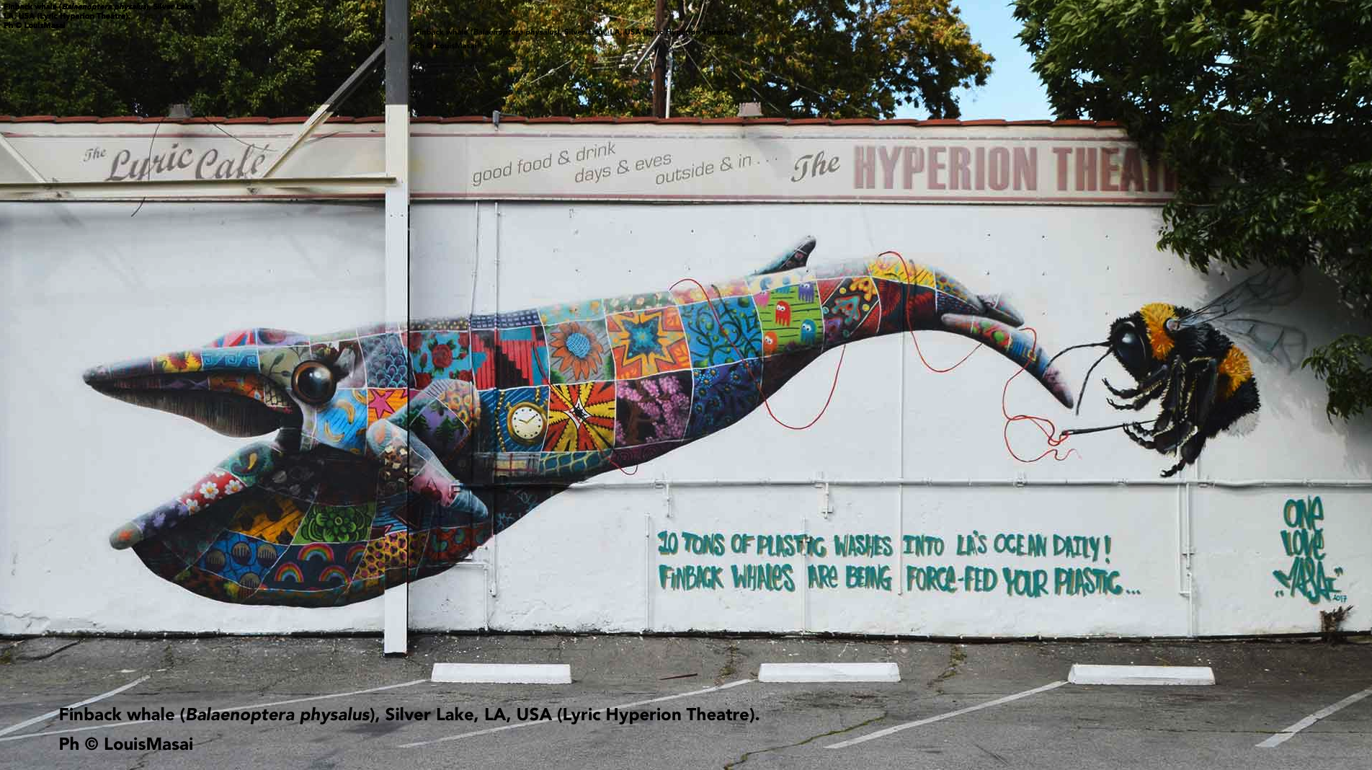
NOTE FOR TRANSLATORS: the words “10 TONS OF PLASTIC WASHES INTO LA’S OCEAN DAILY. FINBACK WHALES ARE BEING FORCE-FED YOUR PLASTIC” must be translated into your national language. PLEASE DELETE THESE INSTRUCTIONS AFTERWARDS.
Max, what does the sign say ?
It says “10 tons of plastic washes into LA’s ocean daily. Finback Whales are being force-fed your plastic.”

Slide 39
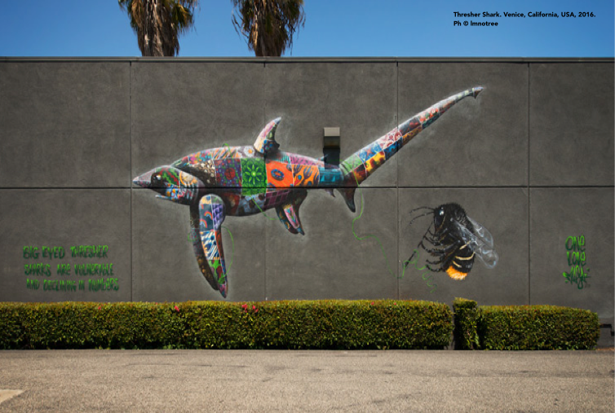
Samir, us bee are relevant for sharks’ lives, too??!!!!
Yes, for them too.
This specie is called :
BIG EYE THRESHER SHARK

Slide 40
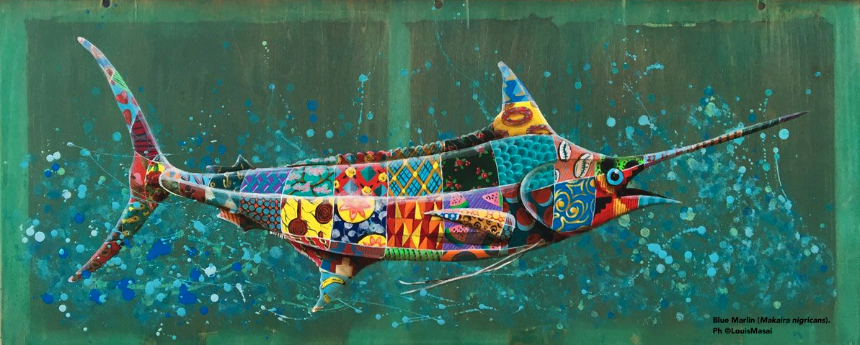
This fish lives in the Mediterranean. It is in danger due to HUMAN FISHING ACTIVITIES
Do you know its name ?

Slide 41
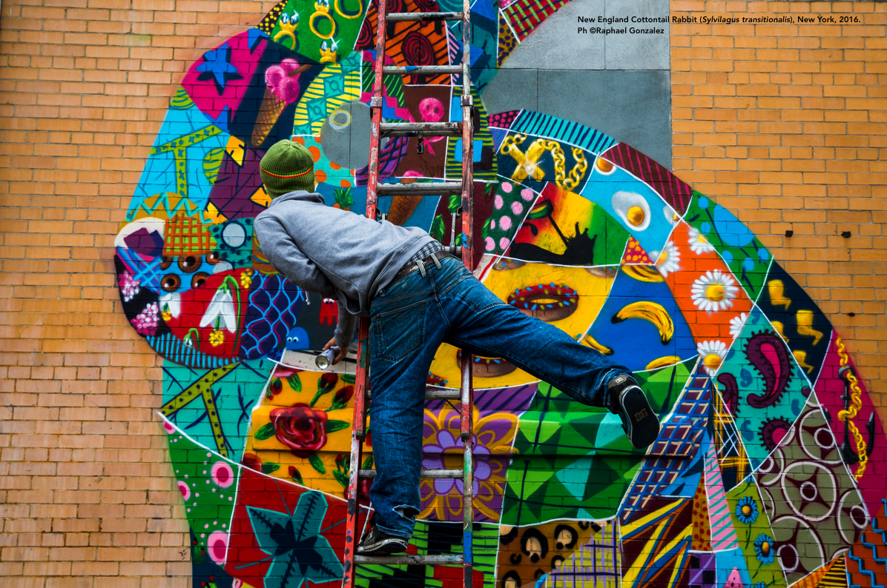
Here is our friend Louis at work !

Slide 42
If you enjoyed Louis Masai
wall paintings, see more on the internet!
Search on Google for:
Luois+Masai+images

Slide 43
Very well, Buzzyette !
Let’s continue exploring the art world.
We would like to introduce you another astonishing artist ...

Slide 44
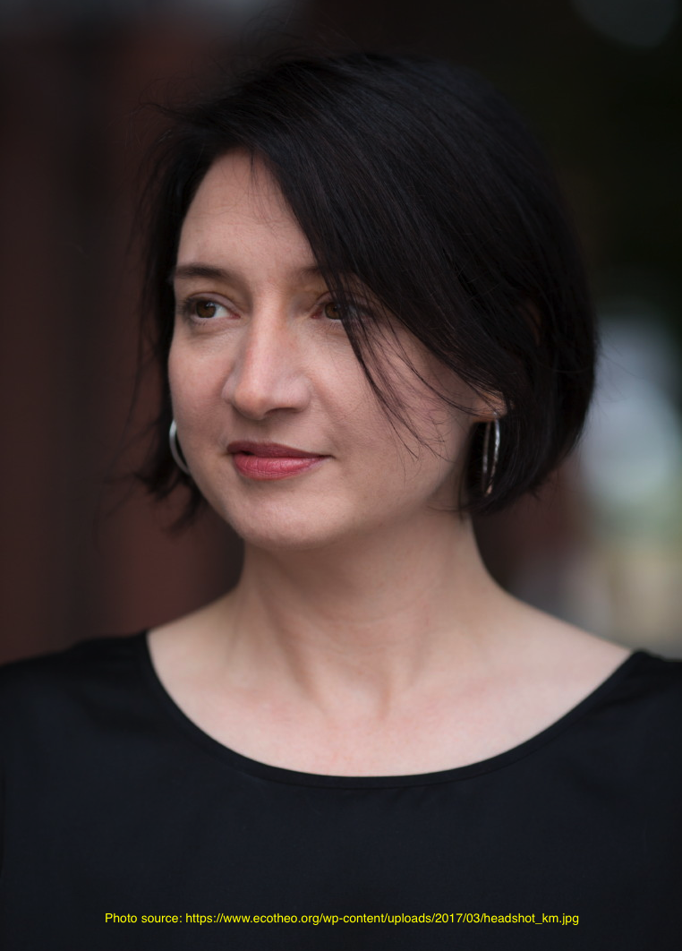
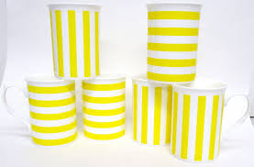
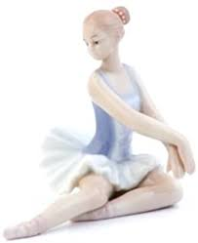
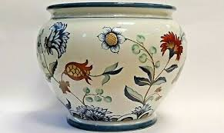
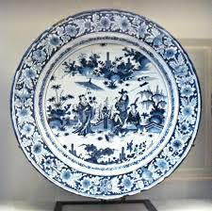
KATE MACDOWELL
Kate MacDowell is an artist from the USA.
She loves PORCELAIN most of all.
Do you know what it is?
Do you have some porcelain object in your house ?

Slide 45
Kate MacDowell loves porcelain because of its NICETY and THINNESS.
Porcelain fragility recalls her the FRAGILITY OF ECOLOGICAL NETWORKS
Fragility of ecological networks ??
What does it mean ?!?

Slide 46
WHAT DOES KATE TELL US ?
Kate is really FOND OF NATURE.
She is very concerned because HUMAN BEINGS MISTREAT NATURE and
DON’T RESPECT HER.
RELATION between humans and natural world is often VERY COMPLICATED.
Give some example of a difficult relation between human beings
and Nature

Slide 47
Kate’s MISSION is to HELP PEOPLE COMPREHEND this difficult relation.
For example, her artworks tell us about CLIMATE CHANGE, POLLUTION and GENETICALLY MODIFIED ORGANISMS.
Do you know what these expressions mean ?
Kate MacDowell in her studio.

Slide 48
Have a look at Kate’s ARTWORKS
and let’s try to understand together what her MESSAGE is.
Look attentively at the details.

Slide 49
Mutiny Fruit – Apple,
2017

Slide 50
Cross-Pollination, 2009
Why has the artist realized human hands, bees and pollen ?

Slide 51
First and last breath, 2010
This artwork’s title is “First and Last Breath”. Why has the artist chosen this title?
Which animals are these ?
Do you see anything weird in this sculpture ?

Slide 52
Last of his tribe, 2012
What do you see here ?
A little help.
This artwork composition’s title is “Last of his tribe”

Slide 53
Nursemaid 1, 2 e 3, 2015
What do you think about these statues?
What do they have to do with BIODIVERSITY ?

Slide 54
Feral, 2019
What’s happening here?

Slide 55
Soliphilia, 2010
The word SOLIFILIA is a NEOLOGISM coined by Glenn Albrecht, an Australian environmental philosopher, a contemporary of ours.
The MEANING of this word is rather complicated. To explain it simply, we can say that it means...
… “THE LOVE OF AND RESPONSIBILITY FOR A PLACE, BIOREGION, PLANET”.
Now that you know what it means, comment on this sculpture!

Slide 56
So, Buzzyette…
These artworks are very POWERFUL, aren’t they?
HOW DO these sculptures make YOU FEEL?
.... Wow....
Kate’s sculptures are startling!
Do you have more to show me ?

Slide 57
If you too liked Kate MacDowell’s works,
You can fin more on her personal website:
http://www.katemacdowell.com/portfolio.html
Look at them with your teacher
and comment them.

Slide 58
EPILOGUE

Slide 59
So, Friend,
What do you think?
Did you enjoy what you’ve seen ?
Here we are again !
Yes, it’s been a surprising experience!
I am honoured I’ve been the protagonist of this tour !!!

Slide 60
Yes, very well said !
We must JOIN OUR FORCES AND WORK TOGETHER!
And ART can HELP !
I feel very SAD for my animal friends in danger! It’s been SHOCKING to see what’s happening to the natural world....
.... Though, KNOWING IS BETTER THAN NOT KNOWING.

Slide 61
Why BUZZYETTE says that getting to KNOW an issue is BETTER than IGNORING it ?
Why MAX says that we
Must WORK ALL TOGETHER?
In your opinion, when SAMIR says that
ART IS IMPORTANT, what does he mean ?
A little hint for you… think about these two verbs:
SPREAD and RAISE AWARENESS.
Do you know what they mean?
Can you think at some other verb connected with these two?

Slide 62
Thank you, my dear friends !!!
Now I know a lot more!
And we COMMIT for things to change!
I must go with my friends the bees, now.
I’ll be back when things will be different.

Slide 63
Bye-Bye, Buzzyette!
Bye, friends !
Safe travels !

Slide 64
The end

